Slide 1
Mote Science Education Aquarium
Sarasota County Commission Meeting
October 24, 2018

Slide 2
Background
Sarasota County received a series of three letters from Mote Aquarium regarding the Science Education Aquarium in the spring of 2018 requesting a long-term lease and financial support.
July 10, 2018 – Board of County Commission (BCC) requested that an independent review of the Mote Aquarium Business Plan be conducted.
September 11, 2018 – BCC approved staff continuing working with Mote representatives, approved the separation of the request for land and financial support and requested that staff bring back a resolution supporting the proposed aquarium.
October 9, 2018 – BCC approved a resolution supporting the proposed aquarium project and requested a term sheet be developed and brought to them on or before October 24, 2018.

Slide 3
Project Agreement Process
Term Sheet
Approval of Omnibus Agreement and Execution of Short-Term Two-Year Lease
Conditions Precedent
Mote Due Diligence
Commencement of Short-Term Two-Year Lease
Entitlements (SPA/REZ)
Conveyance
Long-Term Lease
Notes:
Mention the preliminary items prior to execution of short term lease – site boundary and parking study/analysis

Slide 4
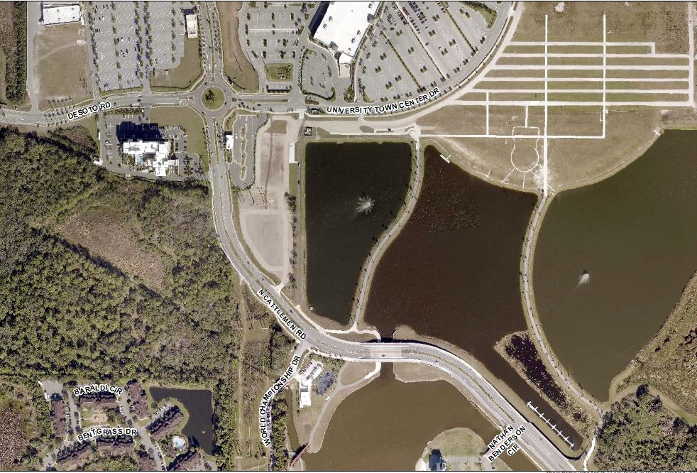
Nathan Benderson Park Aerial Map

Slide 5
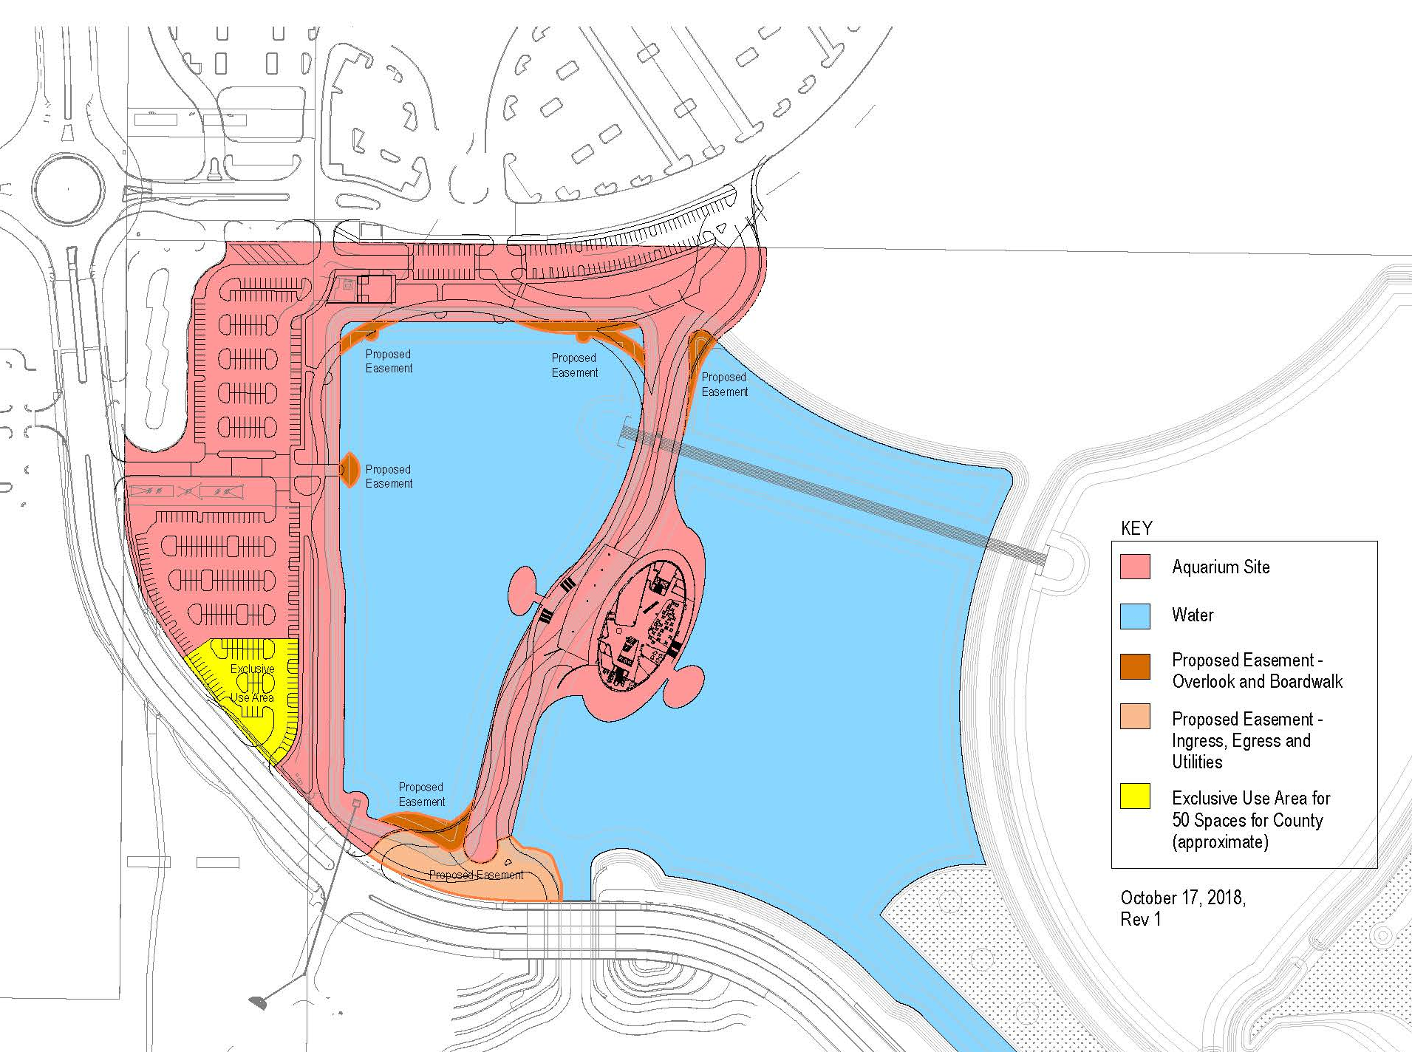
Proposed Property

Slide 6
Terms of Land Agreement
Term | Description
Project Agreement Process | Identified process beginning with short-term lease, entitlement phase and then conveyance or long-term lease.
Property Boundary | Land identified for proposed aquarium exclusive use.
Adjacent Lake and Pond | County to retain ownership and will enter into an agreement with Mote regarding future use.
Adjacent Lake and Pond | Maintenance to be determined between SANCA and Mote during conditions precedent.
Easements | Variety of easements have been identified as being needed to address public access, ingress, egress, utilities, sidewalks, stormwater, drainage and maintenance functions.
Notes:
11.45 acres identified

Slide 7
Terms of Land Agreement
Term | Description
Timeline of Agreements and Land Use Applications | Process and timelines for agreements and application steps have been outlined within the term sheet.
Conditions Precedent and Due Diligence Activities | A list of conditions precedent have been identified and outlined in the term sheet. These conditions and due diligence activities must be met for the short-term lease to commence.
Proof of Funding | Proof of full project funding required prior to conveyance or construction commencing.
Construction Commencement | Construction commencement will not occur until land use decision has occurred or other conditions in the term sheet are triggered.
Parking | Exclusive use of parking for Mote in the west parking lot with an exception of 50 dedicated parking spaces for exclusive use by Sarasota County.

Slide 8
Next Steps
With Board approval of the term sheet, County and Mote representatives will continue to work collaboratively to develop the Omnibus Agreement and will use their best efforts to present the proposed agreement to the Board on or before January 30, 2019.

Slide 9
Recommendation
The approve a term sheet for the transaction of land in partnership with Mote Marine Laboratory and Aquarium related to a proposed new Mote Science Education Aquarium.

