Slide 1
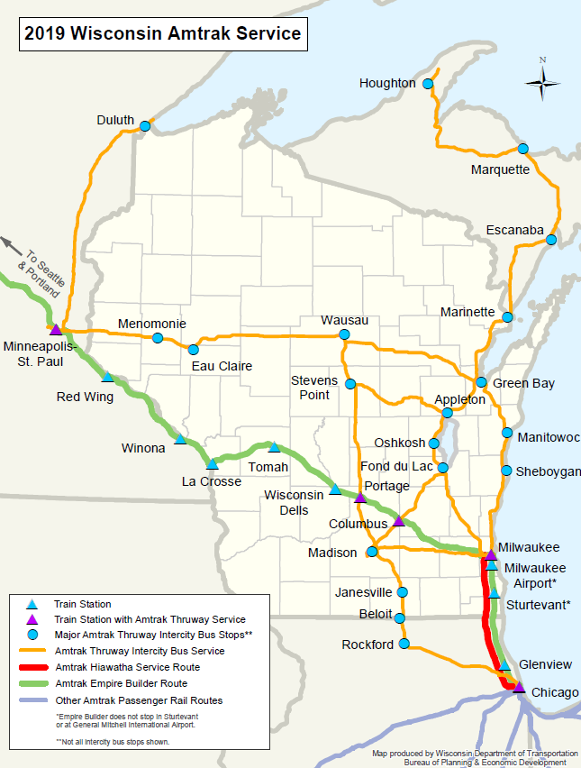
17 WI Counties
Adjacent to the
Route
Roughly ½ the population of the State could be within a short drive of an existing station
Two trains daily would significantly expand convenience from Chicago to Twin Cities

