Slide 1
Brentwood Pump Station – Little Harpeth River
Brentwood Public Meeting, January 30, 2020

Slide 2
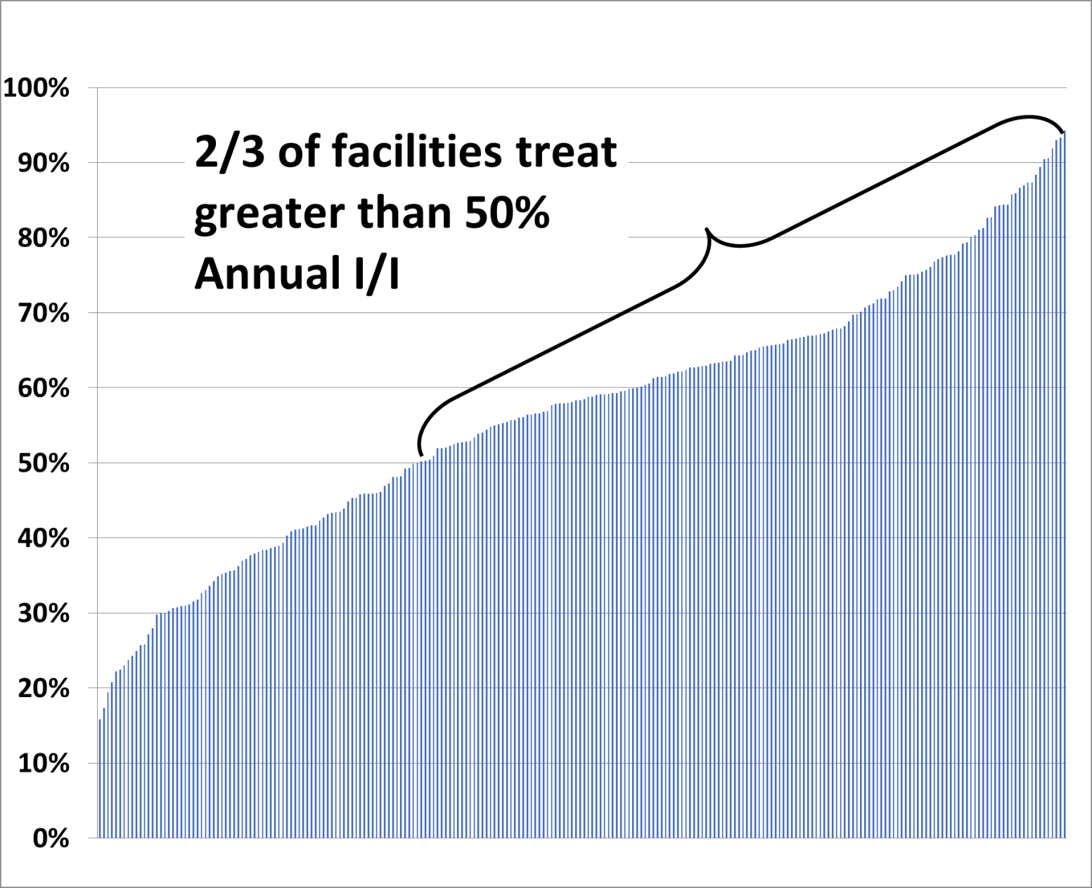
State-Wide Data
181 of 242 (or 82%) of municipal WWTPs exceed their rated capacity in the event of a 2-year 24-hour storm (~3.4 inches)

Slide 3
Cost of Inflow and Infiltration
Total I/I Treated: 120,000,000,000 gal/year
Average I/I Treated: 330,000,000 gal/day
Cost to Treat I/I*:
$200,000,000/year
*Based on $1.80/1,000 gallons

Slide 4
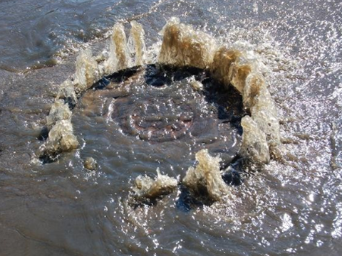
I&I Implications
Overflows and Releases
Public Health hazard
Degradation of Receiving Waters
Algae → Harmful Algal Blooms (HABs)
Increasing treatment challenges
Diminishment of recreational opportunities and quality of life
Higher Sewer Rates
$$$$ to pump and treat clean I&I water
Higher maintenance costs
Higher operational costs
Loss of System Capacity
Major Upgrades
LARGER AND SOONER than necessary

Slide 7
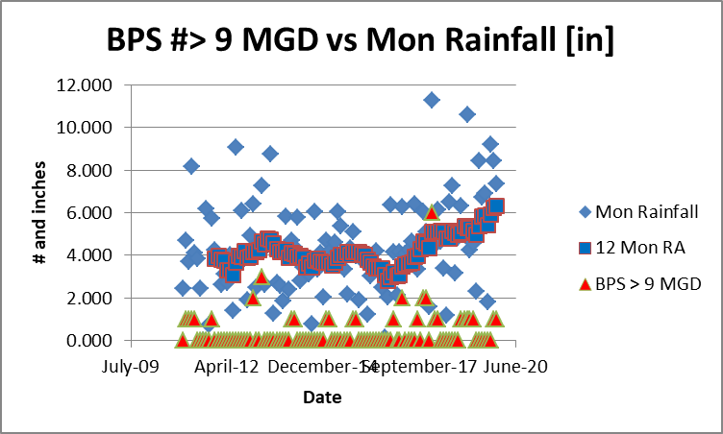

Slide 8
Consent/Agreed Order #04-0347 Status
Issued Jointly to MWS and Brentwood in 2006
Aggressive and successful sewer rehab effort resulted in measured reductions in RDI&I in the Brentwood system:
Aug 20, 2008: 50,000 gpd
May 14, 2009: 767,000 gpd
Dec 19, 2012: 442,000 gpd
Phase III CAP/ER submitted Sep 30, 2014
Evaluated 4 options
New BPS 3-MG EQ Basin → Recommended
New Tower Park 3-MG EQ Basin
Additional Sewer Rehab @ $1.25M/year
Increased BPS Capacity to MWS (9+MGD→12+MGD) → Not recommended

Slide 9
Issue today
Dec 13, 2019 CAP/ER Compliance Update ltr to TDEC-DWR
Requested extension of Order from 2018 → 2022 to complete BPS EQ Basin
Reply pending

Slide 10
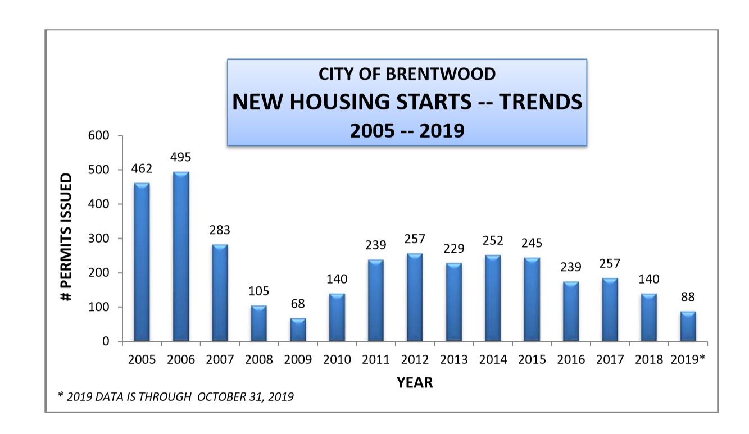
Housing Starts

