Slide 1

Sewer System
Work Session
January 30, 2020

Slide 2





Presenters:
Mike Orr, PE
Ryan Dean, Sr. Designer
George Garden, PE
Chris Milton, Water Services Director
Drew Muirhead, Water Services Asst. Director
Jonathan Childs, PE
Hatem El-Sayegh, PE, PhD
Matthew Johnson, PE
2

Slide 3
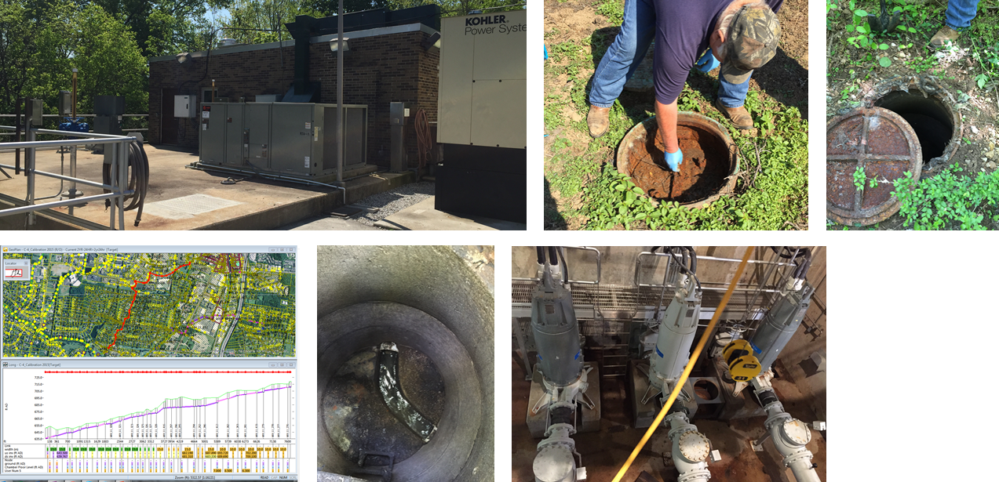
Work Session Agenda
Sewer System Overview
Master Plan
Sewer Rehabilitation
Overflows
TN Dept of Environment and Conservation
Questions
3

Slide 4
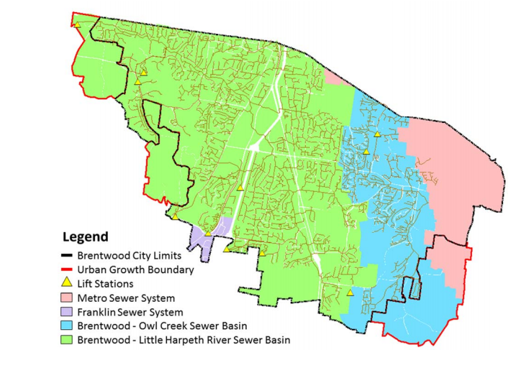
Sewer System Overview
Collection-only
Contracts with Metro Nashville for treatment
293 miles of sewer pipe ranging from 1-1/4" low pressure force mains to 30" gravity sewer
12 pump stations
5,575 manholes
Two sewer basins - Little Harpeth River Basin and Owl Creek
4

Slide 5
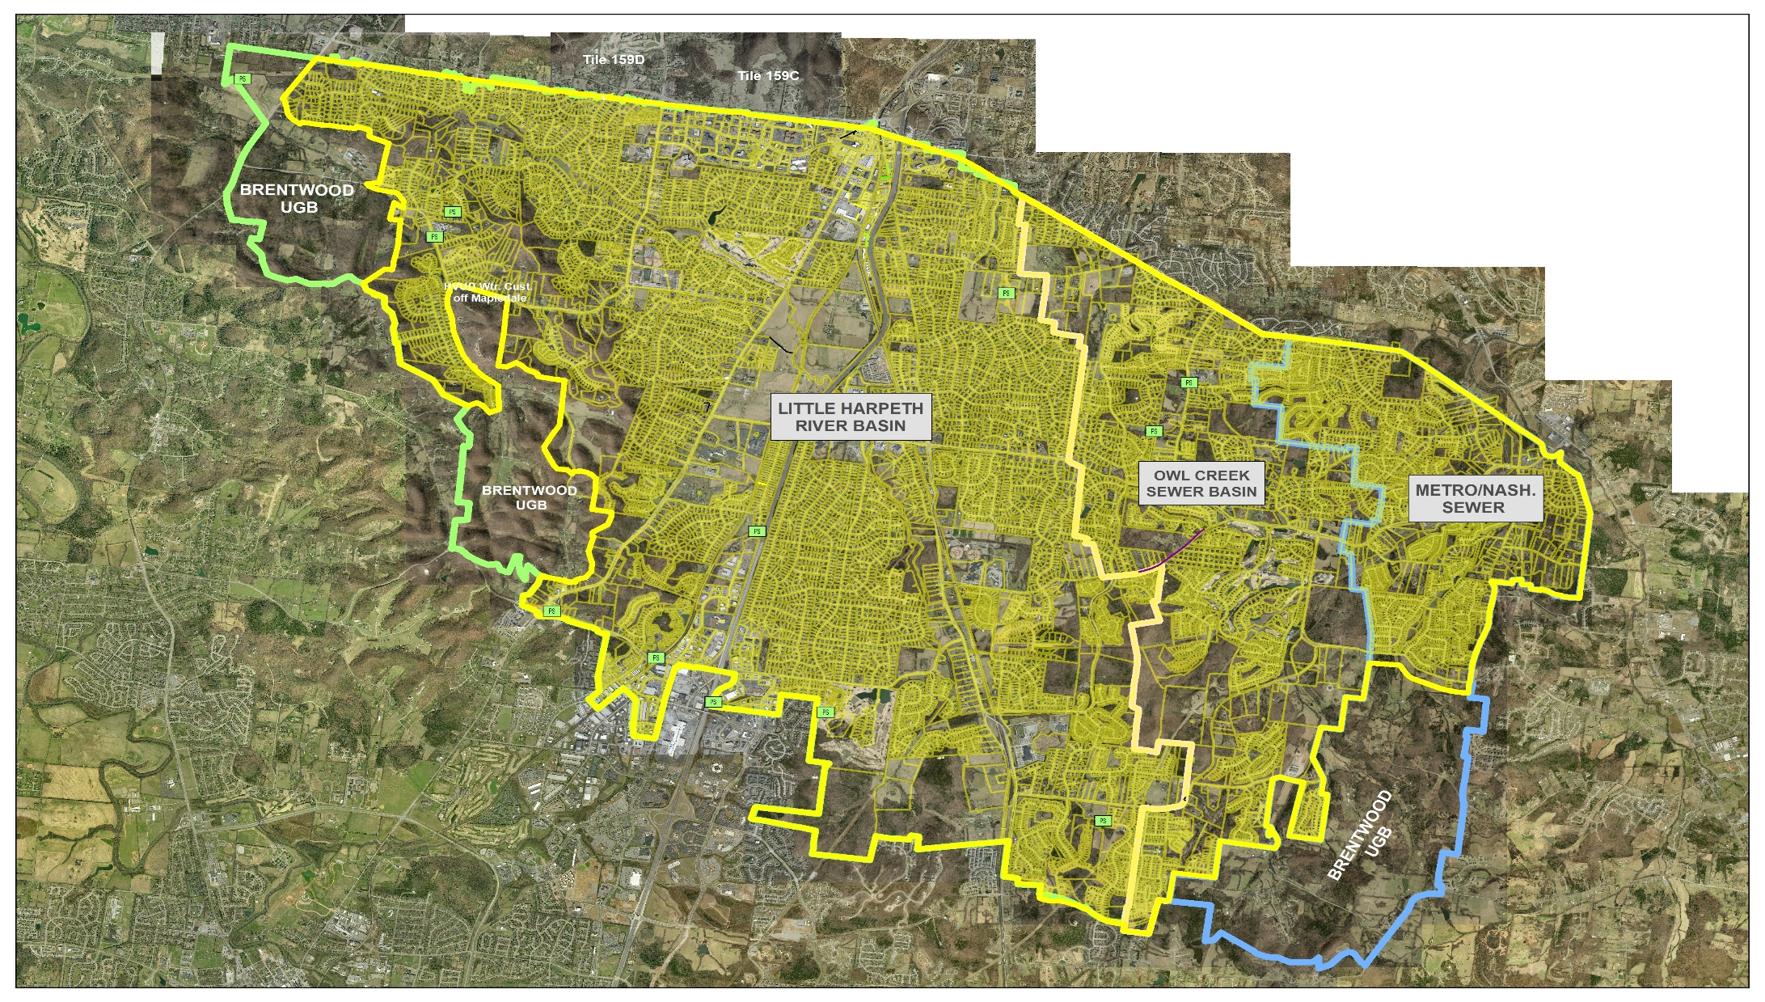
Sewer Basins
5
Notes:
Two Major Sewer Basins, Little Harpeth River Basin and Owl Creek
Little Harpeth River Basin, the Largest @70% of Service Area. Stretches from West of Hillsboro Rd to Split Log Rd.
Owl Creek Basin, @30% of Service Area. Extends from East Old Smyrna Rd., to Taramore, to Sunset Rd. Area.
For Areas East of Sunset Rd., Metro/Nashville Sewer Customer.
Metro Sewer also connects with Brentwood at various locations along Old Hickory Blvd.

Slide 6
Sewer System History
1990s to 2006 - overflows increased during minimal rain events
2006 on forward - TDEC issued Brentwood & Metro an Agreed Order which required Brentwood to develop a Corrective Action Plan (CAP)
Purpose - provide a strategic plan to reduce overflows Brentwood/Metro Pump Station
6

Slide 7
Corrective Action Plan (CAP):
CDM Smith Engineering firm hired to develop the CAP
CAP strategy: Evaluate sewer flows, system capacity analysis, impact of rainwater infiltration & inflow (I/I) into the system and develop recommendations
Final recommendations included a multi-year, $30 million plan that targets rehabilitation of sewer basins identified as having high contributions of rainwater I/I (In other words, fix leaky pipes, manholes, services) and then size/build storage needed to contain remaining peak I/I
7

Slide 8
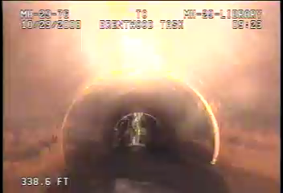

Slide 9
CAP Progress To Date
31+ Miles or 166,000 feet of pipes relined
1,732 Manholes lined and/or repaired
15% of the Little Harpeth River sewer basin rehabilitated
System overflows reduced
700 Million gallons annually I/I removed
All CAP Program objectives met
8

Slide 10
Next Steps
Complete Final CAP Project – sizing and construction of storage at the Brentwood/Metro Pumping Station
2014, Board approved agreement with HAZEN Engineering for development of system-wide hydraulic computer model. Model is an advanced tool used for master planning and system optimization
2016, Sewer System Master Plan completed and developed to prepare a comprehensive long-range plan to meet future capacity needs of the city through build-out
Initiate master plan projects and development of post-CAP rehabilitation plan
9

Slide 11
The Master Plan
August 2015 - Sewer hydraulic model development completed
October 2016 - Completed
10

Slide 12
Purpose of Master Plan
Identify hydraulic deficiencies in the sewer collection system
Identify and evaluate improvements to address deficiencies
Identify capital improvements, costs, and schedule for improvements
Provide Brentwood with a tool to perform capacity assessments for new development
11

Slide 13
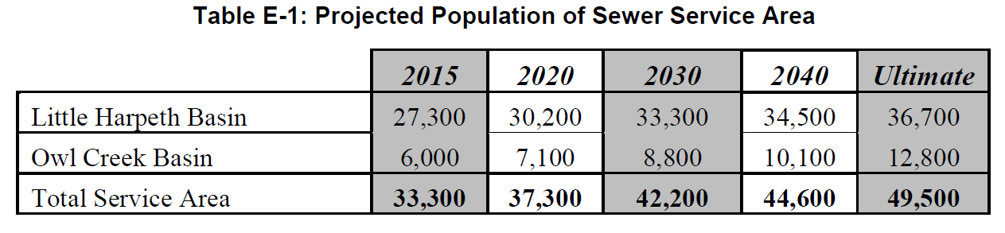
Service Area Population Projections
Master Plan assumed three planning horizons 2020, 2030, and ultimate buildout
12
Notes:
Master Plan assumed three planning horizons in 2020, 2030 and ultimate buildout
Future flow conditions are assumed and based on several factors including population growth, industrial and commercial growth, and rehabilitation effectiveness of existing system
Master plan used regional transportation planning projections for planning horizons, which included population and employee count.
Ultimate buildout projections incorporated maximum allowable zoning densities based on existing zoning.
The starting point or base year for projections was chosen as 2015 since the hydraulic model was generally developed and calibrated to this period. For the MP, planning horizons were chosen as Year 2020, Year 2030, and a non-specified year in the future representing complete buildout for
Brentwood in terms of reaching its maximum sewer capacity.
Although data from the MPO was used for Years 2020 and 2030, it was not considered suitable to use by itself for the ultimate buildout scenario. Buildout in OCB is not projected to be completely built out until well after Year 2040.
Therefore, available land and allowable zoning densities were also considered for the ultimate buildout scenario.

Slide 14
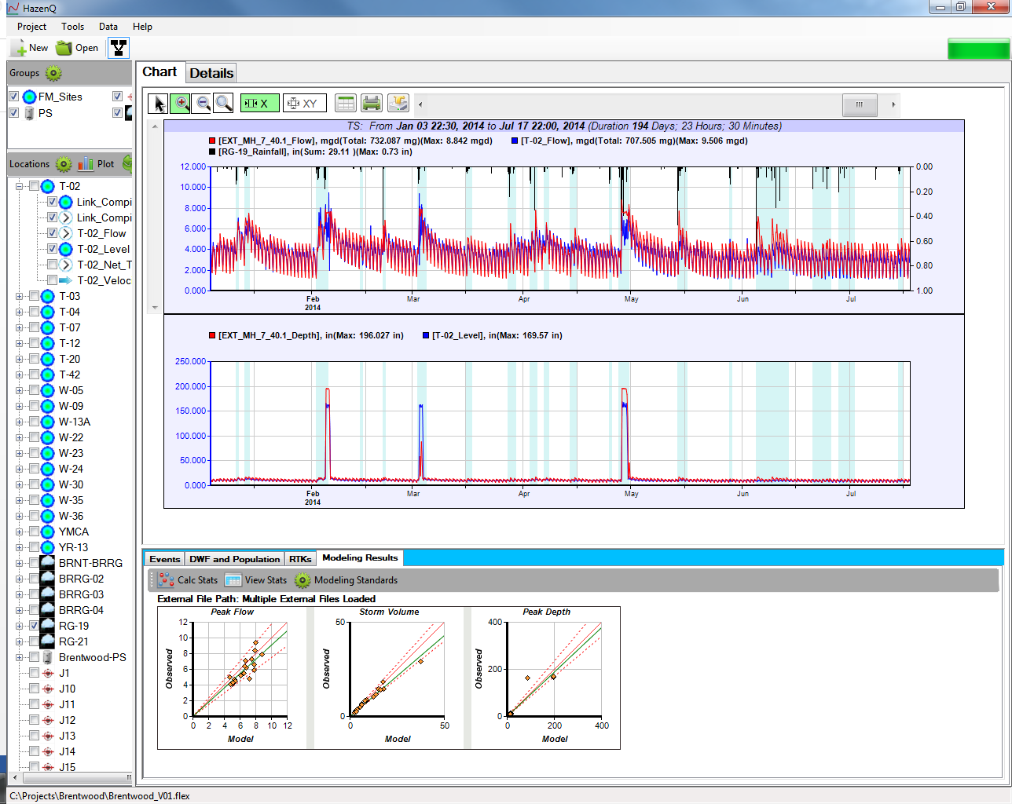
System Hydraulic Performance Evaluation
System performance for dry weather conditions based on depth of flow in pipe
System performance for wet weather conditions based on level of surcharge in pipe
13
Notes:
Generic lead-in to how system is evaluated. Could mention that we look at both dry and wet weather conditions.
Could also discuss surcharge utilizes in-line storage and is generally acceptable for existing sewer systems provided no overflows occur.
Figure above shows how the model compares to observed data in terms of flow, level and rainfall. Shows how flow, depth and rainfall are related. Also shows both dry and wet weather periods.

Slide 15
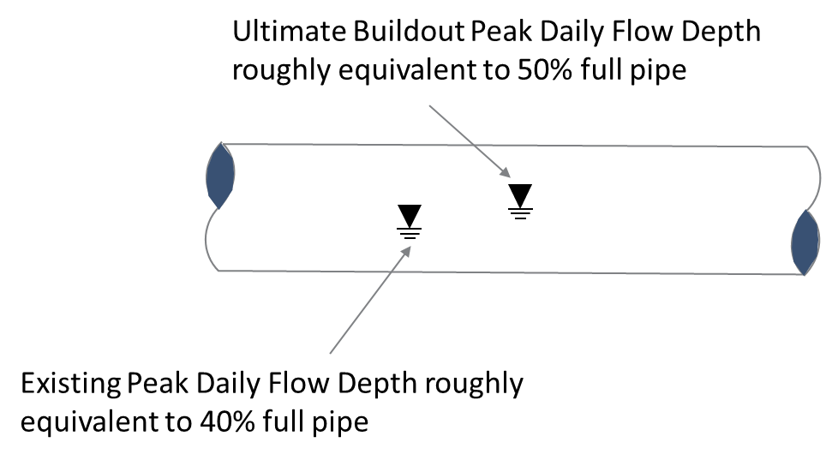
System Evaluation Results
Flow meters show trunk sewer does surcharge and overflow in some existing wet weather events
No dry weather overflows occur due to capacity limitation. This is also true with future dry weather flow projections at full build-out conditions
14
Notes:
Brentwood’s collection system was modeled under both current and future conditions to determine
locations where overflows are predicted to occur during the design storm event. For future conditions, it was assumed that a certain amount of I&I would be removed due to rehabilitation efforts. The areas identified for 25 % I&I reduction represent sub-basins where rehabilitation plans are known to be underway and 10% I&I reduction for other areas in the system likely to be rehabilitated. Since rehabilitation will continually be performed as a component of Brentwood’s CMOM program, it was assumed that any reductions from rehabilitation would be maintained over the planning horizons beginning in Year 2020.
Modeling predicts overflow volumes for the 2-year, 24-hour design storm do increase in future conditions with no improvements.

Slide 16
Alternatives Identification and Evaluation
Wet-weather overflows were the sole trigger for identification of needed improvements
Three approaches were evaluated to address overflows caused by capacity limitations
Source: MWS CAP/ER - September 2011
15
Notes:
This is the identification approach MWS took with its CAP/ER.
Equalization alternatives of both BPS and Mid-Trunk EQ only did not eliminate overflows.
Upsizing trunk to BPS was evaluated as way to eliminate mid-trunk EQ, but was found to be expensive and still requires larger EQ tank at BPS.

Slide 17
Recommendations
Ultimately, storage along with a continued rehabilitation program were determined to be the best solution based on cost and effectiveness
Storage improvements were sized to keep sewer level surcharge in trunk sewer at appropriate levels during a 2-year, 24-hour design storm
Localized areas with predicted overflow during future conditions were identified for additional study
16
Notes:
Chenoweth LS and Scales LS identified during evaluation for upsize
3,300 LF of 8-inch sewer south of Concord Rd in the vicinity of Brentwood’s First Presbyterian
Church near Franklin Rd and Longstreet Dr identified for upsize
2,910 LF of 12-inch & 380 LF of 15-inch sewer at the downstream end of the Owl Creek basin in
the vicinity of Concord Rd and Sunset Rd identified for upsize

Slide 18
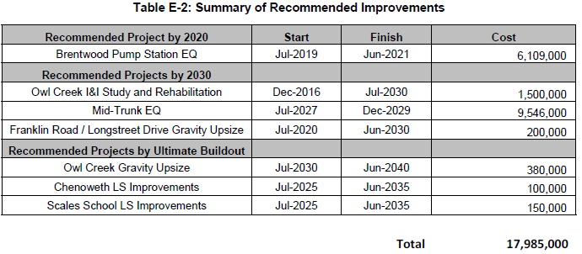
Summary of Master Plan Recommendations
17
Notes:
Chenoweth LS and Scales LS identified during evaluation for upsize
3,300 LF of 8-inch sewer south of Concord Rd in the vicinity of Brentwood’s First Presbyterian
Church near Franklin Rd and Longstreet Dr identified for upsize
2,910 LF of 12-inch & 380 LF of 15-inch sewer at the downstream end of the Owl Creek basin in
the vicinity of Concord Rd and Sunset Rd identified for upsize

Slide 19
Evaluating New Capacity Requests
Application for Water and Sewer Availability
  Owner/Property/Project Information
  Water and sewer service demands for project
Hydraulic modeling completed for projects with flows > 10,000 gallons per day and/or differ from assumptions made in Master Plan
Modeling scenario is at City build-out during a 2-year/24 hour rain event
Recommendations made for localized improvements are identified during availability review
18
Notes:
Chenoweth LS and Scales LS identified during evaluation for upsize
3,300 LF of 8-inch sewer south of Concord Rd in the vicinity of Brentwood’s First Presbyterian
Church near Franklin Rd and Longstreet Dr identified for upsize
2,910 LF of 12-inch & 380 LF of 15-inch sewer at the downstream end of the Owl Creek basin in
the vicinity of Concord Rd and Sunset Rd identified for upsize

Slide 20

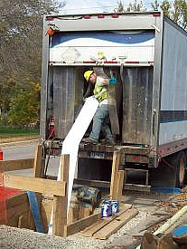
What’s Next?
The City of Brentwood's Water Services Department has contracted with Barge Design Solutions, an Engineering company, to provide continued rehabilitation program assistance for the next phases of the program
20

Slide 21
Sewer Rehabilitation Overview
Flow Monitoring
I/I Analysis
Rehabilitation
Planning for Post CAP/ER Rehabilitation
21

Slide 22
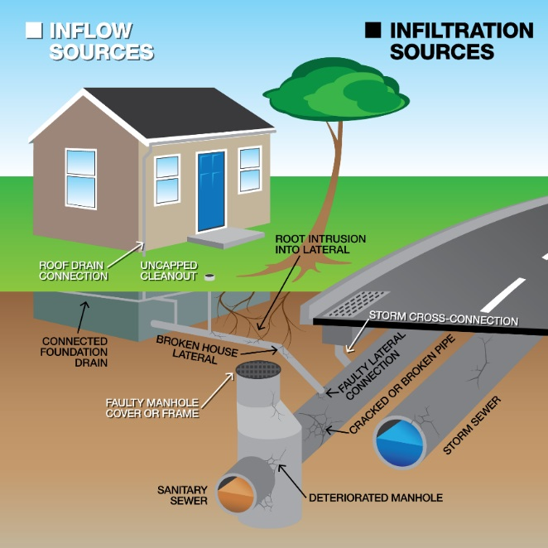
How Inflow and Infiltration
Enter the Sewer System
Source: WEF Fact Sheet: Sanitary Sewer Flow Monitoring and Data Analytic
22

Slide 23
Analysis Procedure
Identify dry periods
Identify events for analysis
Calculate excess flow
Rank monitoring areas to identify most significant issues
Prioritize sewer inspection based on analysis results
Prioritize rehab based on inspection findings
23

Slide 24
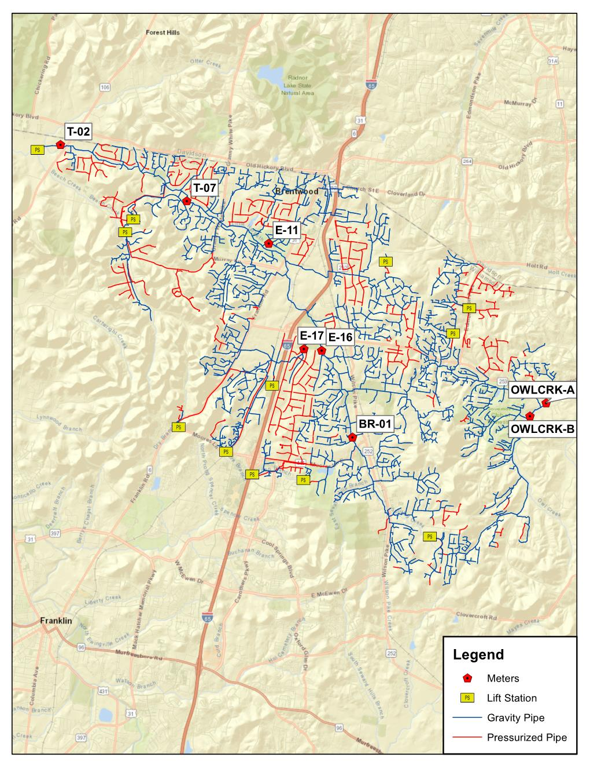
Brentwood Pump Station
Flow Monitoring Program
Eight permanently installed flow monitors
Three rain gauges
Earliest monitoring began in 2008
24

Slide 25
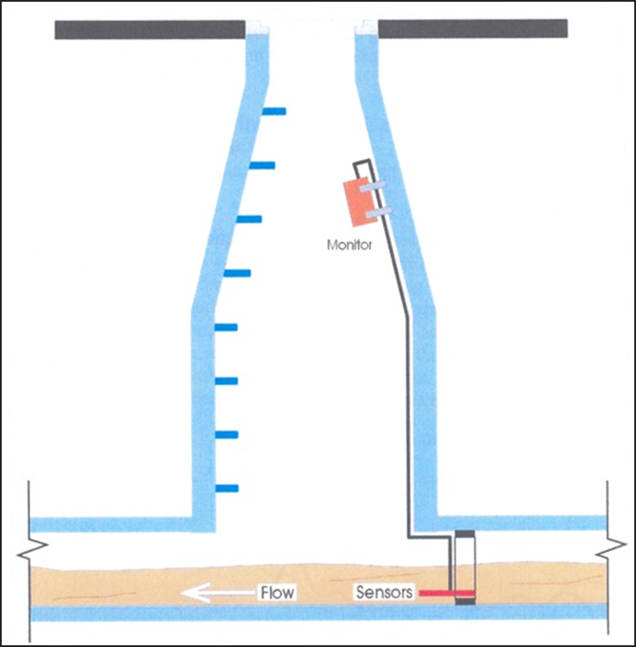
Flow Monitoring in Sanitary Sewers
25

Slide 26
Impact of Inflow and Infiltration on Sewer System Response
RDII: Rainfall Dependent Inflow and Infiltration
BWF: Base Wastewater Flow
GWI: Ground Water Infiltration
26
Source: WEF Fact Sheet: Sanitary Sewer Flow Monitoring and Data Analytic

Slide 27
Sanitary Sewer Overflow and
Rainfall Analysis
Year | Total Annual Rainfall (In.)* | Number of Overflow Events (-) | Total Overflow Duration (Hours)
2008 | 46.7 | 18 | 1881
2019 | 76.6 (+64%) | 8 (-56%) | 458 (-76%)
* Rainfall data from BRNT_BRRG
27
Notes:
INSERT CHART: showing Annual SSO Count (from Drew) and Annual rainfall
Initial analysis shows SSOs dropped by 50% from 2008 to 2018 (18 SSOs in 2008 and 9 SSOs in 2018), while rainfall increased by about 50% (44 inches to 62 inches)

Slide 28
Pre- and Post-Rehab Inflow Analysis
Meter T-02
1.2 Million Gallons
28

Slide 29
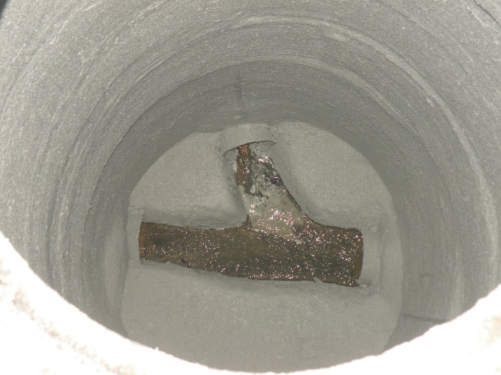
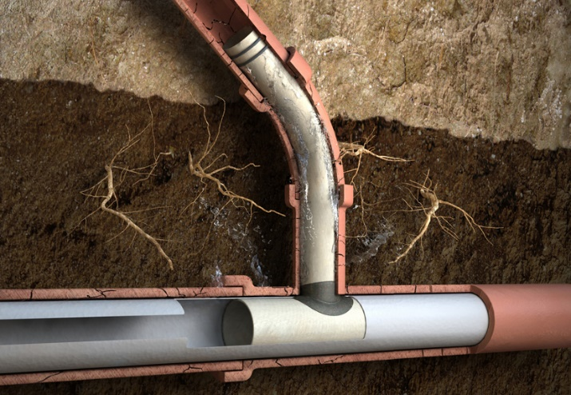
Pipe and Manhole Rehabilitation
Pipelines
    Cured in Place Pipe
Manholes
    Epoxy Rehab
Service Laterals
    Lateral Lining
29

Slide 30
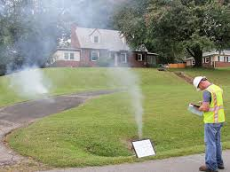
Planning for Post CAP/ER Rehabilitation
Rehabilitation Work Identified in Master Plan
System Investigation Methods
    Main Lines
        Closed Circuit TV
        Manhole Inspections
        Dye Testing
  Private Property
      Smoke Testing
30

Slide 31
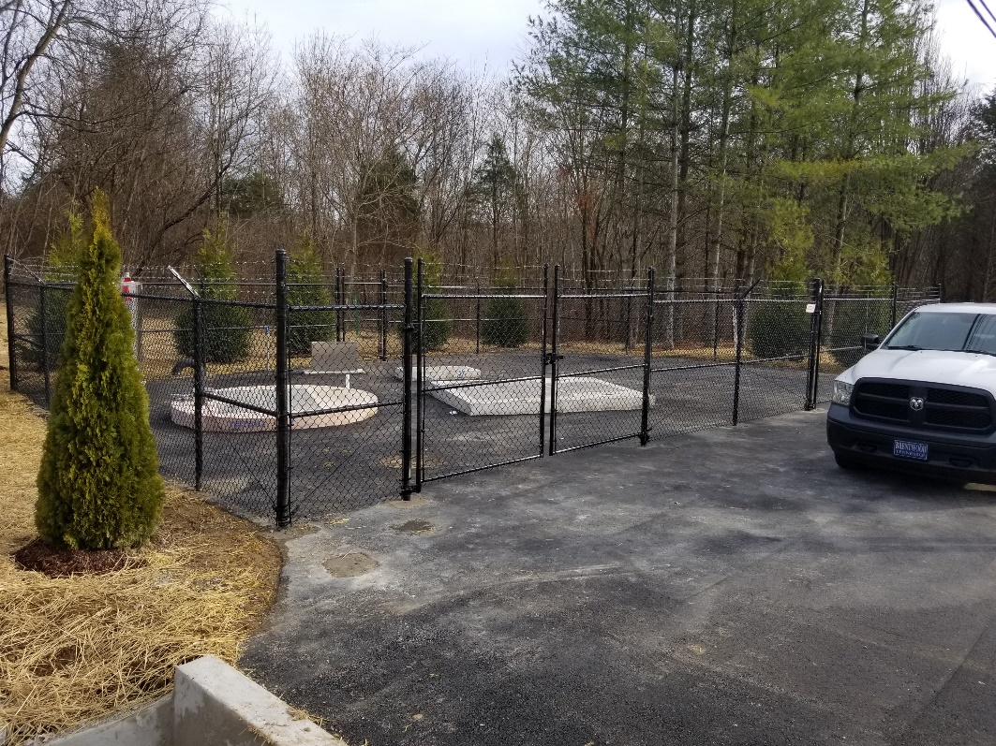
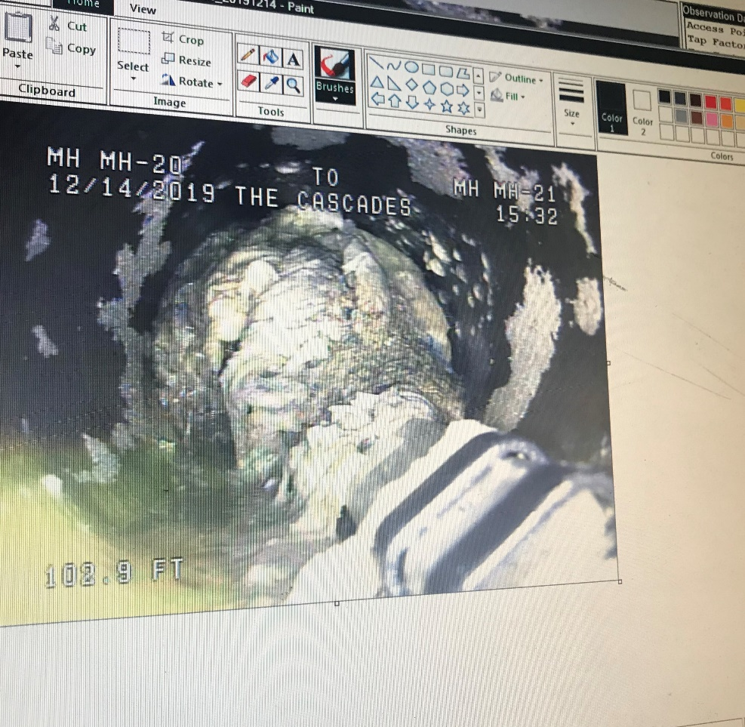
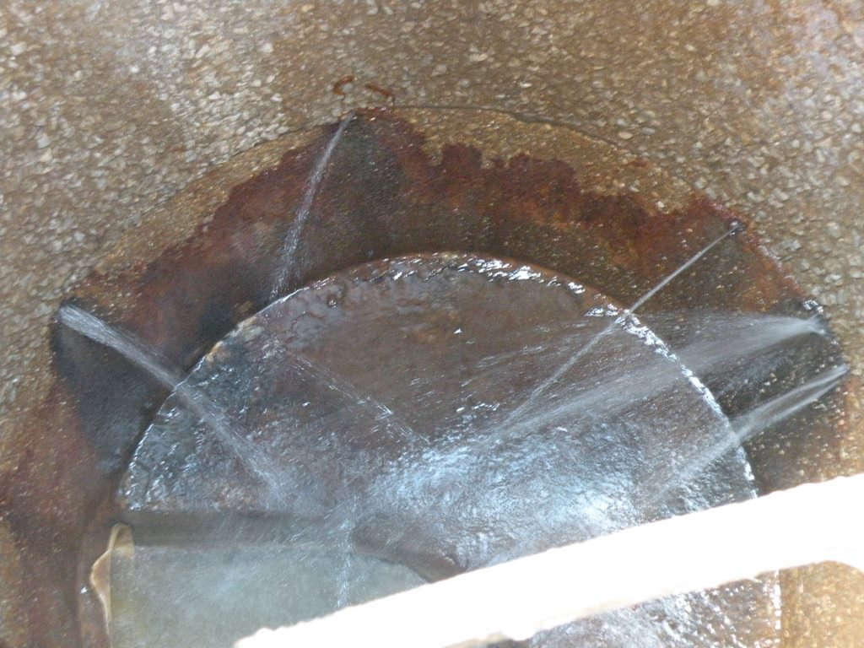
What Causes Overflows?
Mechanical failures
  Pump Stations
Pipe Blockages
  Fats, oils, and grease buildup
  Flushing items that shouldn’t be flushed
  Other debris entering system
Direct damage to infrastructure
  Contractors
Rainfall and Groundwater
  Inflow and Infiltration (I/I)
30

Slide 32
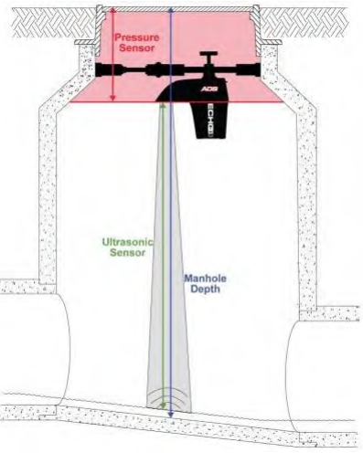

Overflow Monitoring
Brentwood/Metro Pump Station
  Wet Well Levels
Manhole Depth Meters
  Measures sewer levels in a manhole
Visual by City Crews
31

Slide 33
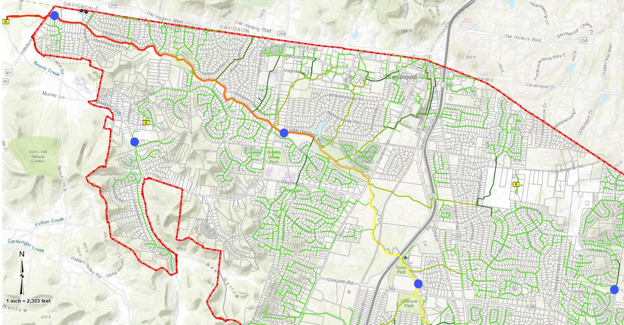
Overflow Monitoring Locations
1
2
5
Hillsboro Road
Granny White Pike
Heritage Way
Chenoweth Station
Scales School Station
3
4
32

Slide 34
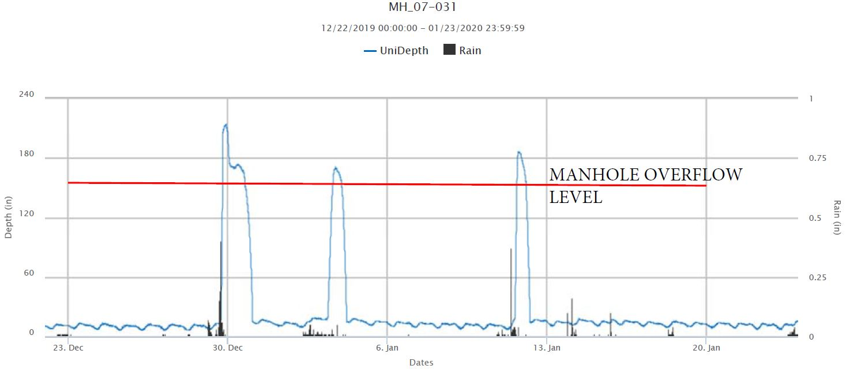
Overflow Monitoring Results
33

Slide 35
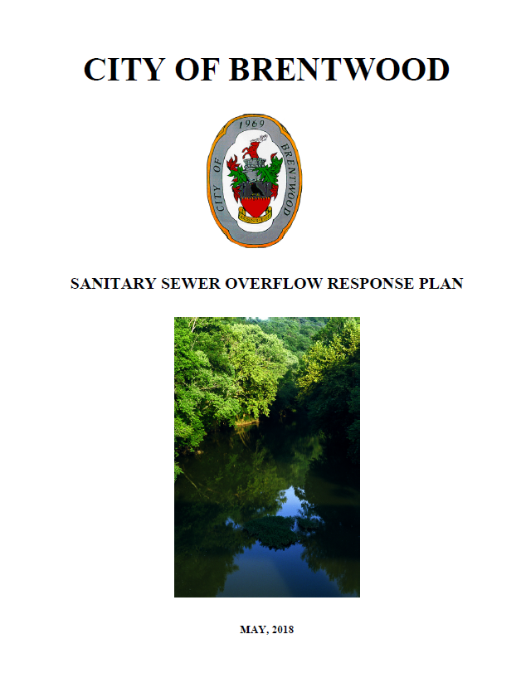
Sanitary Sewer Overflow Response Plan
Tennessee Department of Environment & Conservation (TDEC) requirements
Standard response & Operating Procedures
Reporting & Tracking
Cleanup
34

Slide 36
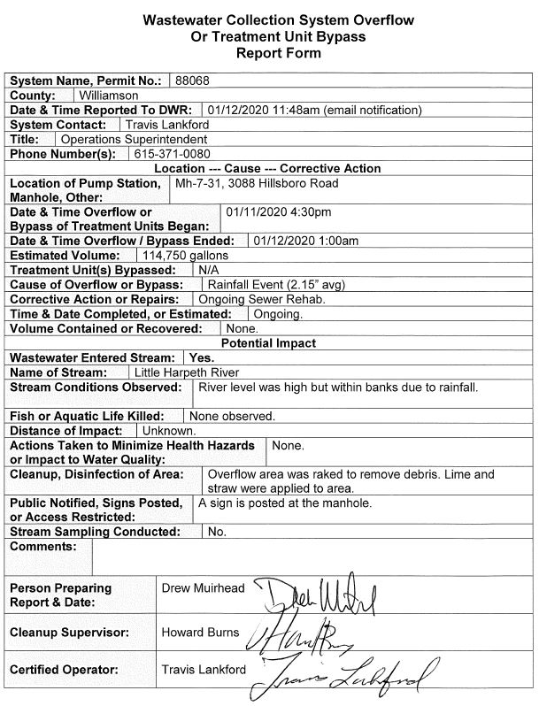
Overflow Reporting
Within 24 Hours:
  Tennessee Department of Environment & Conservation (TDEC) requirements
5 Days Later:
  Date, Time, and Location
  Event Duration
  Estimated Volume
  Cause
  Impacted Streams
  Cleanup
35

Slide 37
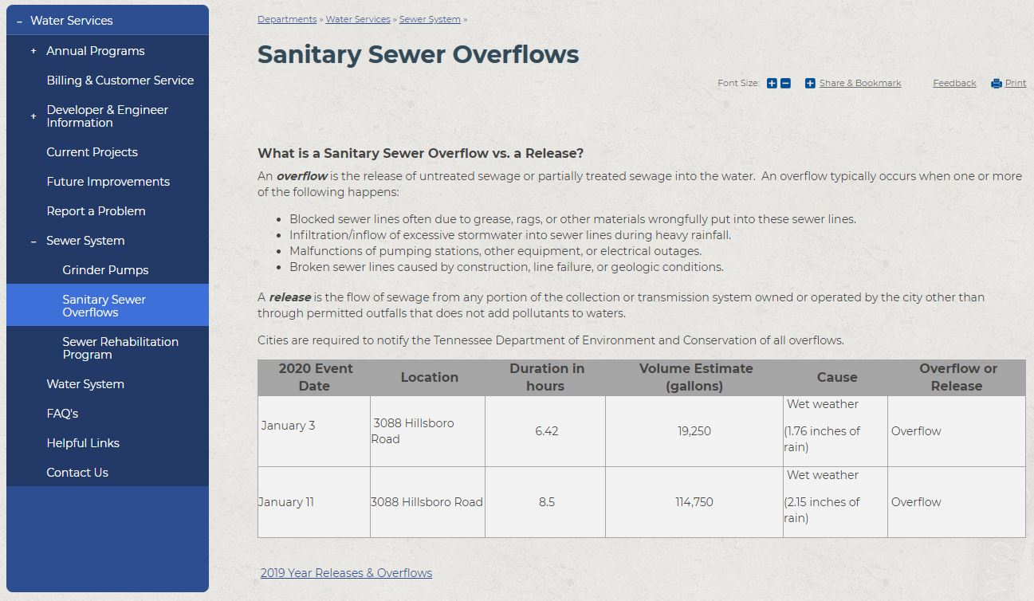
Overflow Reporting
All overflows are posted within five days on the City’s website.
36

Slide 38
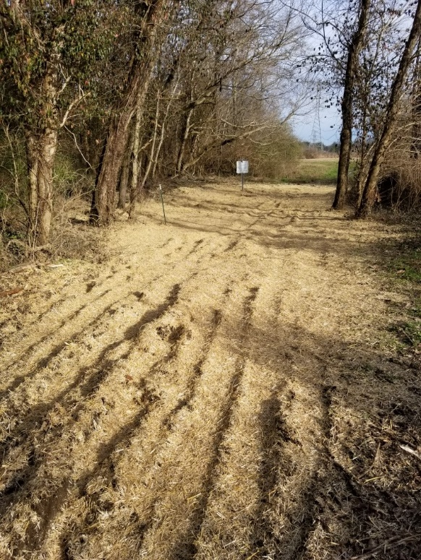
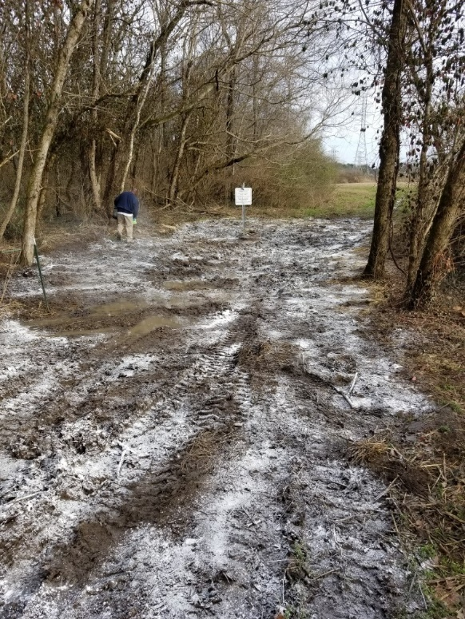
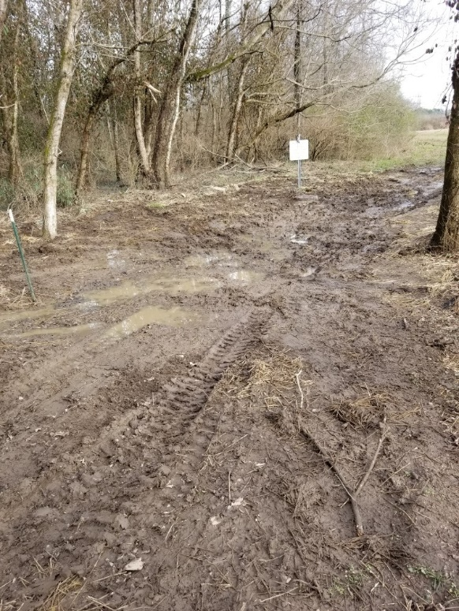
Overflow Cleanup Process
Removal of debris
Apply disinfectant
Place straw
37

Slide 39
TDEC Regulatory Discussion
38

Slide 40
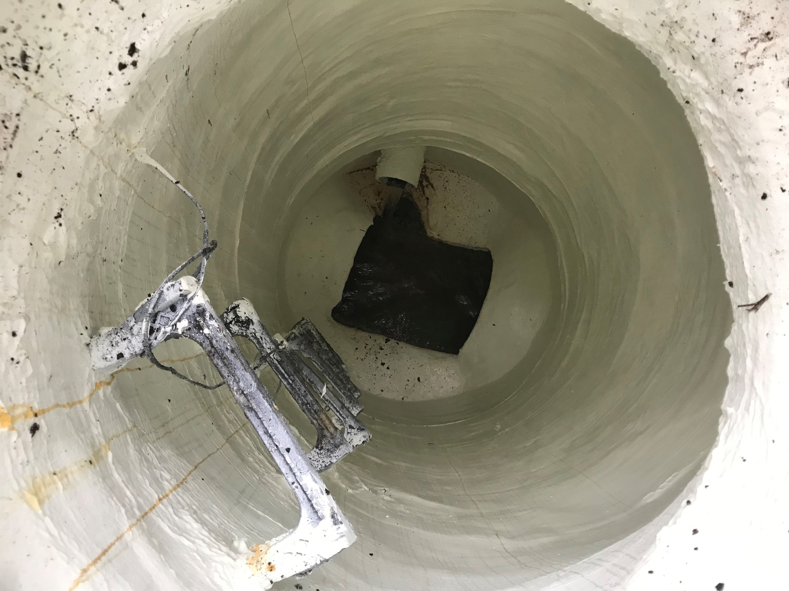
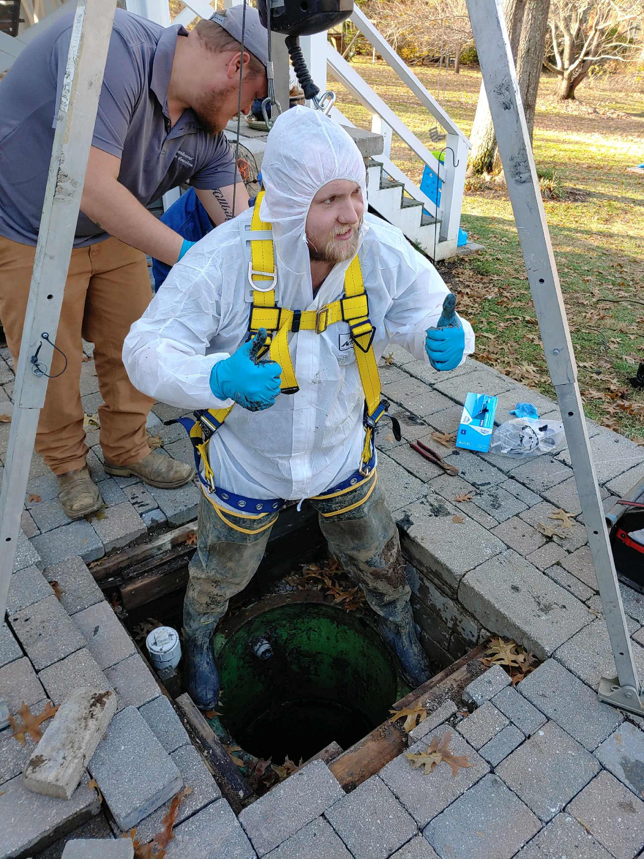
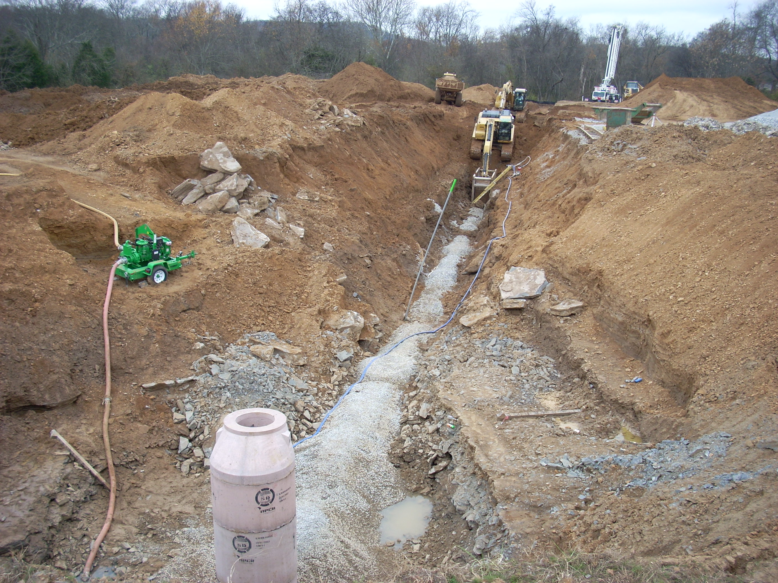
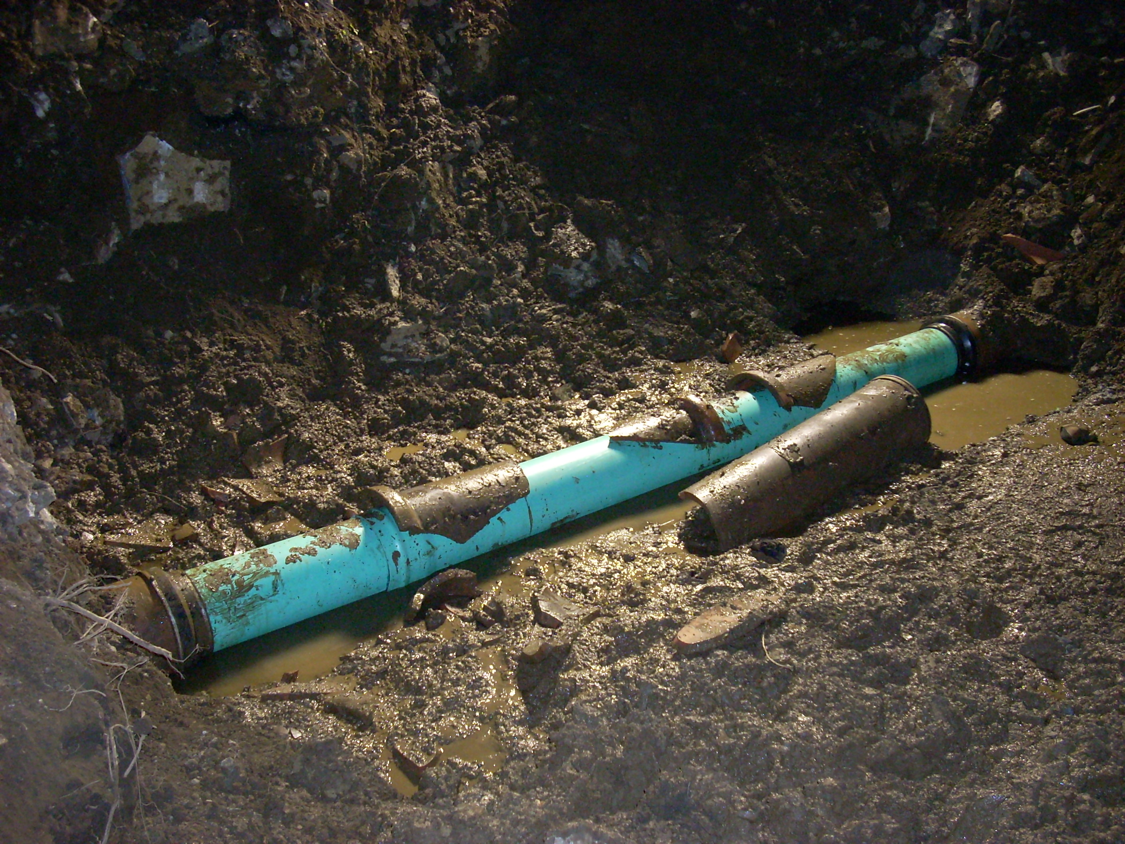
Questions and Discussion
39

