Slide 1

Officer Involved Shooting
Occurred on:
March 15th, 2021

Slide 2
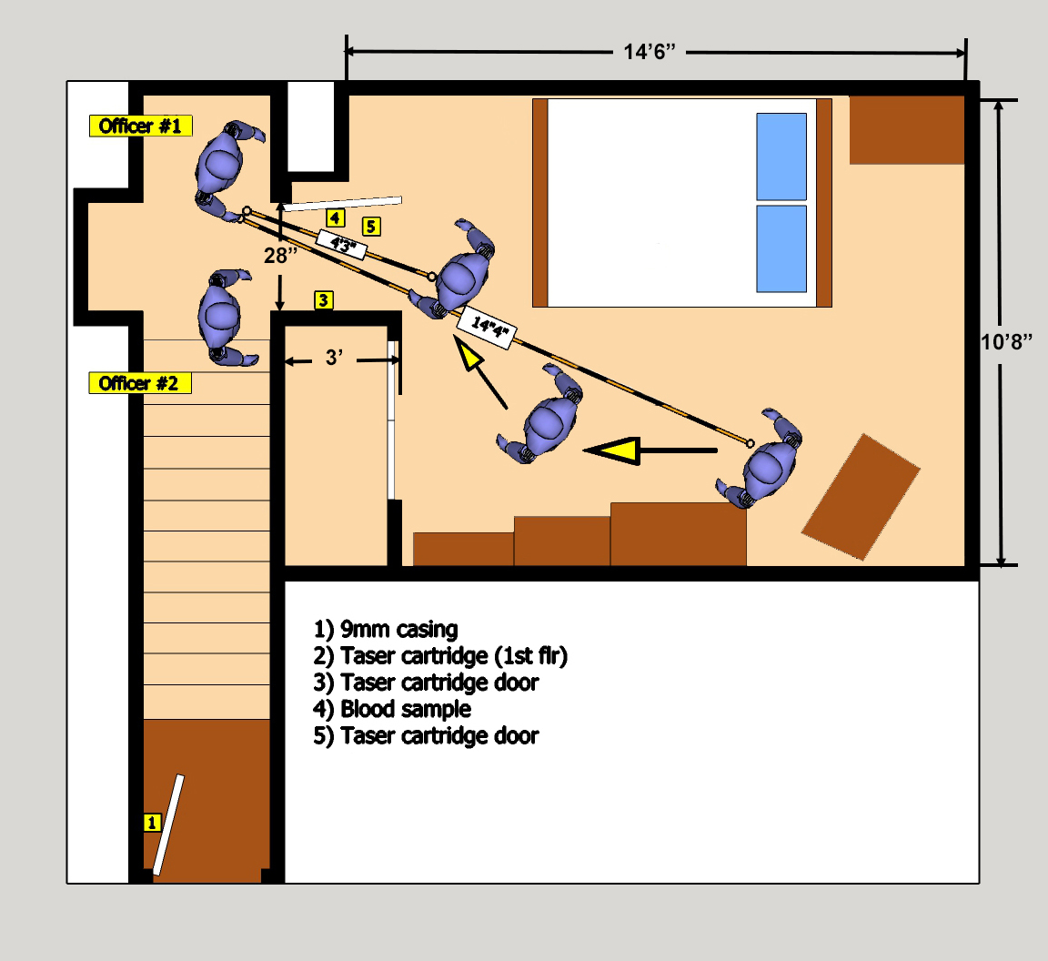

Slide 3
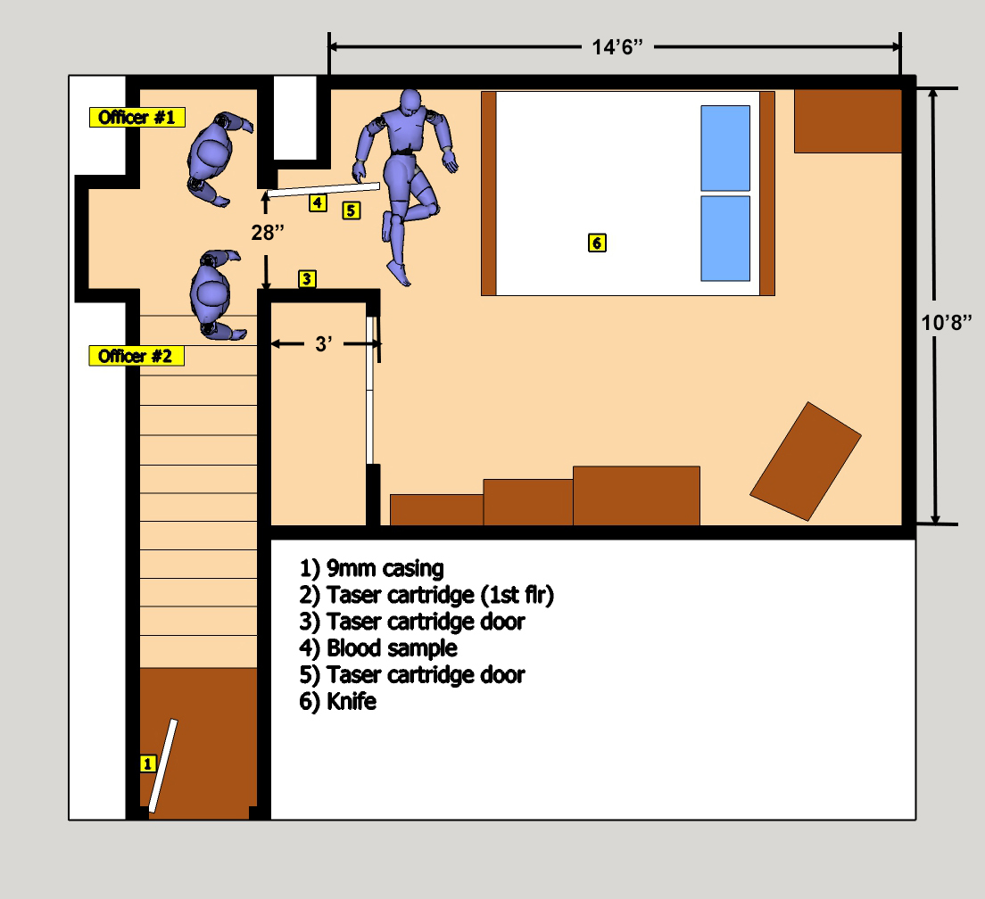

Slide 4
