Slide 1

NEW CASTLE COUNTY
FISCAL YEAR 2020
EMBARGOED UNTIL 5:30 p.m. on 3/26/19
Budget Address
March 26, 2019
Matthew Meyer
County Executive

Slide 2


Slide 3

General Fund Revenues vs. Expenditures
FY19 Outlook
Notes:
As a reminder, here is the imbalance between revenues and expenditures. If we do nothing dramatic to close the gap, we will have to take the difference from reserves to deliver a balanced budget…

Slide 4
FY19 Outlook: Declining Reserve Balance

Slide 5
Current Outlook: Stabilized Reserve Balance

Slide 6
FY 2020 Recommended Budgets
Expenditures | Fiscal 2020
General Fund | $ 212,462,262
Sewer Fund | 86,270,444
Light Tax Fund | 6,381,565
School Crossing Guards Fund | 3,724,763
TOTAL OPERATING | $ 300,300,635
General Fund Capital | $ 18,552,238
Sewer Fund Capital | 48,590,563
Other | 8,564,138
TOTAL CAPITAL | $ 75,706,939
5
Notes:
General Fund Growth = 3.06%
Sewer Fund Growth = 4.20%
Light Tax = -3.94%
School Crossing Guard = -1.10%

Slide 7
FY2020 Operating Budget Highlights
$9.2M Operating Budget Growth (3.16%)
    $4.5M Debt Service
    $3.1M Personnel
    $1.4M Contractual Services
    $200k Fire Service
    $540k One-Time Items
    ($262k) Street Light
    ($42k) Crossing Guard
Notes:
$4.5M Debt Service (includes impact for $40M GF, $70M Sewer scheduled for May 2019)
$3.14M Personnel
$3.8M Pension Contribution (lowered rate of return, change in demographics)
$900k Merit Steps for eligible employees
$($2.0M) Health Care – Pharmacy Carveout eff January 2019
($1.6M) 1% Attrition countywide (offset by $.9 for adding back 2.5% Police Attrition)
966.2k 15 Paramedics (Temporary Overfill for current class)
$200k Other Benefits (UI, FICA, W/C, Life Ins)
$147.8k 2 Staff Engineers (Land Use – stormwater management construction inspections – offset by revenue)
$1.44M Contractual Services/Grants and Fixed Charges
$515.6k Countywide Technology Enhancements - Microsoft Office 365 and VOIP Phone System
$197.6k 3% Fire Company Grant increase and the addition of a grant for companies operating Aerial fire trucks
$133.4k Public Safety technology investments (maintenance contracts for AEDs, Fusion Center Video Wall, First Watch Software and Scheduling Software)
$131.6k Public Works facility/property maintenance
$175k Continued legal services for Vacant/Problem Property Initiatives and Third Party Collection services
$74.3k Enhance Rt 9 Eatery operations, recreational activities in the parks and background checks for volunteer workers
$75k GreeNCC Initiative and Stormwater Pond Maintenance
$0.54M One-Time Items
$200k Comprehensive Development Plan Update (Land Use)
$340.2k Legal Services for CoW Arbitration and expanded Efficiency Review, technology enhancements (Council and Land Use)
($0.26) Street Light reduction – Delmarva passed on Corporate Tax reduction
($0.04) Crossing Guard – based on anticipated needs requested by school districts

Slide 8
Capital Investments
Southern Regional Library – Design/Construction
Public Safety Vest Protection Program
Surratte Pool – Bath House renovations and pool pump and electrical upgrades
Jester Walking Path and Historical Structure Rehabilitation
Delcastle Park bleachers
Other park enhancements
Route 9 TAP Bicycle/Pedestrian Improvements – Design
Sewer improvement projects:
  Brandywine Interceptor Renovation
  Delaware City Industrial Sewer Expansion
  North Delaware Interceptor – Claymont Transit/Governor Printz
  Lea Eara Farms Treatment Plant Closure
Notes:
Public Safety
Fleet Equipment
- $4,690,788 prior committed leases
- $292,902 (Police ) 40 Tahoes, 8 Interceptors, 2 Harleys
- $163,965 (EMS) 5 Response Vehicles, 2 Supv Response Vehicles, 2 Interceptors
- $10,810 (Emergency Communications) Surburban, Interceptor
$13,034 (Emergency Mgmt) 4x4 Crew Cab
$400k 800 MgHZ Communications Equipment – 50-75 Portable Radios
$64k Communications Upgrade – Single Supv Console, 4 addtl Consoles
$150k Public Safety Equipment - 24 AEDs; Body Worn Camera Annual Contract; Tech Crimes, SWAT and CNT Units equipment
$100k Public Safety Vest Protection Program – 95-100 Police and 38 EMS

Slide 9
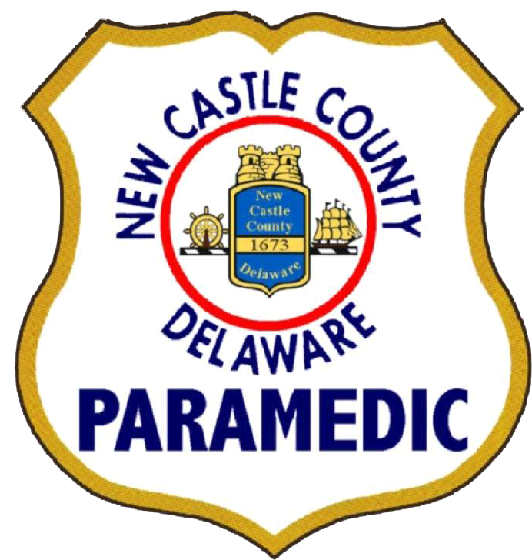

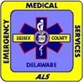
Investing in our Paramedics
Sharing Paramedic Costs 50/50
between Counties and State

Slide 10
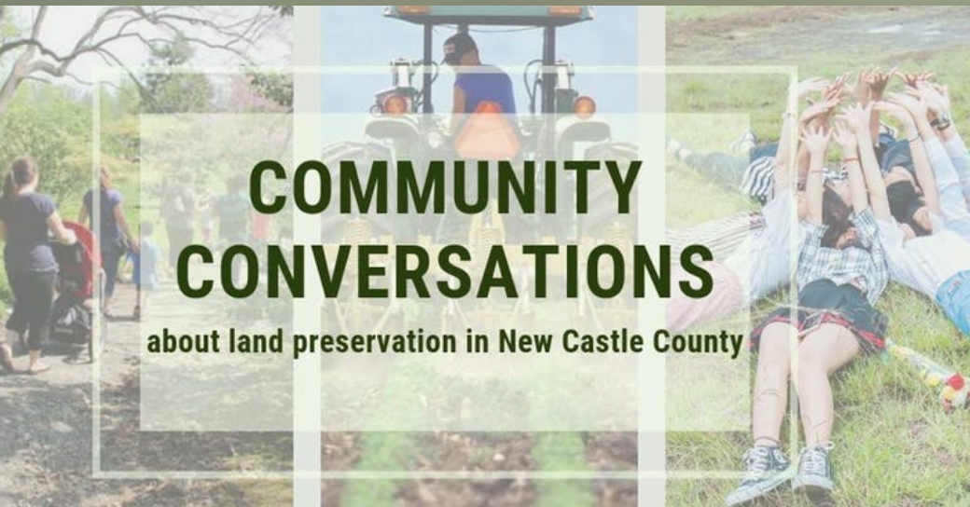
Community Conversation on Land Preservation
Join us Thursday, March 28
3-6:30pm
NCC Gilliam Building, New Castle
Notes:
Sewer
Airport Road System Rehabilitation
Brandywine Interceptor Renovation
Delaware City Industrial Sewer Expansion
DelDOT Coordination Project II
Holloway Terrace Outfall
Lea Eara Farms Treatment Plant Closure
North Delaware Interceptor – Claymont Transit/Governor Printz
Sewer Fleet Equipment
Southern Sewer Service Area
Stormwater
General Stormwater Improvements
Stormwater Basin Renovation II
Water Quality Improvement Plans

Slide 11
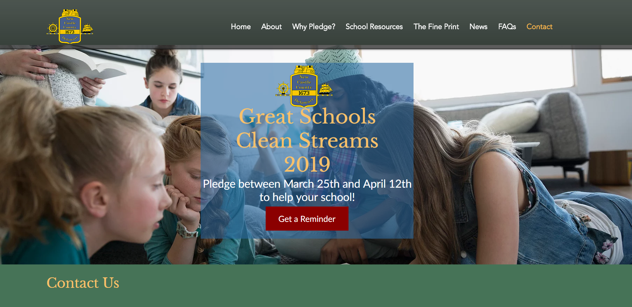
GreatSchoolsCleanStreams.org
Make your pledge by April 12th!
Notes:
Sewer
Airport Road System Rehabilitation
Brandywine Interceptor Renovation
Delaware City Industrial Sewer Expansion
DelDOT Coordination Project II
Holloway Terrace Outfall
Lea Eara Farms Treatment Plant Closure
North Delaware Interceptor – Claymont Transit/Governor Printz
Sewer Fleet Equipment
Southern Sewer Service Area
Stormwater
General Stormwater Improvements
Stormwater Basin Renovation II
Water Quality Improvement Plans

