Slide 1
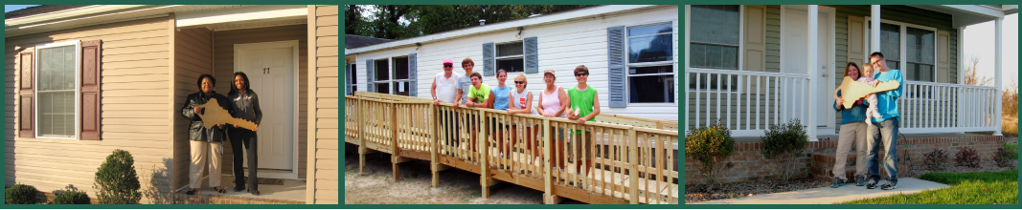
Milford Housing
Development Corporation
Providing Affordable Housing Solutions

Slide 2
Who We Are
Our mission is to provide decent, safe, & affordable housing solutions to people of modest means.
MHDC is a value-driven, nonprofit housing developer.
Known for our open-minded approach, commitment to quality, & a caring, sound passion for clients & staff alike.
Established in 1977 by group of local concerned citizens.
Today we are Delaware’s leading nonprofit affordable housing provider.
Now also servicing parts of Maryland & Virginia.

Slide 3
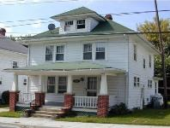
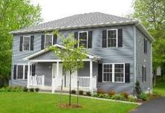
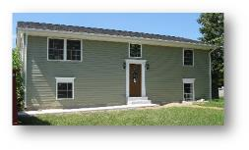
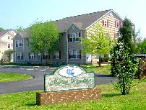

What We Do
Multi-Family Rentals
Self-Help Housing
Homebuyer’s Club
Emergency Home Repairs
Transitional Housing
Homeownership
Opportunities
Housing Rehab & Preservation
Property Management

Slide 4
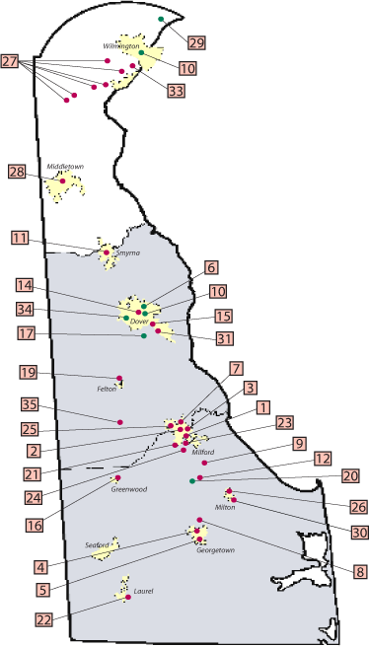
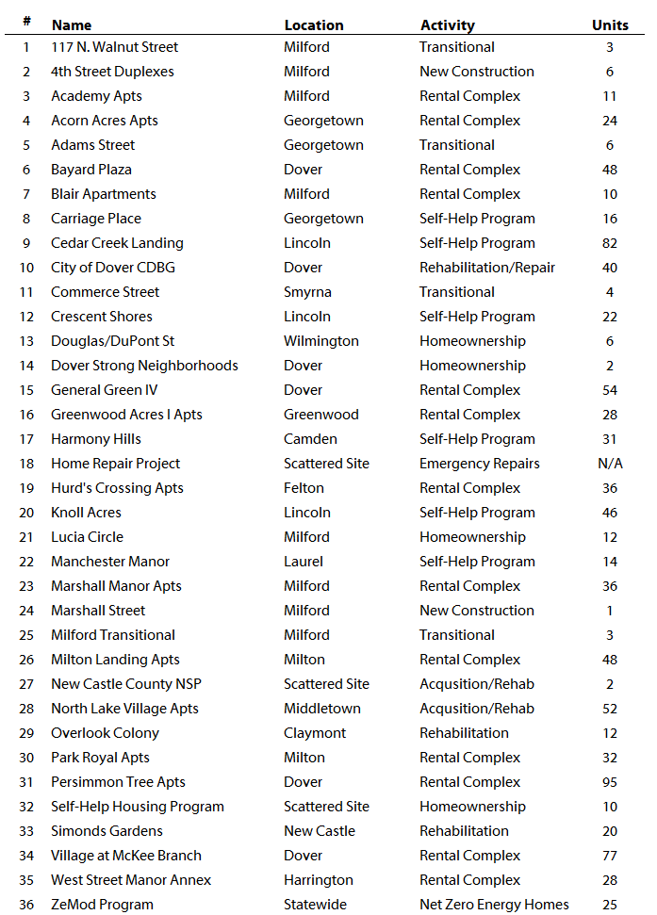

Where We Serve

Slide 5

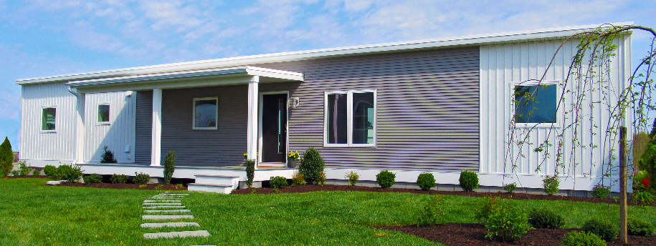




Slide 6
What the Heck is a ZeMod?
A ZeMod is a zero energy modular home.
Zero energy homes produce as much energy as they use, which means there are little to no electric or fossil fuel costs.
ZeMod achieves zero energy because it is a super insulated envelop. It’s walls, roof, and floors are all packed with extra insulation that wraps the home like a thick blanket, reducing energy loss.
Energy Produced = Energy Used

Slide 7
A ZeMod is a Green Home
An all-electric HVAC system incorporates efficient heat-pump technology, keeping you warmer in winter and cooler in summer.
Solar panels produce all the energy needed to run the home.
High performance windows, doors, and airtight ducts throughout the home create a better seal.
The home comes standard with all ENERGY STAR* rated appliances and lighting fixtures.
These features together make this home as efficient and green as possible.

Slide 8
A ZeMod is a Healthy Home
The Conditioned Energy Recovery Ventilator (CERV) is a balanced ventilation system that includes an integrated air-source heat pump — a type of appliance that has been dubbed a “magic box” by engineers.
The CERV monitors indoor air quality and automatically delivers fresh air whenever levels of carbon dioxide and volatile organic compounds (VOCs) exceed 1000ppm.
Studies have shown that homes that exceed this level produce notable decreases in people’s mental performance, sleep quality, and productivity.

Slide 9
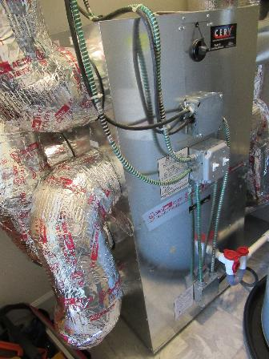
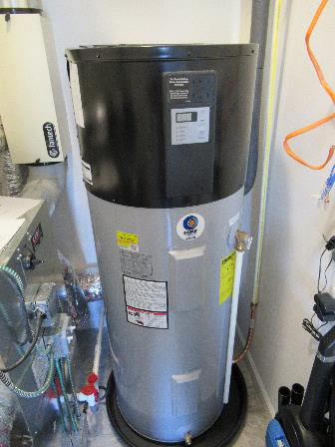
A ZeMod is a Healthy Home
The CERV Unit and Water Heater

Slide 10
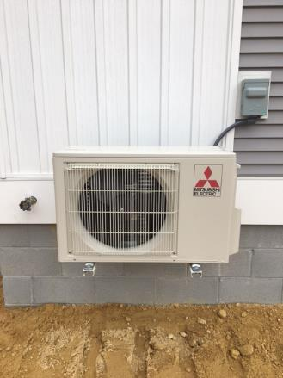
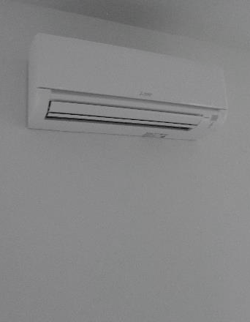
A ZeMod is a Healthy Home
The Magic Boxes

Slide 11
A ZeMod is a Healthy Home
ZeMod’s high-quality materials and Indoor airPLUS Certification enhance your family’s health.
All the paints, flooring, cabinets, and other finishes in the ZeMod are low-VOC. Reducing your exposure to airborne pollutants.
These low emission materials include:
    Formaldehyde-free products
    Hardwood cabinets and low-VOC countertops
    Low-VOC paints and finishes
    Hardwood flooring
    Sheetrock walls

Slide 12
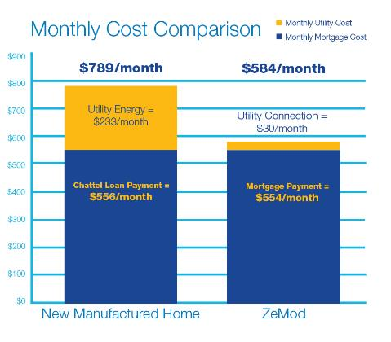
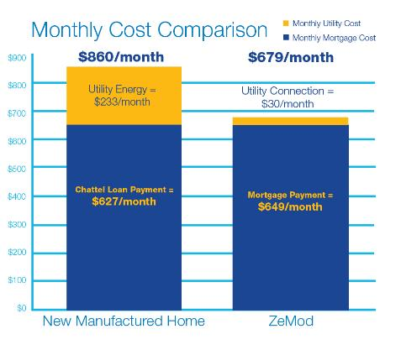
A ZeMod is Affordable
The Solstice Model The Sundial Model

Slide 13
A ZeMod is Affordable
The Solstice Model

Slide 14
A ZeMod is Affordable
The Sundial Model

Slide 15
A ZeMod is Affordable
We’ll even help you buy it.
The ZeMod Delaware program services include:
Homebuyer counseling and financial empowerment courses: Help getting mortgage ready
Down-payment assistance to qualified buyers below 120% AMI (Up to $25,000 for eligible buyers)
Renewable energy incentives for qualified buyers below 120% AMI (Up to $16,500 for eligible buyers)
Assistance in choosing suitable and affordable lots
Access to MHDC’s inventory of lots as well

Slide 16


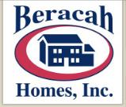

ZeMod Delaware Program
Partnership Makes It Possible!
The ZeMod Delaware Program is a 3-year pilot program funded by the Delaware Sustainable Energy Utility (DE SEU).
Milford Housing Development Corporation administers the program and packages the loans.
Beracah Homes builds all ZeMod homes.
Vermont Energy Investment Corporation (VEIC) provides Technical Consulting Assistance.

Slide 17
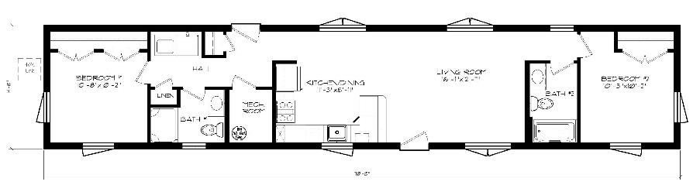
ZeMod Delaware Features
Hard-surface flooring in kitchens, baths, entry, laundry, and utility rooms
Certified low-VOC or no-VOC interior paints and finishes
All ENERGY STAR appliances and lighting included
Certified low-formaldehyde, composite wood materials and structural plywood
CO alarms installed in each sleeping zone
Insulation, air tightness, and HVAC efficiency exceeds ENERGY STAR standards
Sound dampened mechanical room
Material & construction details significantly reduce maintenance
Open floor with large kitchen and ample closet space

Slide 18
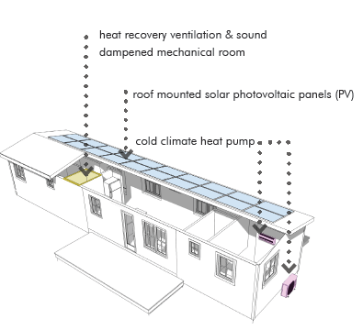
ZeMod Delaware Features
All homes feature all electric, high efficiency HVAC systems for heating, cooling and hot water, resulting in no fossil fuels used in this home.
A 6.05kW solar photovoltaic (PV) system to the roof of your home, you can produce all your own energy and eliminate all energy costs.
Homes are equipped with a Conditioning Energy Recovery Ventilator (CERV), which combines an air-source heat pump with a ventilation system that monitors carbon dioxide, humidity, and volatile organic compounds (VOCs) in the air and adjusts the ventilation rates as needed.
Additionally, all homes have an energy efficient cold climate heat pump and water heater.

Slide 19
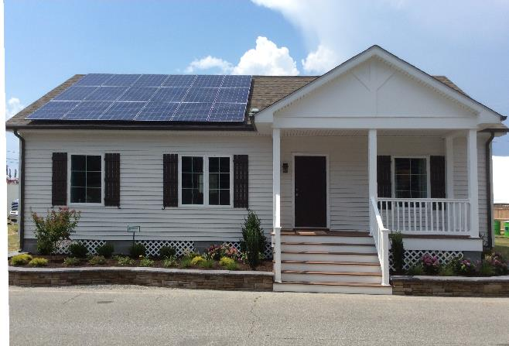
Picture Yourself in a ZeMod
The Sundial Model

Slide 20
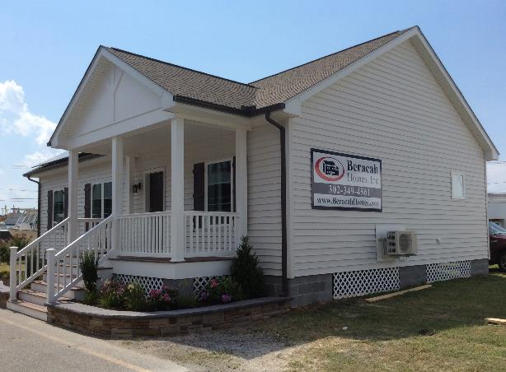
Picture Yourself in a ZeMod
The Sundial Model

Slide 21
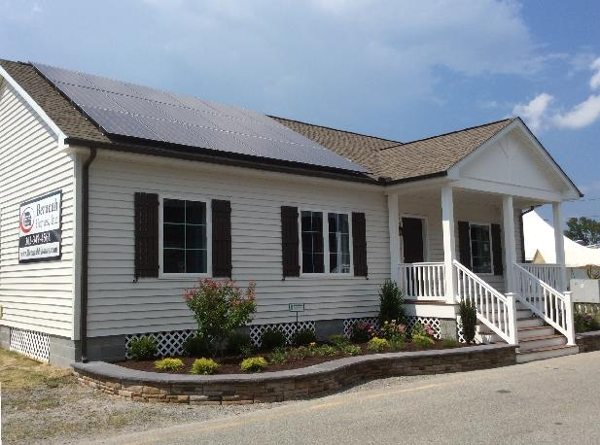
Picture Yourself in a ZeMod
The Sundial Model

Slide 22

Picture Yourself in a ZeMod
The Solstice Model

Slide 23
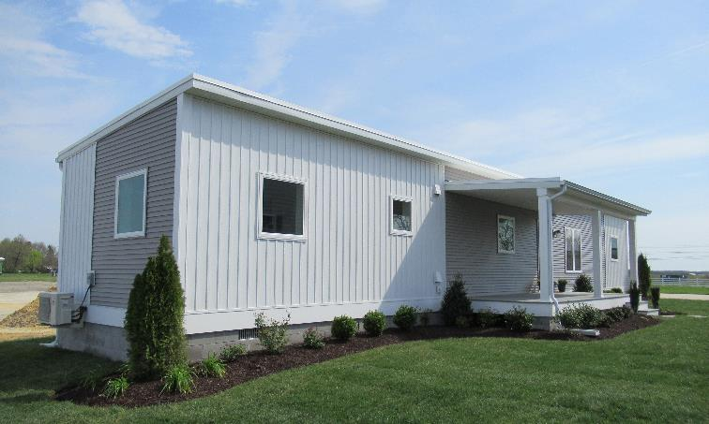
Picture Yourself in a ZeMod
The Solstice Model

Slide 24
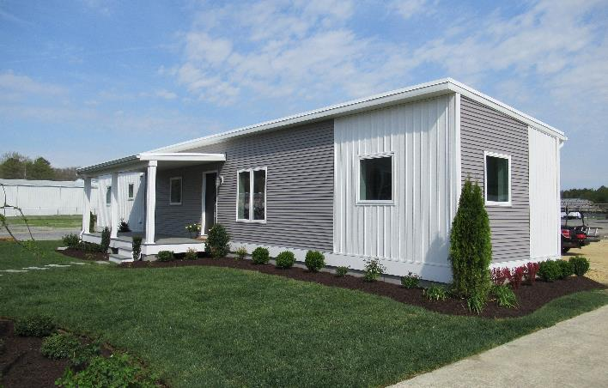
Picture Yourself in a ZeMod
The Solstice Model

Slide 25
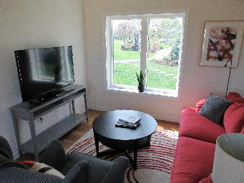
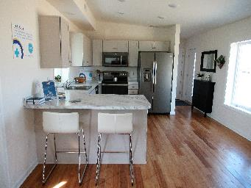
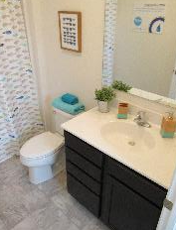
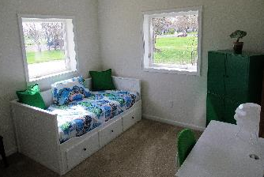
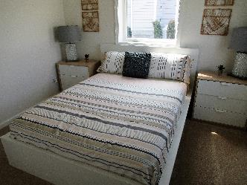
Picture Yourself in a ZeMod

Slide 26
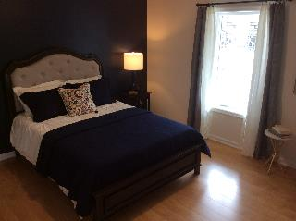
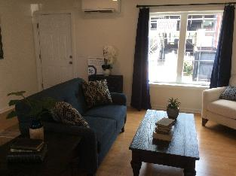
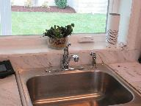
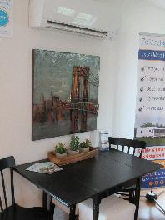
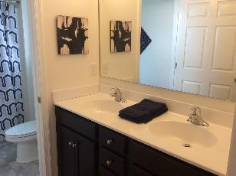
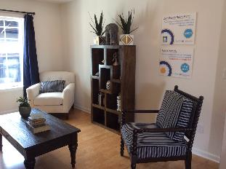
Picture Yourself in a ZeMod

Slide 27
Program Contact
ZeMod Delaware
  Monica Mandujano
  Homeownership Specialist - Bilingual
  mmandujano@milfordhousing.com
  (302) 422-8255 ext.127
  www.ZeModDelaware.com
  www.MilfordHousing.com
Take Charge of Your Family’s Future: Contact Us Today

Slide 28
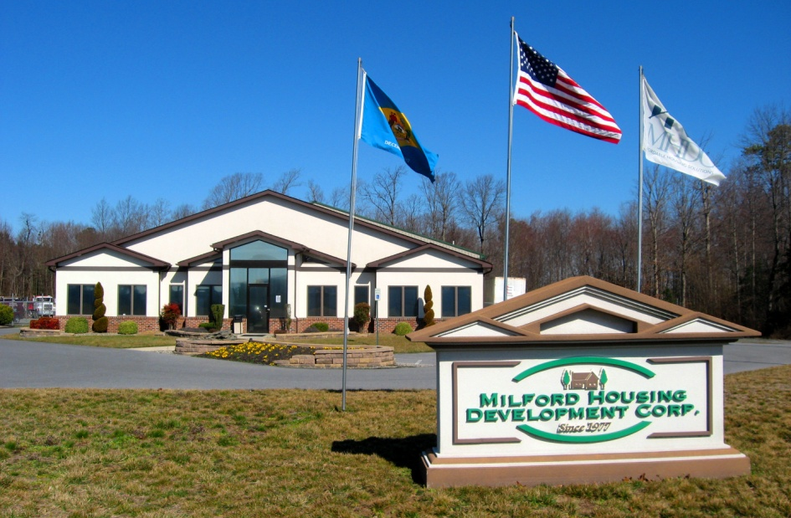


Thank You!
Address
Milford Housing Development Corporation
977 East Masten Circle
Milford, DE 19963
Website
www.milfordhousing.com
Contact Info
Susan M. Davis
Resource Development Specialist
302-422-8255 Ext 102
sdavis@milfordhousing.com
Find us on Facebook & Twitter too!

