Slide 1

WY2026 Spring Flow Recommendation
Trinity River Restoration Program Flow Work Group
Patrick Flynn – Coordinator
TMC 03/26/2026
Notes:
Coordinator since early June
TRRP/county role funded partially by TRRP

Slide 2
Table of Contents
Flow Planning Process
  B120 forecasts
Hydrograph Scenarios
WY2026 objectives
Developed Hydrographs
DSS Results
Selected Hydrographs
Recommendation from Flow WG/IDT to TMC
Notes:
Memo provided to IDT and TMC yesterday 9/10

Slide 3
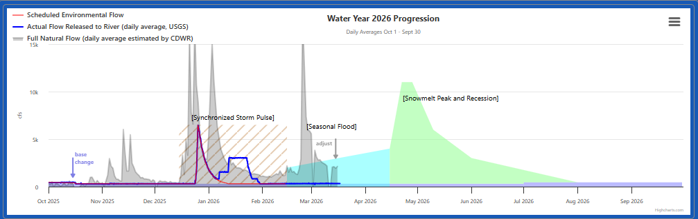
WY2026 Flow Regime
Full winter variable flow (WVF) regime
  TMC voted to implement full WFV during September meeting
Second of three years of the WVF experiment period as requested by Hoopa Valley Tribe
Notes:
Of course the Hoopa Valley Tribe also signed the FONSI for the Winter Flow project in December, which created a new flow planning regime for the Trinity River.

Slide 4
Flow Planning Process
Second consecutive year of Winter Variable Flow (WFV)
Safety of Dams (SOD) releases
  Began January 7 at 1500 cfs
  Increased to 3000 cfs around January 12, back down to 800 cfs January 22, returned to 300 cfs January 30
Four meetings total between December and March
Notes:
Memo provided to IDT and TMC yesterday 9/10

Slide 5
Water Year Designation/Forecast
Notes:
These are the tools we used, etc.?

Slide 6
February B120
March B120
DRY
DRY
Release beginning February 16: 0 af
Release beginning March 16: 20kaf
Notes:
These are the tools we used, etc.?

Slide 7
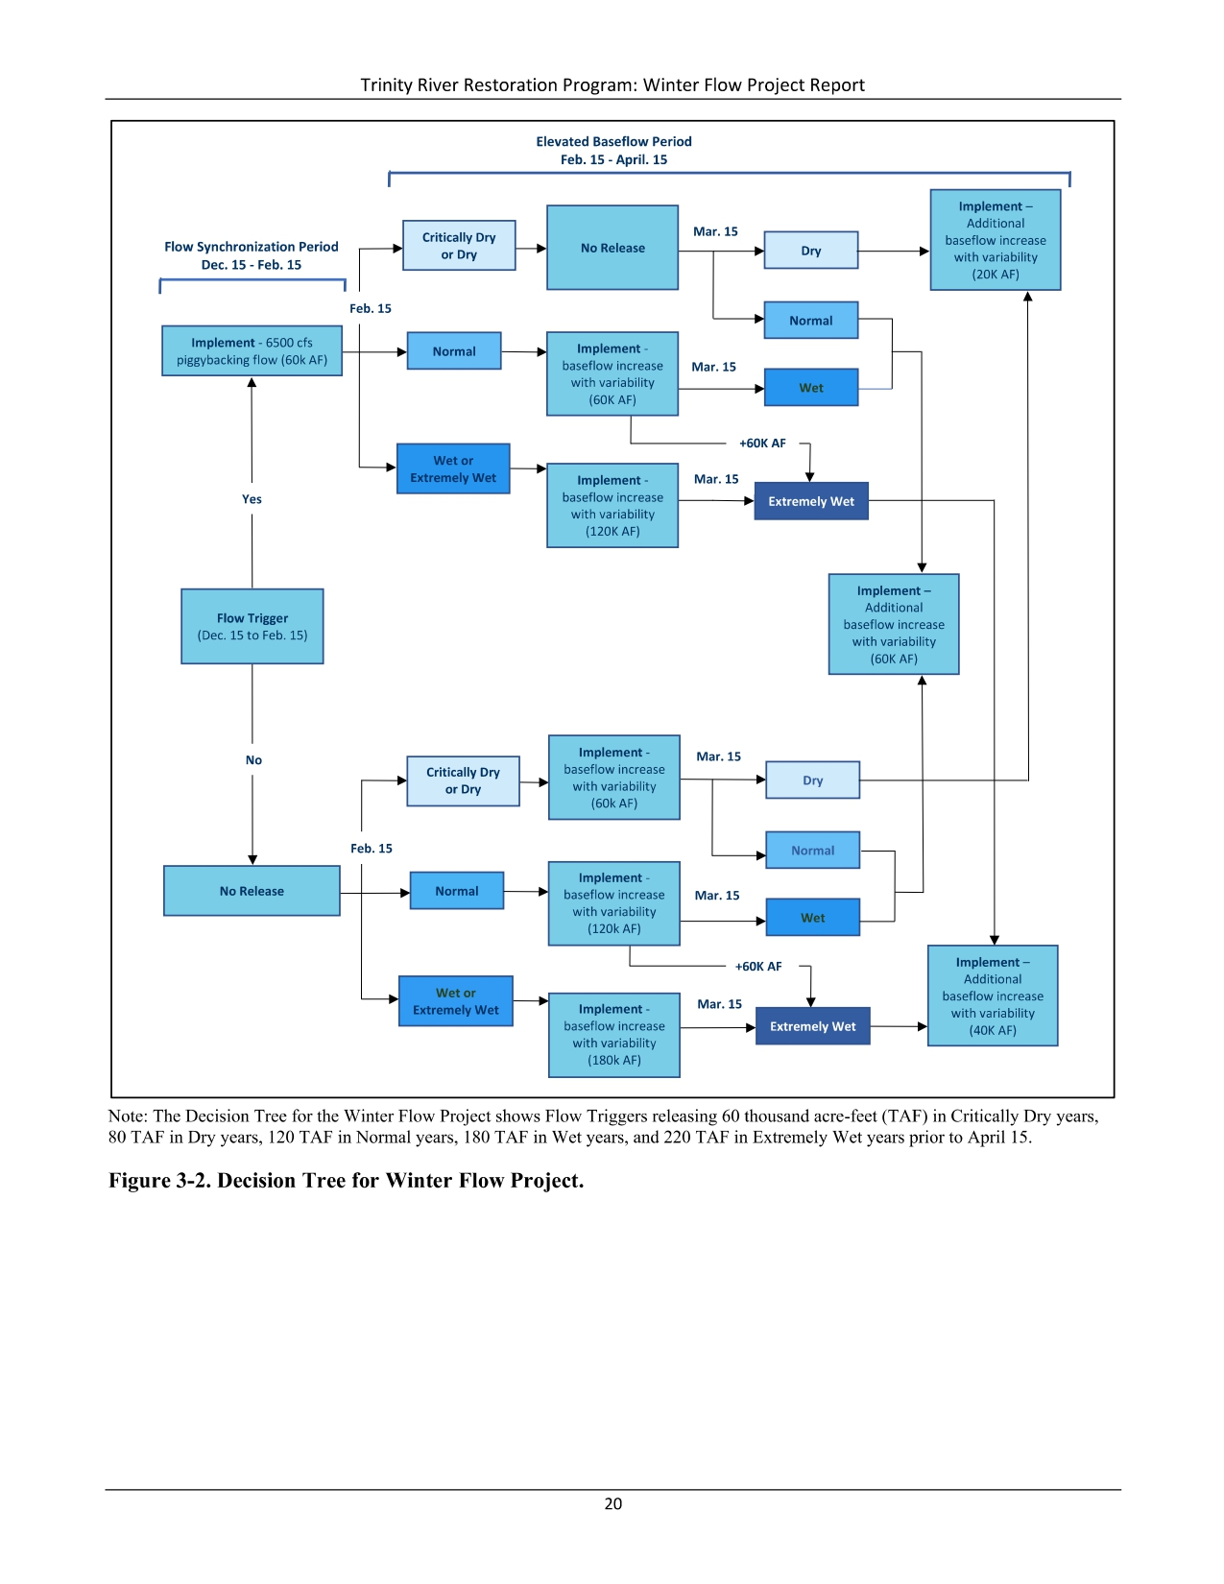
Winter Flow Ruleset

Slide 8
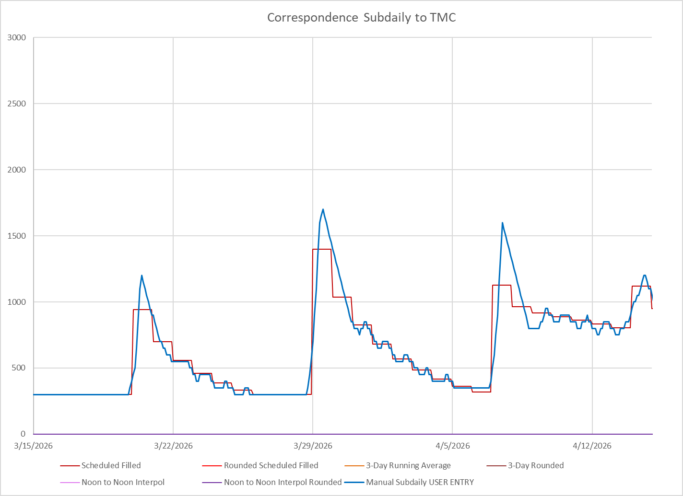
This is what 20kaf looks like…

Slide 9
Hydrograph Scenarios
Scenario | Sync | Feb B120 | Mar B120 | Apr B120 | Total released from Dec 16-Apr 15
1 | 60kaf | Dry-0kaf | Dry-20kaf | Dry | 80kaf
2 | 60kaf | Dry-0kaf | Dry-20kaf | Normal | 80kaf
Notes:
The FWG envisioned two scenarios that release 180,000 af during the period from December 15 to April 14 (the “winter period”) and one scenario which releases 120,000 af during the same period, based on the WFV ruleset. These volumes result from the implementation of the synchronization peak flow in late December (60,000 af released), the Normal February B120 90% forecast (60,000 af released from February 15 to April 14), and a Wet March B120 90% forecast (which would allocate an additional 60,000 af from March 15 to April 14). This would result in 180,000 af released above baseflow prior to April 15. A Normal March B120 90% forecast would not allocate additional water and would result in 120,000 af released above baseflow during the same period. The uncertainty surrounding the March B120 dictates the need to plan for two scenarios depending on volume released in the winter period. The FWG also planned for the chance of both a Wet and Extremely Wet water year type based on the April B120. In total, hydrographs were developed and modeled for three scenarios (Table 1).

Slide 10
Objectives for WY2026
Riparian WG
  Target 1300–2500 cfs during Cottonwood seed dispersal (late May) to support natural recruitment.
  Support for natural recession limbs over artificial benches.
  Use of the FYFAM model for amphibian flow analysis.
  Support for winter geomorphic peaks and spring flows focused on biology.
  Suggestion to revisit rounded hydrographs for spring.
Physical WG
  Geomorphic peak during spring is less important because if get a sync event
Maintain temperatures for coho/chinook to degree possible
Minimize stranding of fry and other juveniles
Generally dry years are an opportunity to focus actions on non-fish species (frogs, invertebrates)
Normal year allows for better maintenance of temps for fish

Slide 11
Developed Hydrographs

Slide 12
Set A: Dry March-Dry April
Notes:
Notice here we did not model the SOD flows: they were shorter in duration and are a given input, so theoretically they should have impacted all model runs equally and therefore are not useful to include for comparison purposes between hydrographs

Slide 13
Set A: Dry March-Normal April

Slide 14
Set B: Dry March-Dry April

Slide 15
Set B: Dry March-Normal April

Slide 16
DSS Results

Slide 17
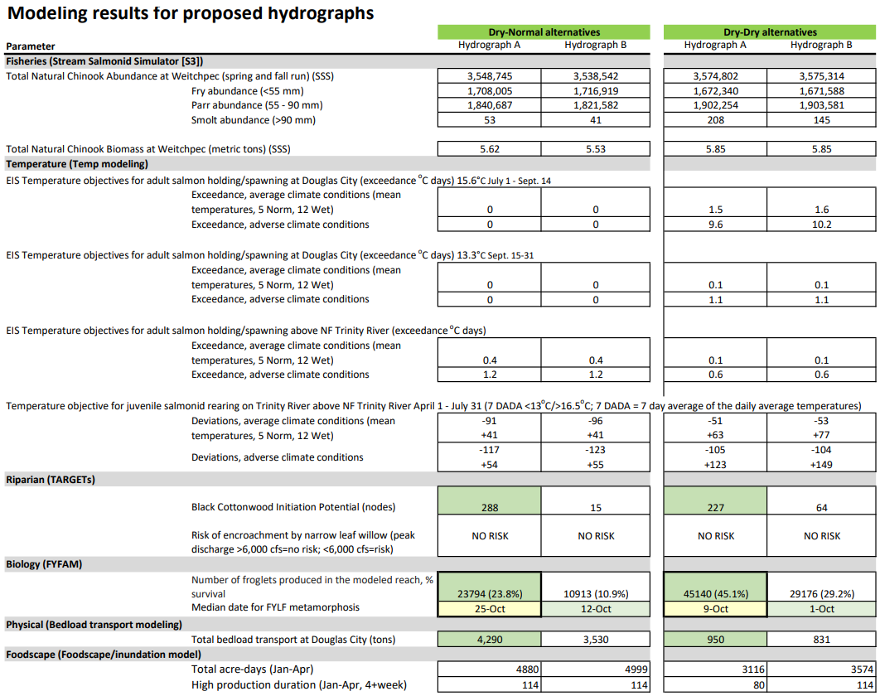

Slide 18
Modeling results for proposed hydrographs
 |  | Dry-Normal alternatives |  |  | Dry-Dry alternatives
Parameter |  | Hydrograph A | Hydrograph B |  | Hydrograph A | Hydrograph B
Fisheries (Stream Salmonid Simulator [S3])
Total Natural Chinook Abundance at Weitchpec (spring and fall run) (SSS) |  | 3,548,745 | 3,538,542 |  | 3,574,802 | 3,575,314
 | Fry abundance (<55 mm) | 1,708,005 | 1,716,919 |  | 1,672,340 | 1,671,588
 | Parr abundance (55 - 90 mm) | 1,840,687 | 1,821,582 |  | 1,902,254 | 1,903,581
 | Smolt abundance (>90 mm) | 53 | 41 |  | 208 | 145
Total Natural Chinook Biomass at Weitchpec (metric tons) (SSS) |  | 5.62 | 5.53 |  | 5.85 | 5.85
Temperature (Temp modeling)
EIS Temperature objectives for adult salmon holding/spawning at Douglas City (exceedance ºC days) 15.6°C July 1 - Sept. 14
 | Exceedance, average climate conditions (mean temperatures, 5 Norm, 12 Wet) | 0 | 0 |  | 1.5 | 1.6
 | Exceedance, adverse climate conditions | 0 | 0 |  | 9.6 | 10.2
EIS Temperature objectives for adult salmon holding/spawning at Douglas City (exceedance ºC days) 13.3°C Sept. 15-31
 | Exceedance, average climate conditions (mean temperatures, 5 Norm, 12 Wet) | 0 | 0 |  | 0.1 | 0.1
 | Exceedance, adverse climate conditions | 0 | 0 |  | 1.1 | 1.1
EIS Temperature objectives for adult salmon holding/spawning above NF Trinity River (exceedance ºC days)
 | Exceedance, average climate conditions (mean temperatures, 5 Norm, 12 Wet) | 0.4 | 0.4 |  | 0.1 | 0.1
 | Exceedance, adverse climate conditions | 1.2 | 1.2 |  | 0.6 | 0.6
Temperature objective for juvenile salmonid rearing on Trinity River above NF Trinity River April 1 - July 31 (7 DADA <13ºC/>16.5ºC; 7 DADA = 7 day average of the daily average temperatures)
 | Deviations, average climate conditions (mean temperatures, 5 Norm, 12 Wet) | -91 +41 | -96 +41 |  | -51 +63 | -53 +77
 | Deviations, adverse climate conditions | -117 +54 | -123 +55 |  | -105 +123 | -104 +149
Riparian (TARGETs)
 | Black Cottonwood Initiation Potential (nodes) | 288 | 15 |  | 227 | 64
 | Risk of encroachment by narrow leaf willow (peak discharge >6,000 cfs=no risk; <6,000 cfs=risk) | NO RISK | NO RISK |  | NO RISK | NO RISK
Biology (FYFAM)
 | Number of froglets produced in the modeled reach, % survival | 23794 (23.8%) | 10913 (10.9%) |  | 45140 (45.1%) | 29176 (29.2%)
 | Median date for FYLF metamorphosis | 25-Oct | 12-Oct |  | 9-Oct | 1-Oct
Physical (Bedload transport modeling)
 | Total bedload transport at Douglas City (tons) | 4,290 | 3,530 |  | 950 | 831
Foodscape (Foodscape/inundation model)
 | Total acre-days (Jan-Apr) | 4880 | 4999 |  | 3116 | 3574
 | High production duration (Jan-Apr, 4+week) | 114 | 114 |  | 80 | 114
Administrative
 | Construction Impacts (Days ≥1000 cfs; July 15 to Sept 15) | ok | ok |  | ok | ok

Slide 19
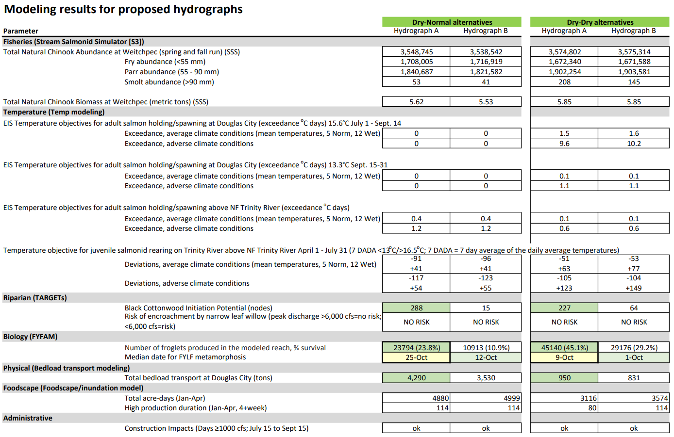

Slide 20
Flow Workgroup WY2026 Spring Flow Recommendation:
Based on DSS results, workgroup recommends Set A for implementation in WY2026.
One hydrograph would be implemented for each scenario that could occur depending the April B120 forecast (shown previously).

Slide 21

Recap and Questions
Thanks to hydrograph developers and modelers!
Flow Planning Process
  B120 forecasts
Hydrograph Scenarios
WY2026 objectives
Developed Hydrographs
DSS Results
Selected Hydrographs
Recommendation from Flow WG/IDT to TMC
Questions?
Notes:
Recap:
Talked about how we got here
Talked about the planning process and meetings we had
Worked through DSS results
Made a recommendation
Questions?

