Slide 1
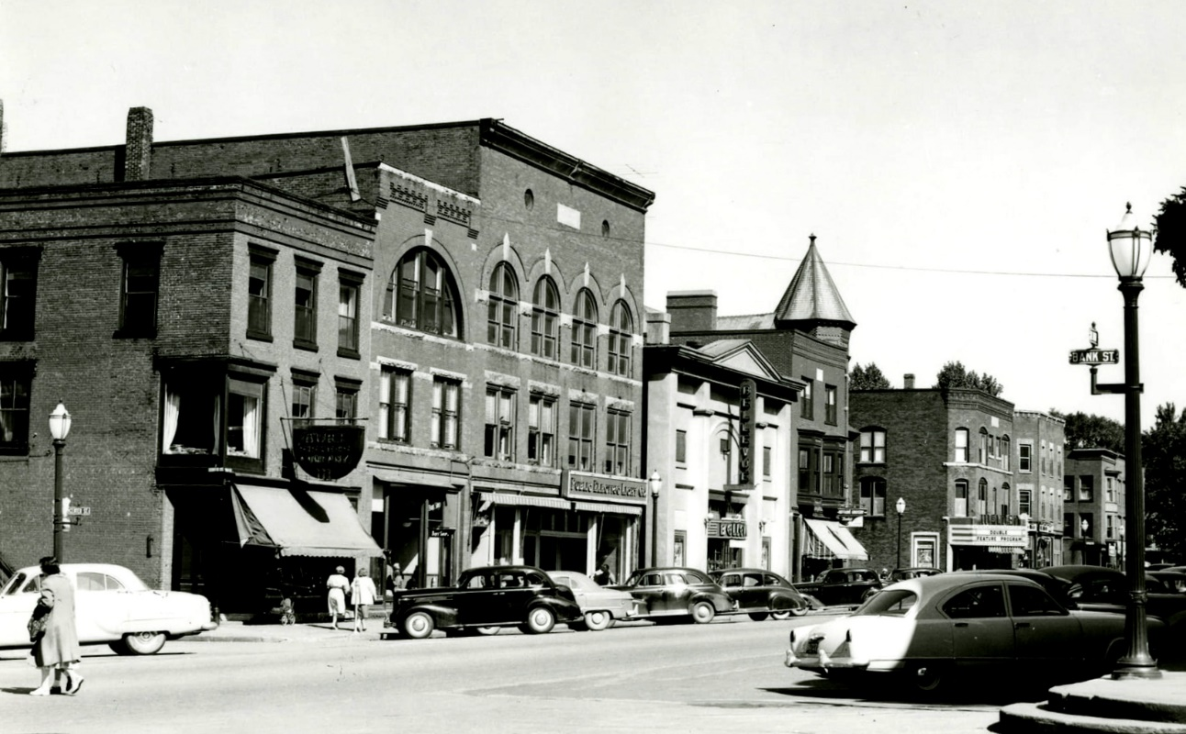
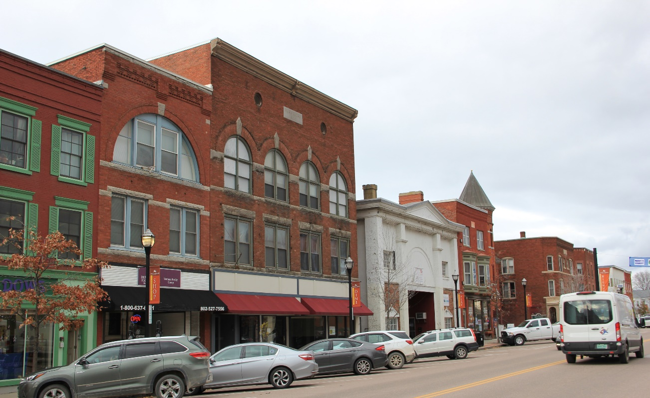
St. Albans Historic District Update
March 5, 2022
Lyssa Papazian, Historic Preservation Consultant, 13 Dusty Ridge Rd., Putney, VT

Slide 2
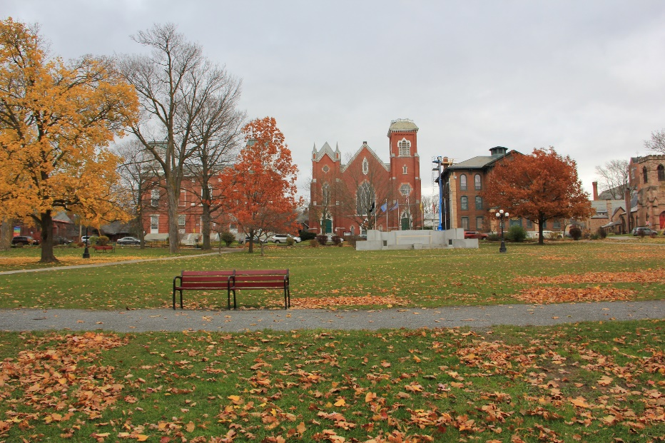
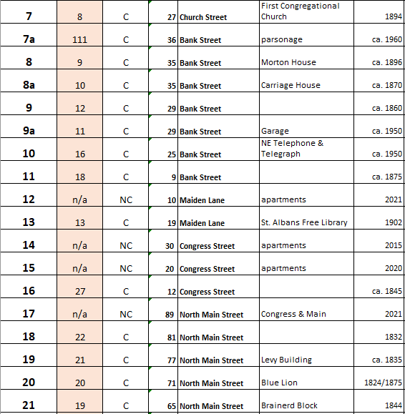
Scope of Update Project
Set of Individual Survey Forms for 112 Resources
  Each form may range from 4 to 12 pages
New Map & Numbering
Spreadsheet List of New Numbers - referencing old number, street address, name, and date
Draft Statement of Significance
Still to be done:
Prepare Updated National Register Nomination form using all the above materials
Submit updated nomination to state and federal agencies for listing

Slide 3
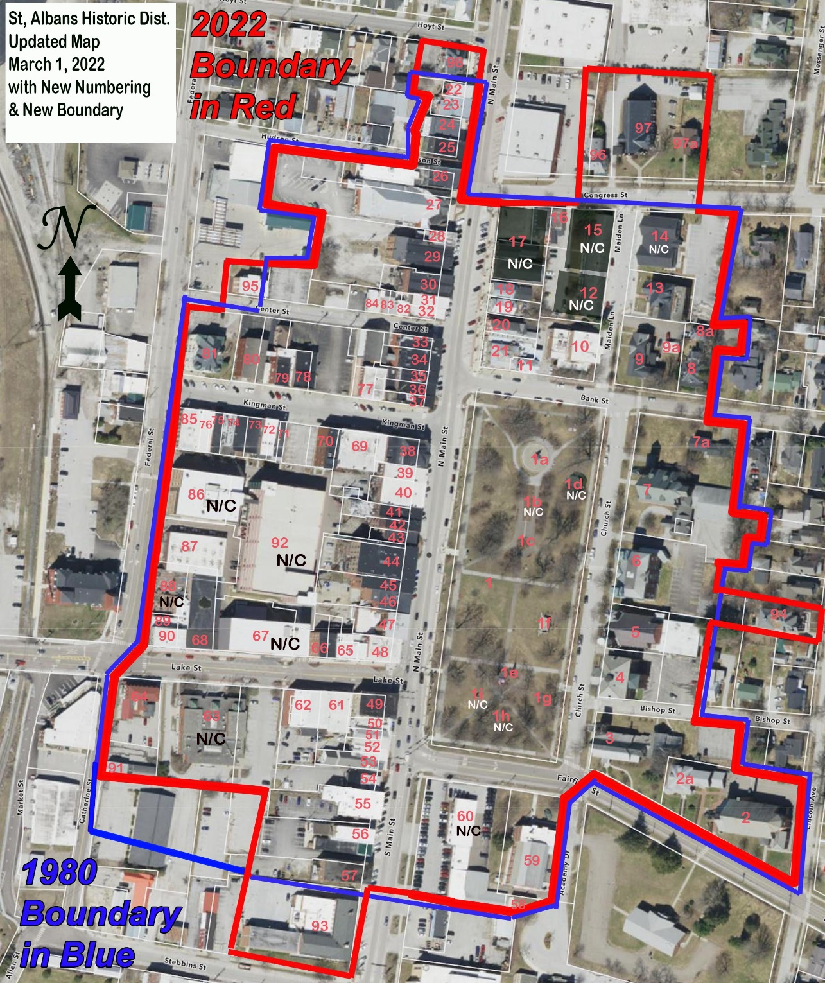
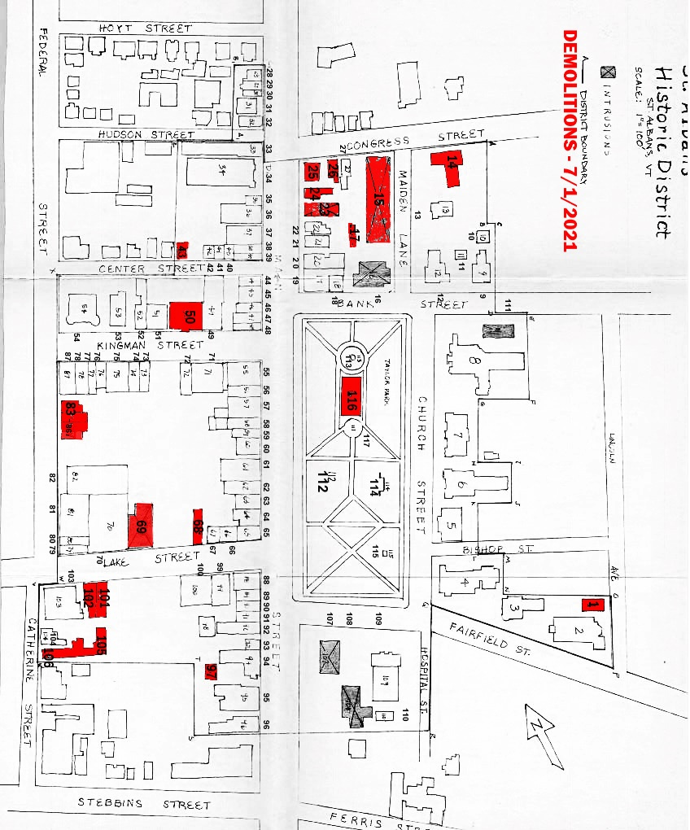
New Map
Review 1980 Map
Re-numbered
Added New Buildings & Objects
Deleted demolished buildings
Expansion:
HD 93 - 50 South Main (USPS)
HD 94 - 30 Lincoln Avenue (Jail)
HD 95 - 37 Center Street 132
HD 96 - 17 Congress
HD 97 - 29 Congress (1st Baptist Ch.)
HD 97a - 31 Congress (Baptist Pars.)
HD 98 - North Main

Slide 4
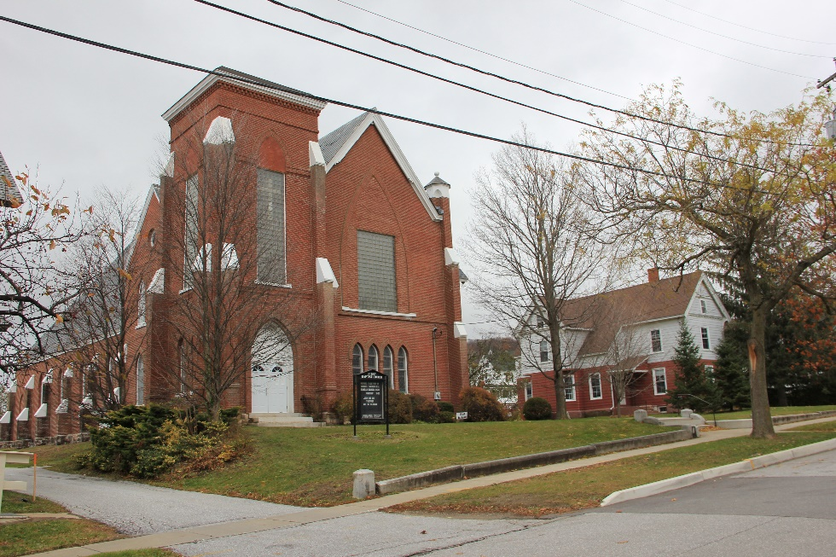
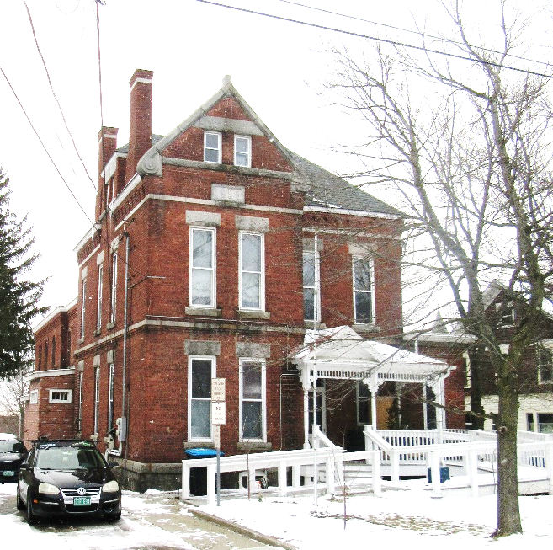
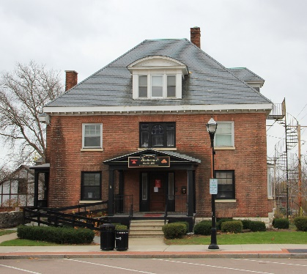
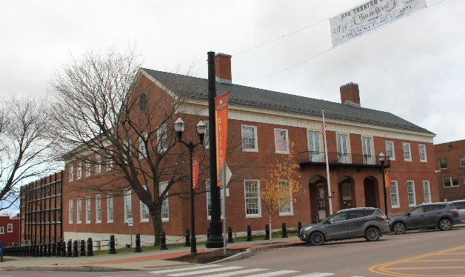
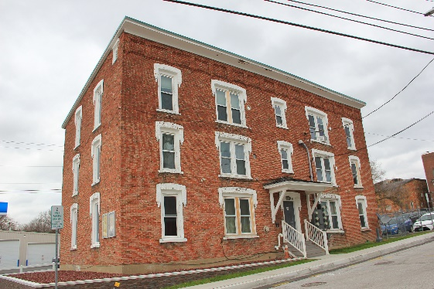
Boundaries
    Expansion
      Viewshed of Taylor Park and more complete representation of set of churches in downtown - 1st Baptist Church
      Complete block of North Main to Hoyt (commercial use)
      Complete Center Street
      Complete block of South Main to Stebbins with USPS
      Add adjacent Jail as important to Courthouse history

Slide 5
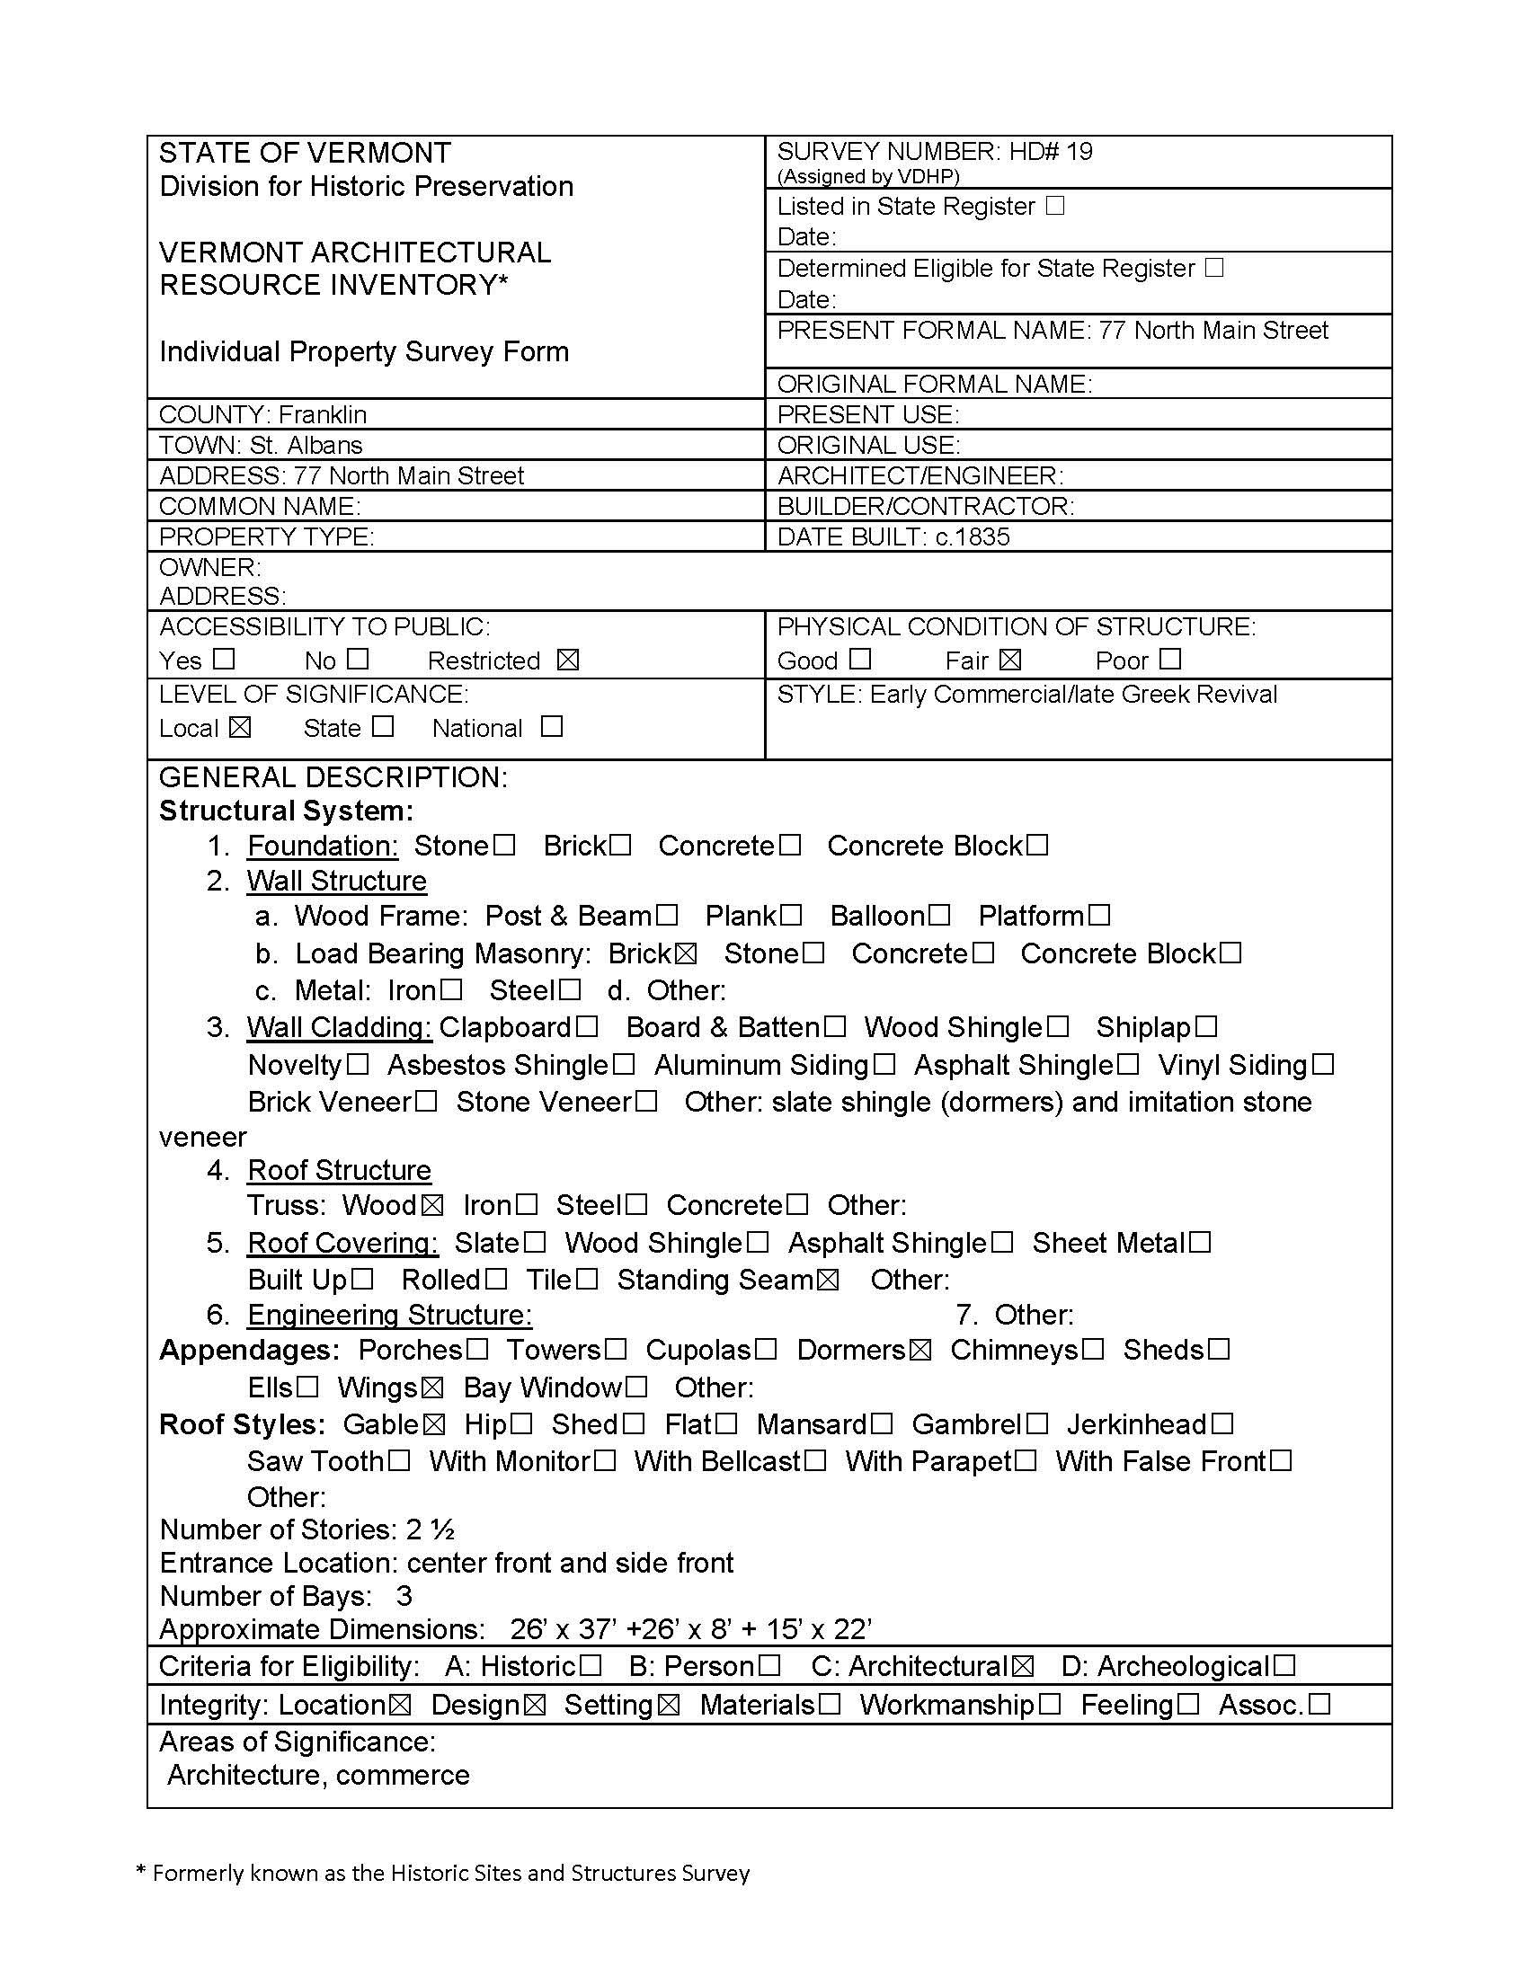
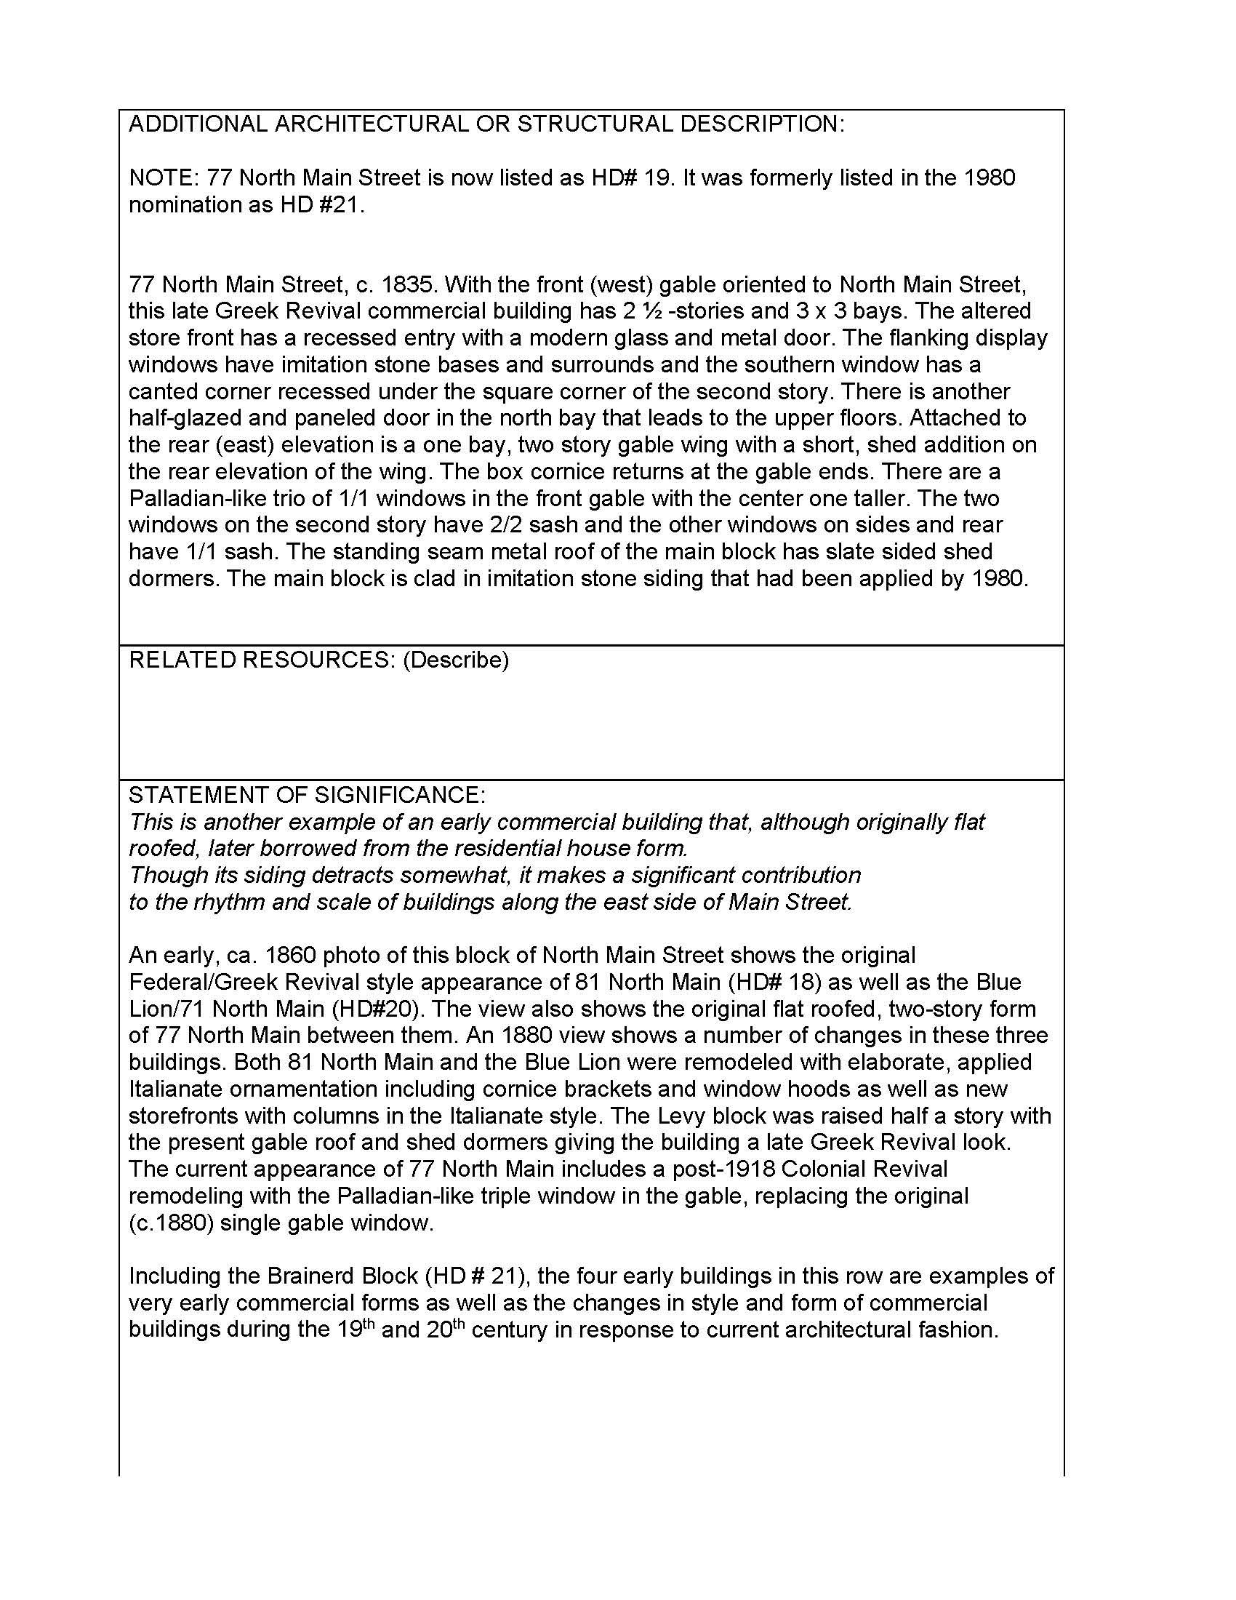
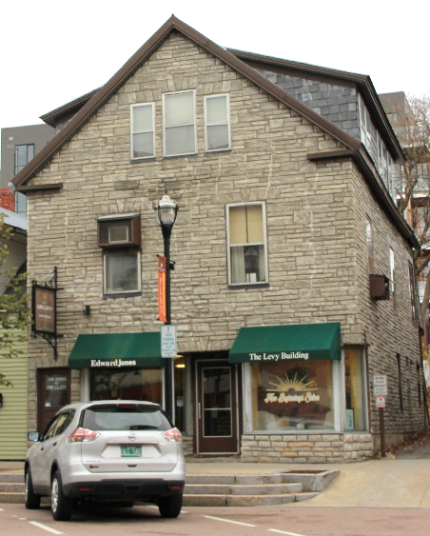
Example of a Survey Form

Slide 6
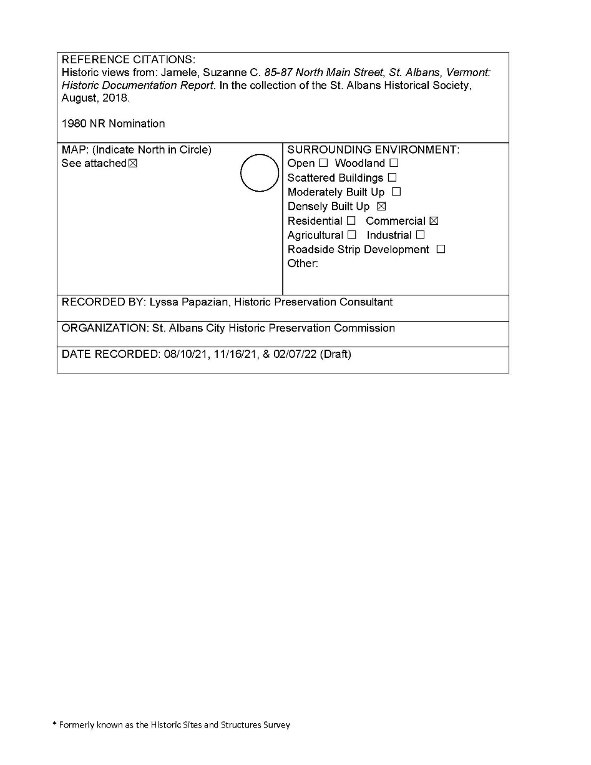
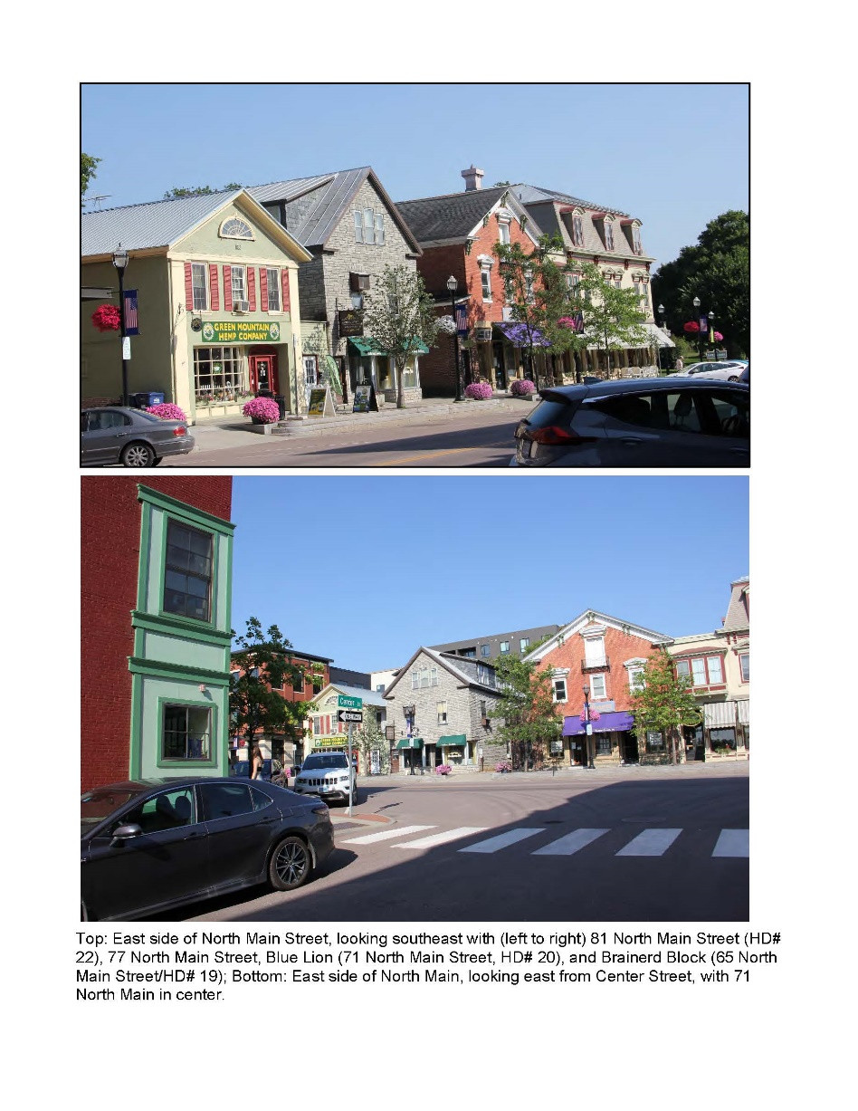
Example of a Survey Form

Slide 7
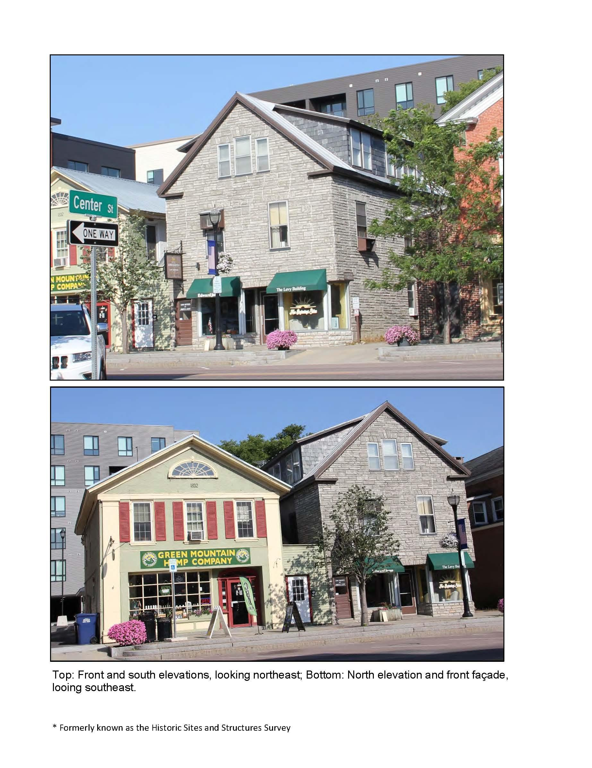
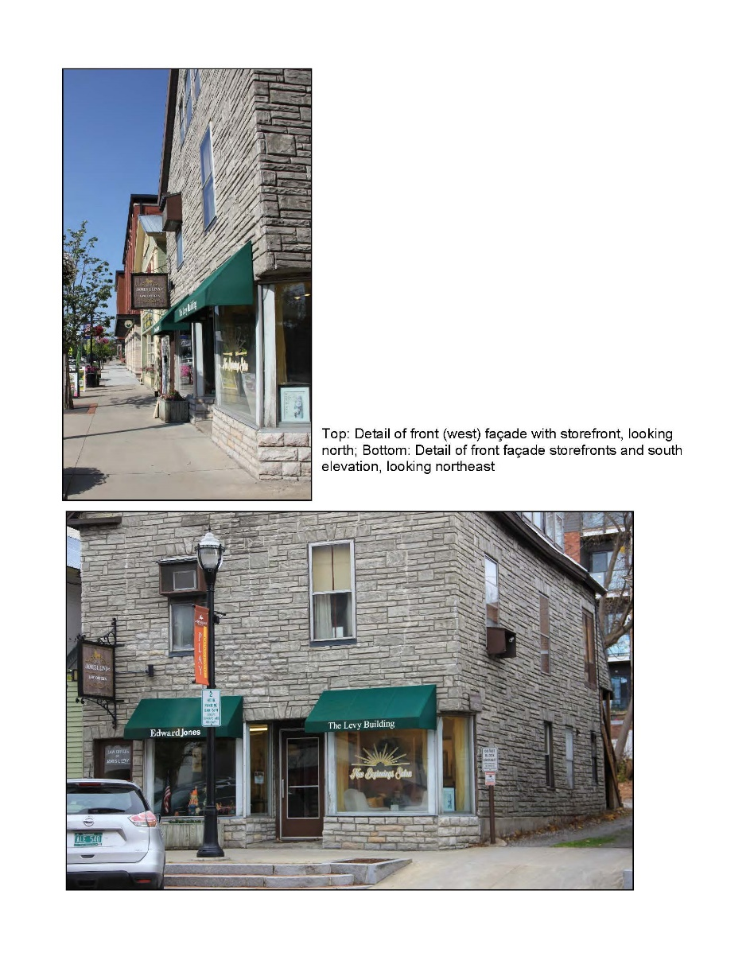
Example of a Survey Form

Slide 8
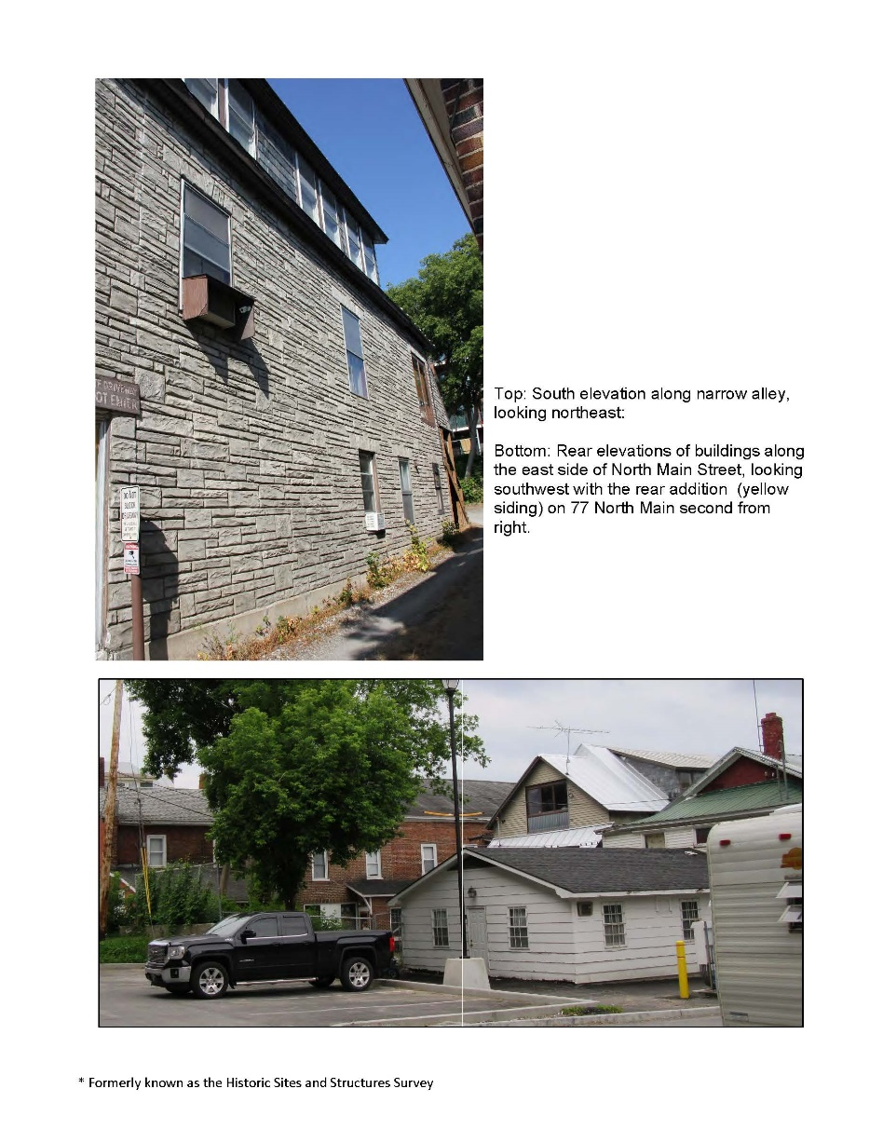
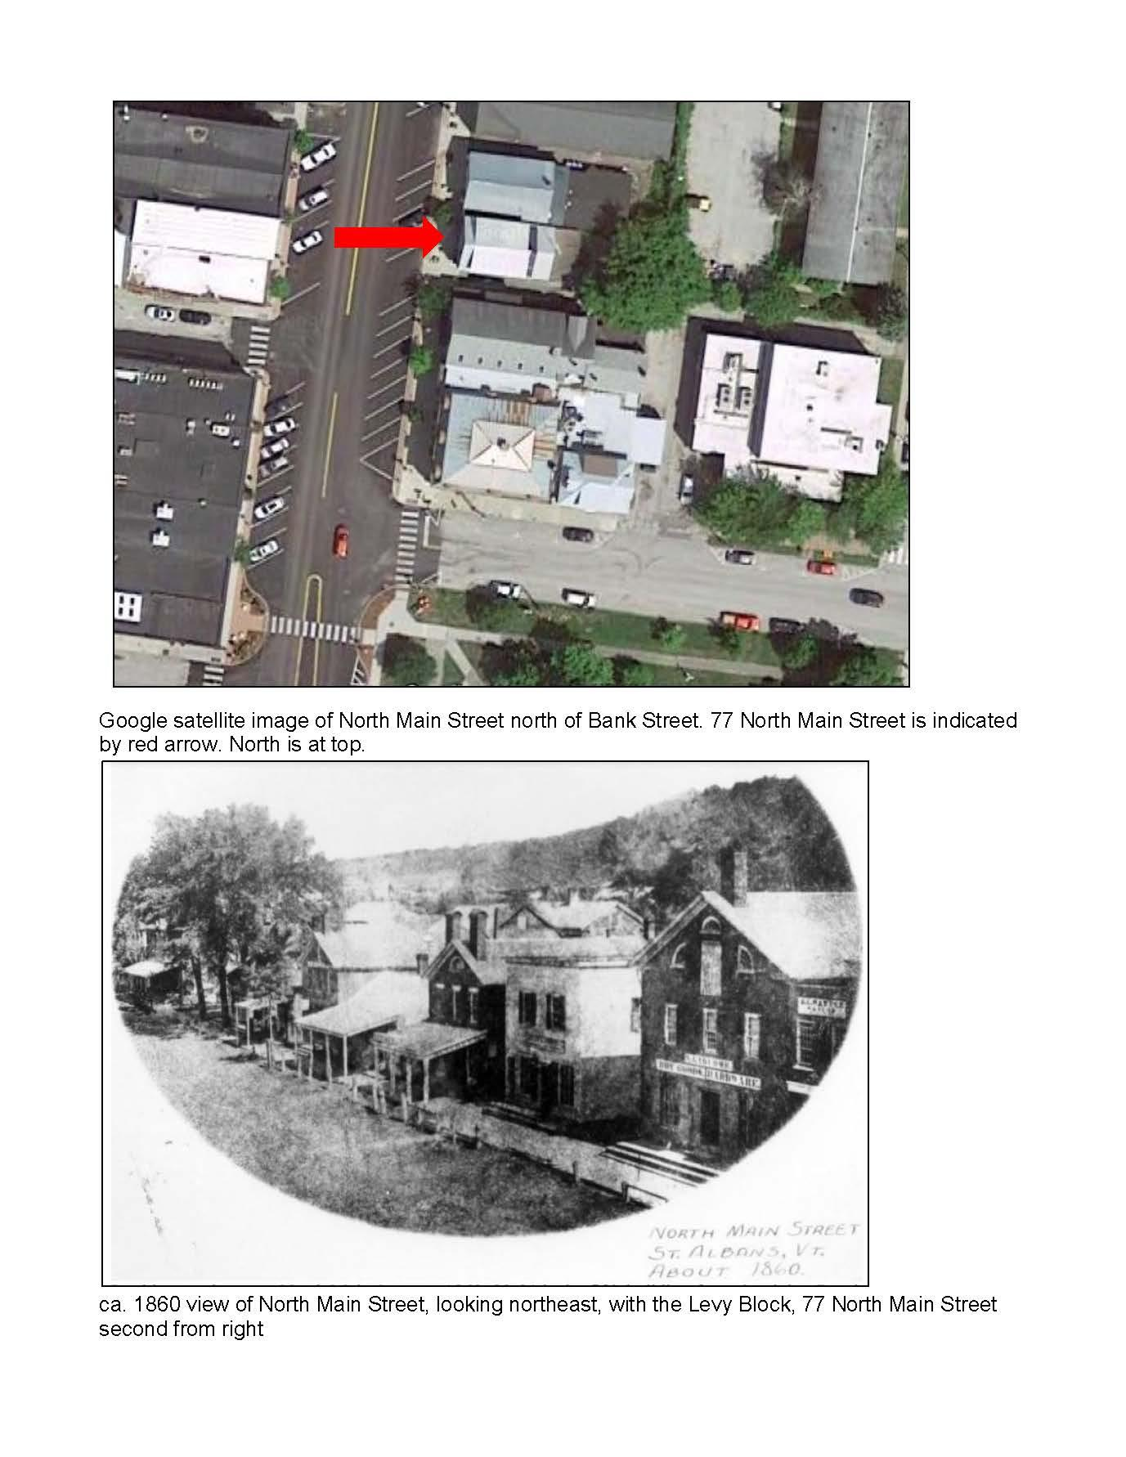
Example of a Survey Form

Slide 9
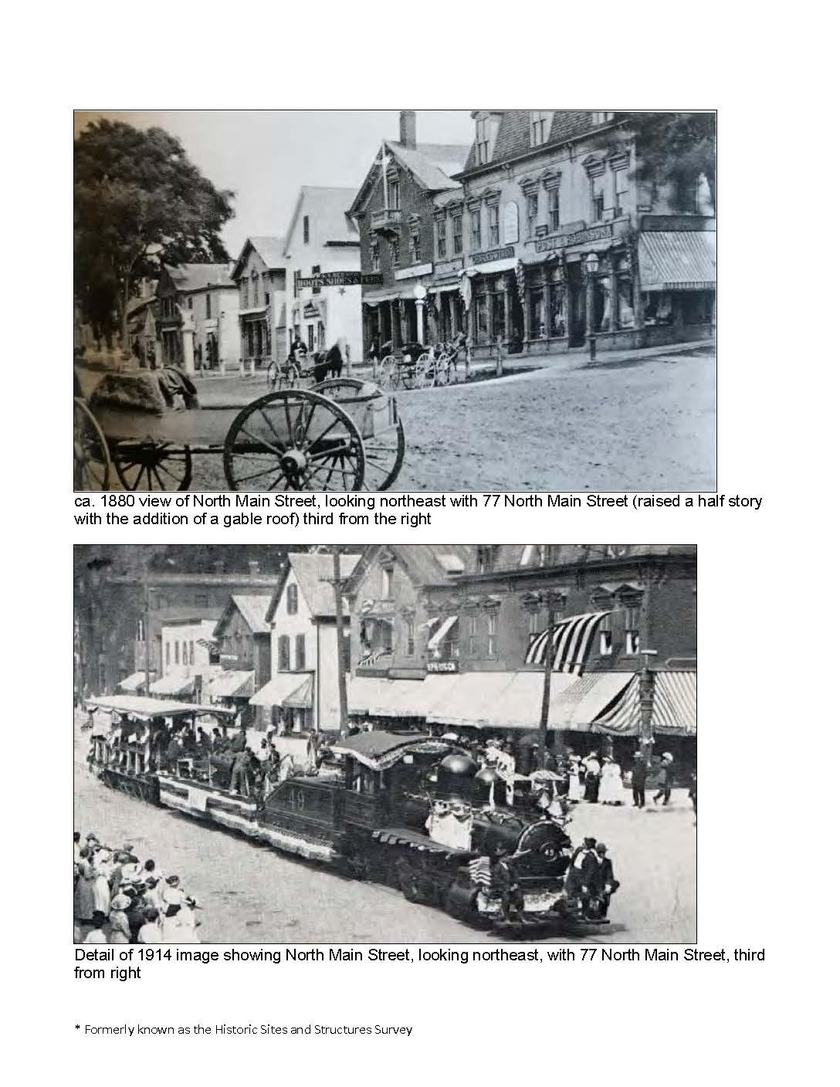
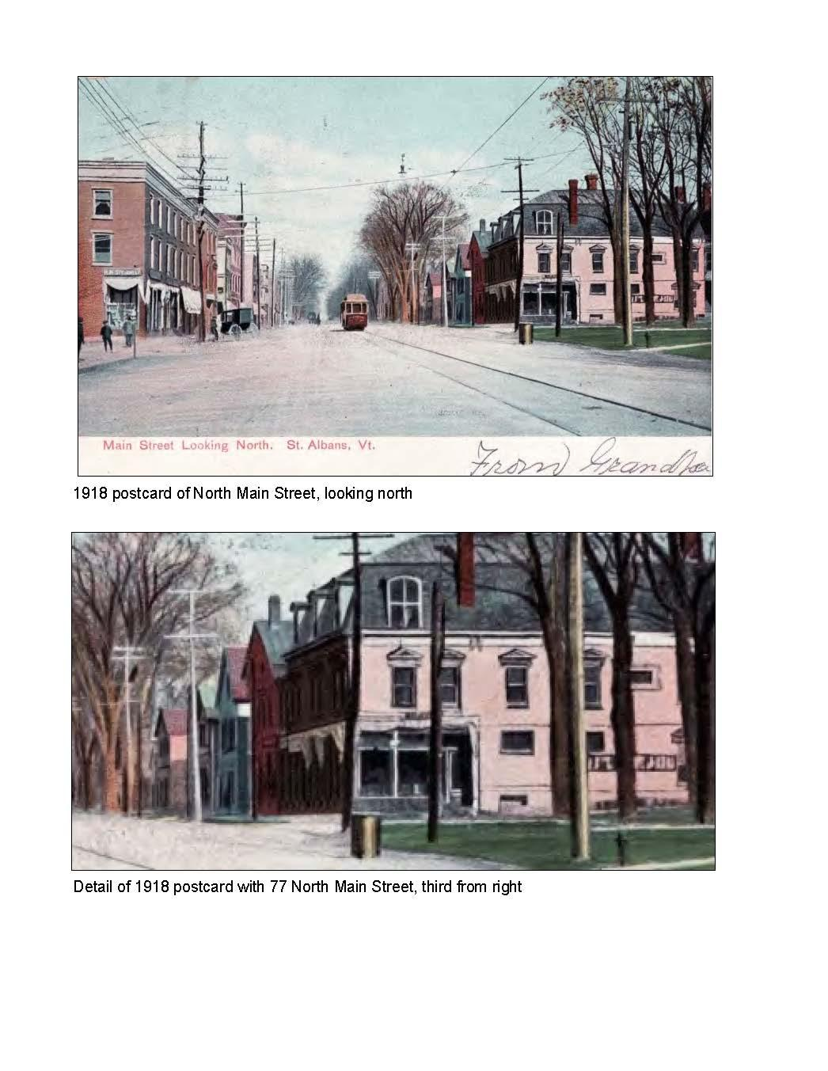
Example of a Survey Form

Slide 10
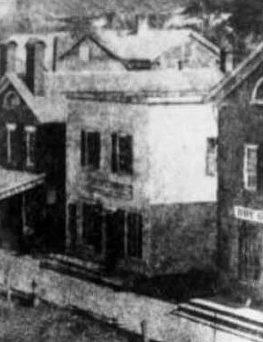
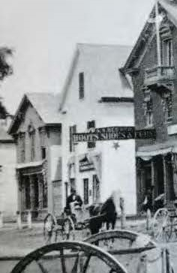
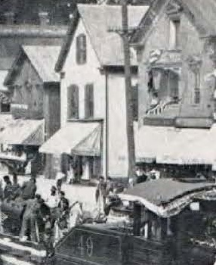
Detail of Photo Evidence of Chronology
ca. 1860 1880s 1914 2021

Slide 11
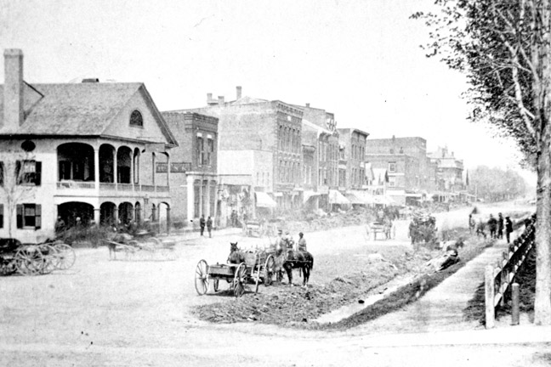
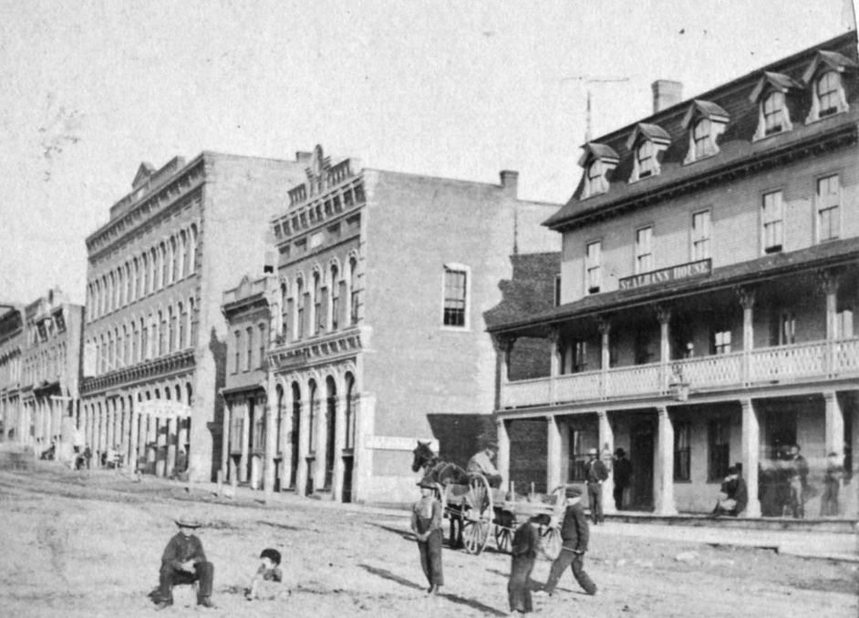
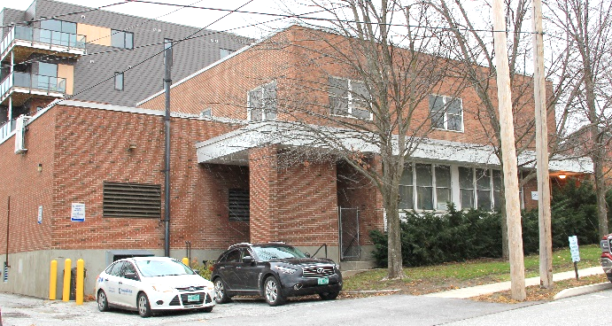
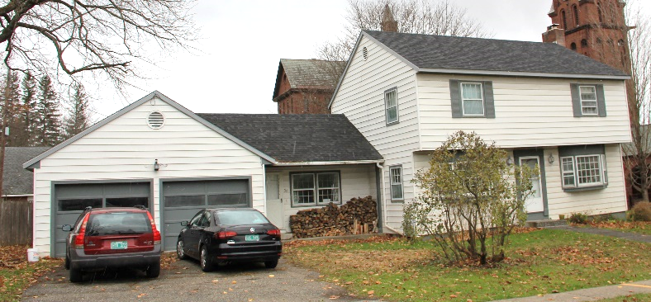
Statement of Significance
Summary Paragraph
  Period of Significance (1792/Taylor Park -c.1960)
  Areas of Significance: Criteria A & C
Introduction: Why period and Areas of Significance Chosen
Criterion A
  Commerce/Hospitality; Industry; & Transportation
  Social History/Entertainment
  Politics/Government
  Religion
  Criterion C
    Architecture

Slide 12
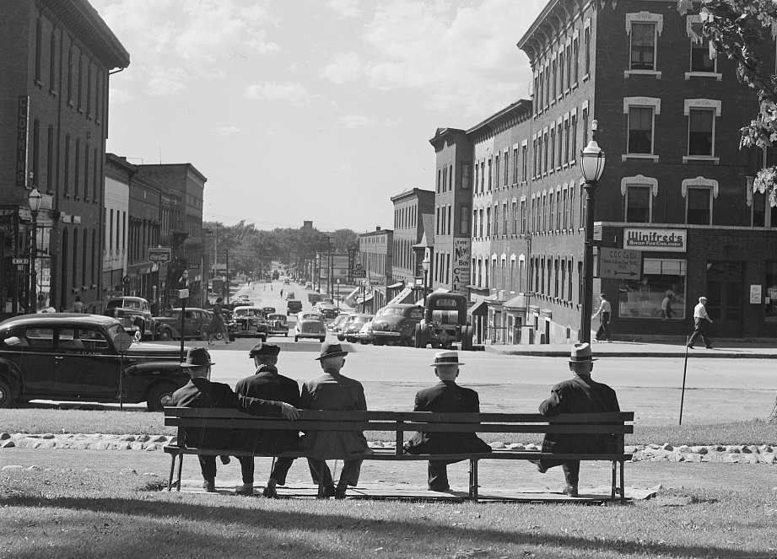
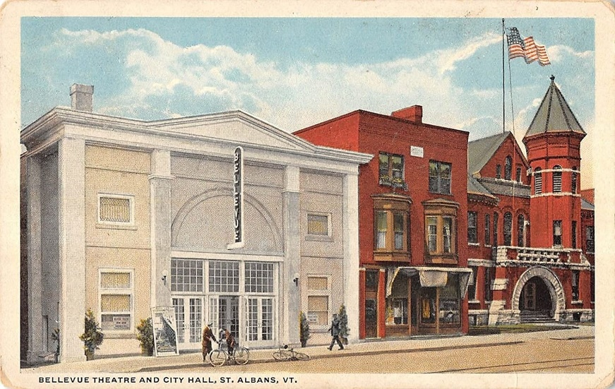
Statement of Significance: Criterion A
Commerce/Hospitality
Social History & Entertainment
  Listed hotels and inns
  Listed theaters & noted them as new property type in early 20th c.

Slide 13
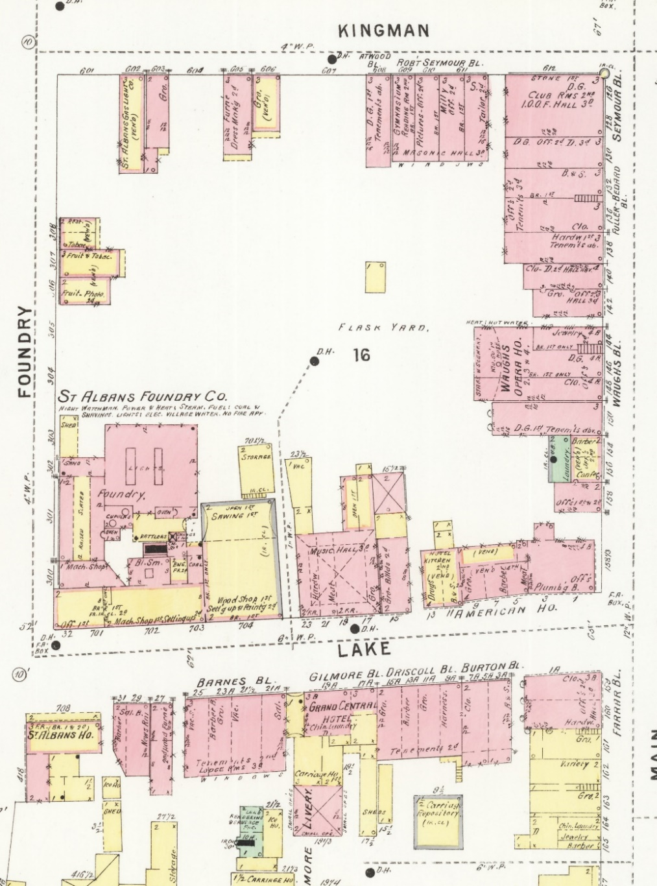
Statement of Significance Criterion A
Expanded on Areas of Significance with Social History & Entertainment
  Included discussion of the many halls on the top floors of commercial blocks and the groups that met (I.O.O.F., Masons, etc.)
  Also skating, billiard halls and bowling
Halls starred
1896

Slide 14
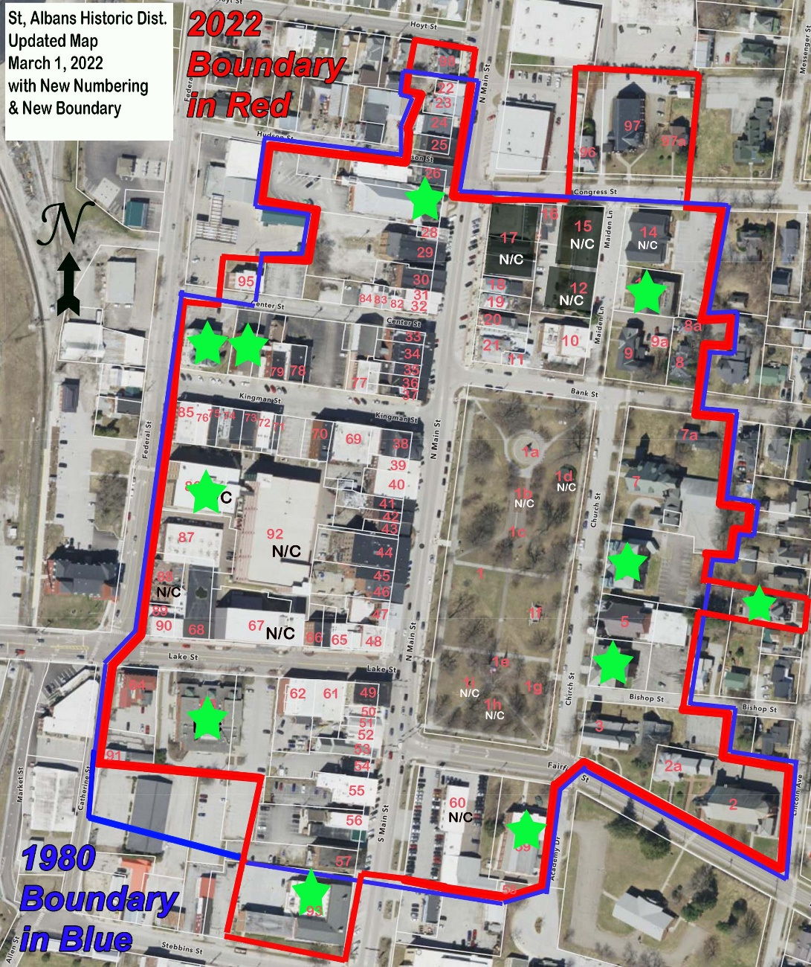
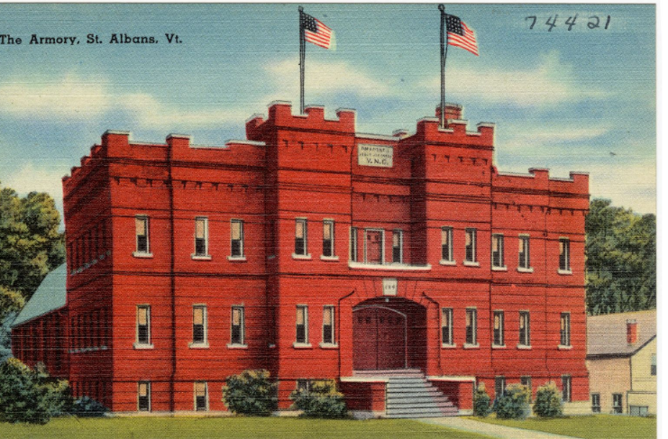
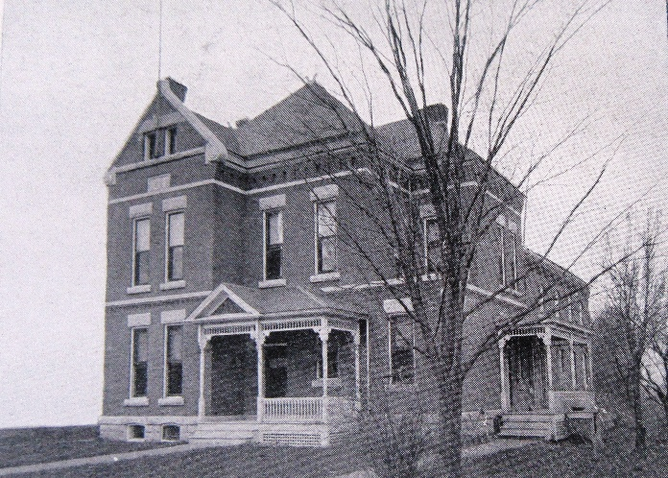
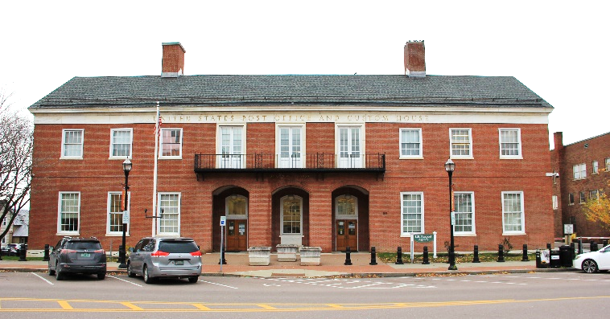
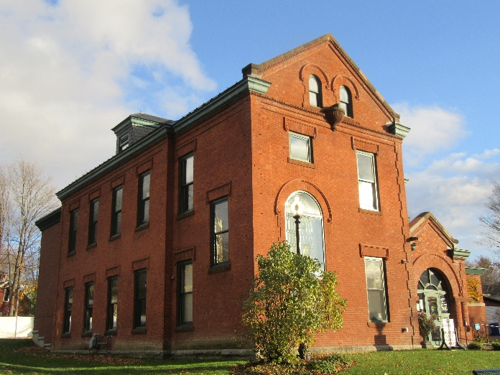
Politics/Government: Civic Buildings

Slide 15
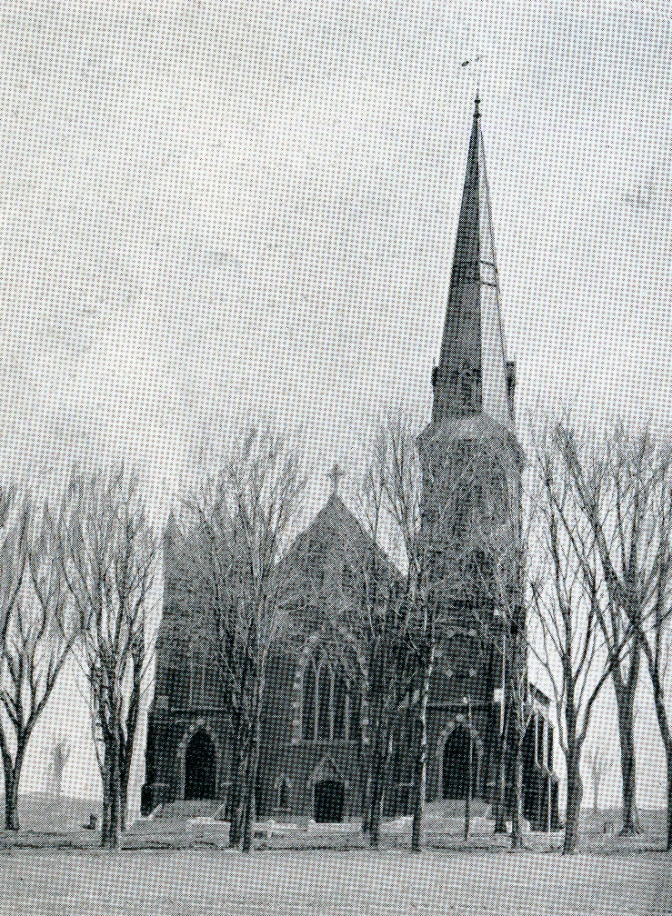
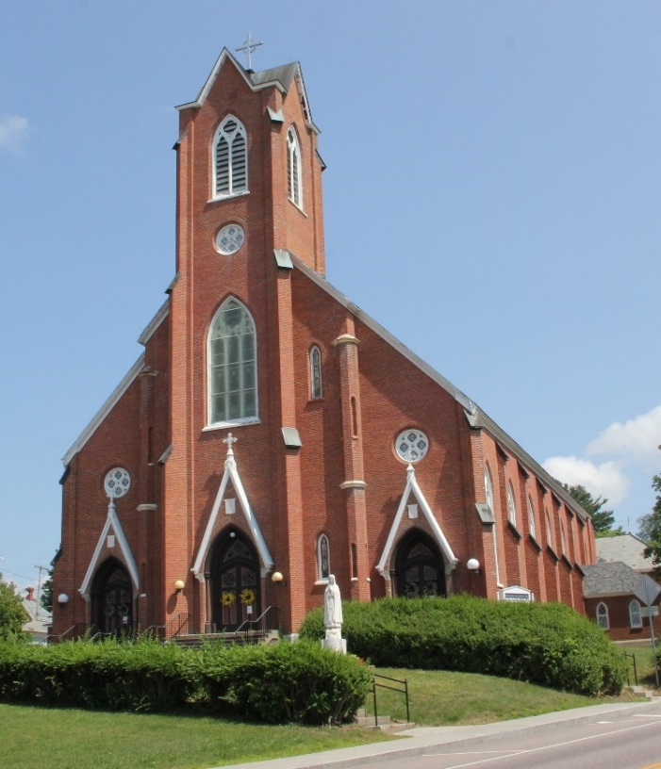
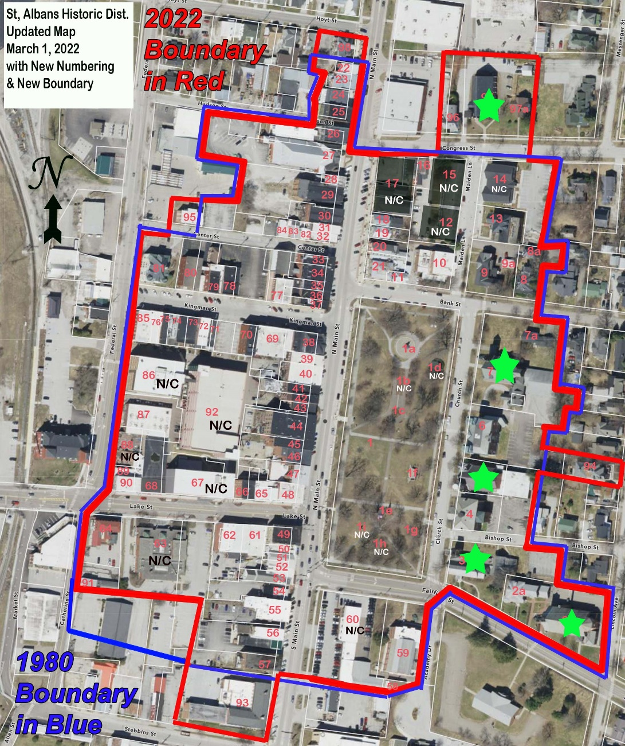
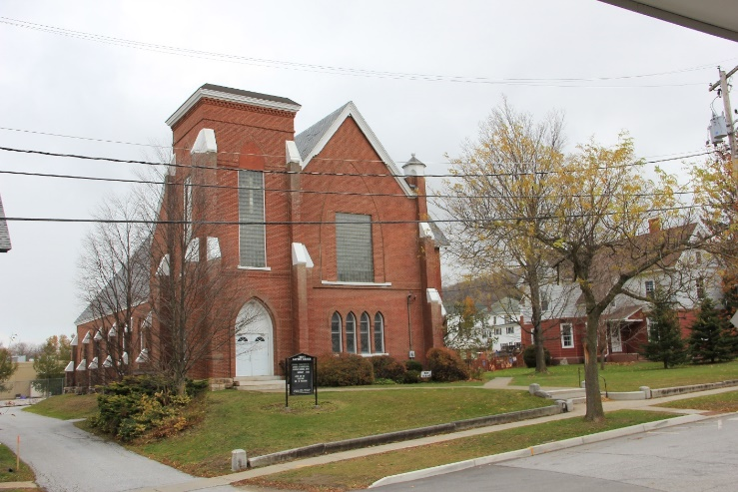
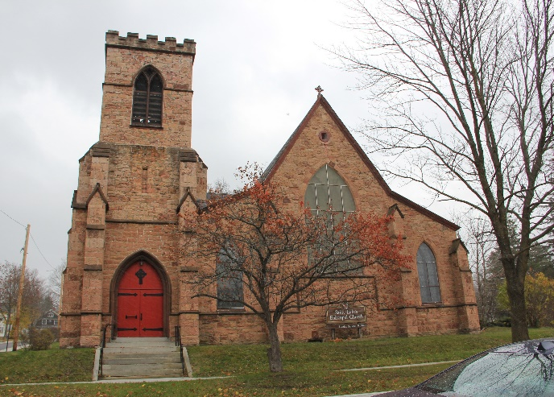
Religion

Slide 16
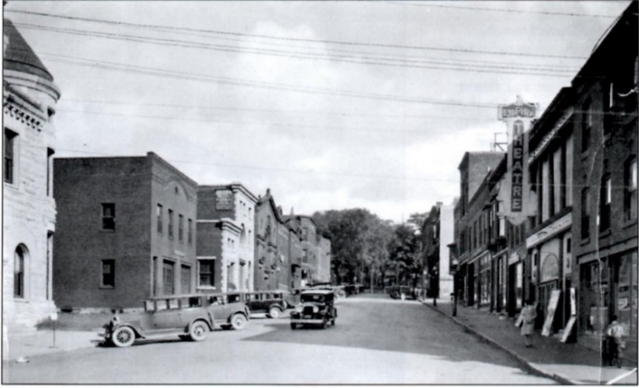
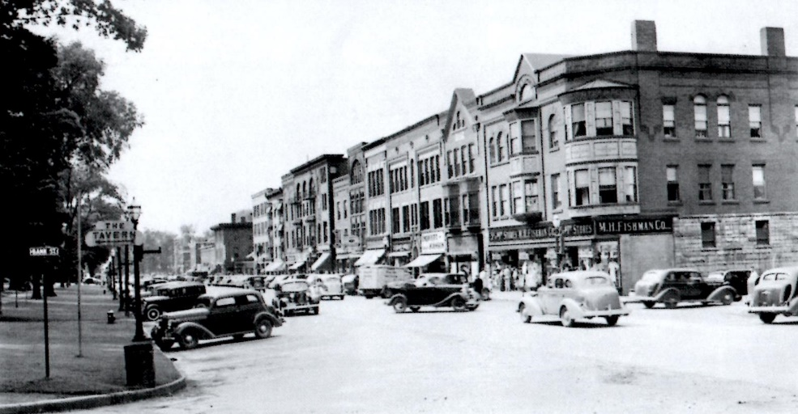
Criterion C: Architectural Significance
The variety of buildings in the district with their layers of renovations tells the story of St. Albans remarkably well.
Continued prosperity to mid-20th century evident in buildings and storefront changes from the period.
The many different components are linked through the urban density, common materials and details, and the common setbacks of both its commercial and institutional buildings.
New construction on Lake, Federal, and North Main Streets, has maintained or restored the urban style of streetscape with little or no setback from the sidewalk. The use of brick, regular fenestration, and traditional forms - even with a modern interpretation - make the new buildings compatible with the historic district.
The district has 14 non-contributing resources out of a total of 112.

Slide 17
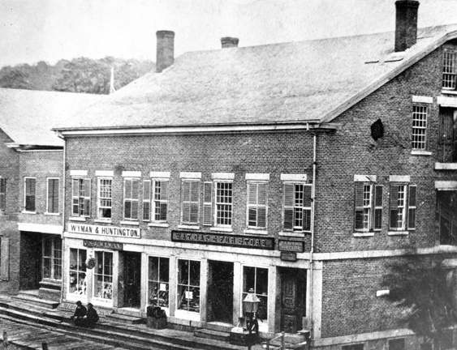
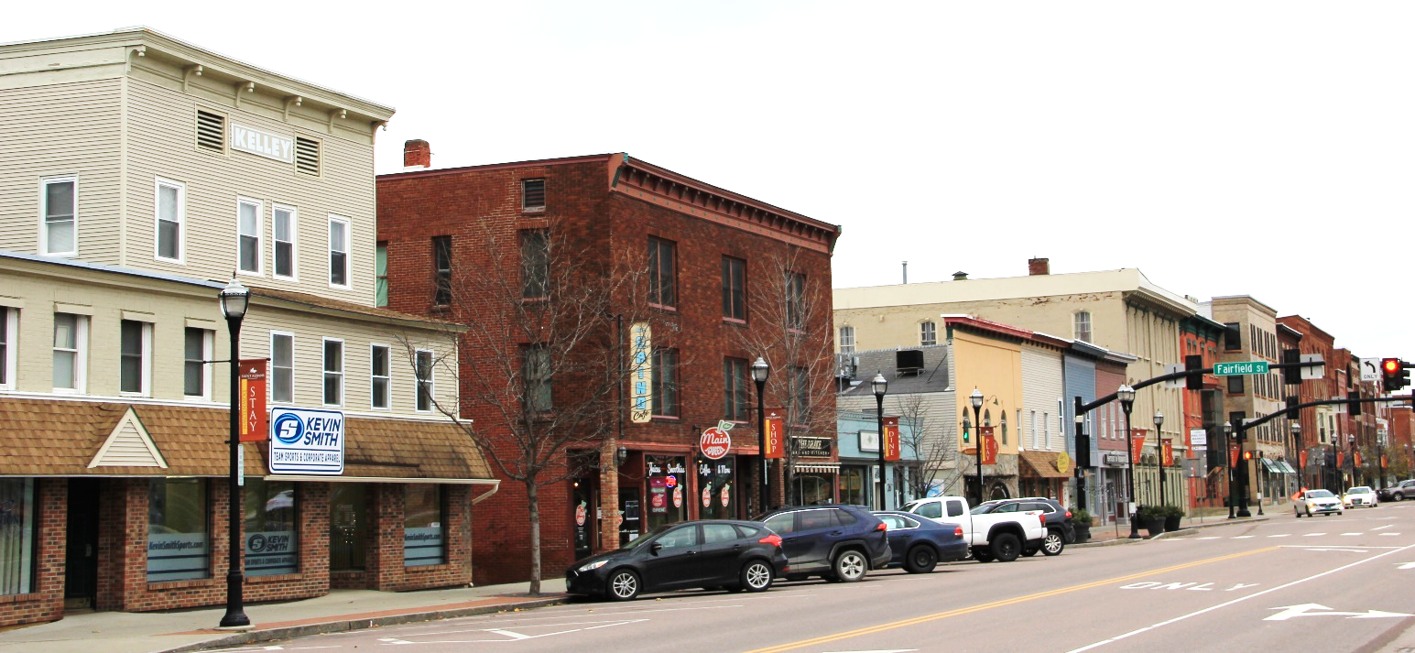
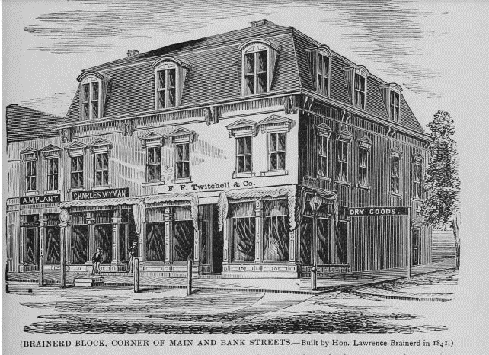
Criterion C
    Architecture: 3 Periods
        1st 1792-1850: Greek Revival, Gothic Revival
        2nd 1850 – 1895: Italianate, Queen Anne
        3rd 1895 – c. 1960: Romanesque Revival, Colonial Revival
    Landscape Architecture: Taylor Park
    Architects: Cass & Lewis, Hart, Keely, Ryer, Silloway, Wilcox. Williams & Johnston, etc.

Slide 18
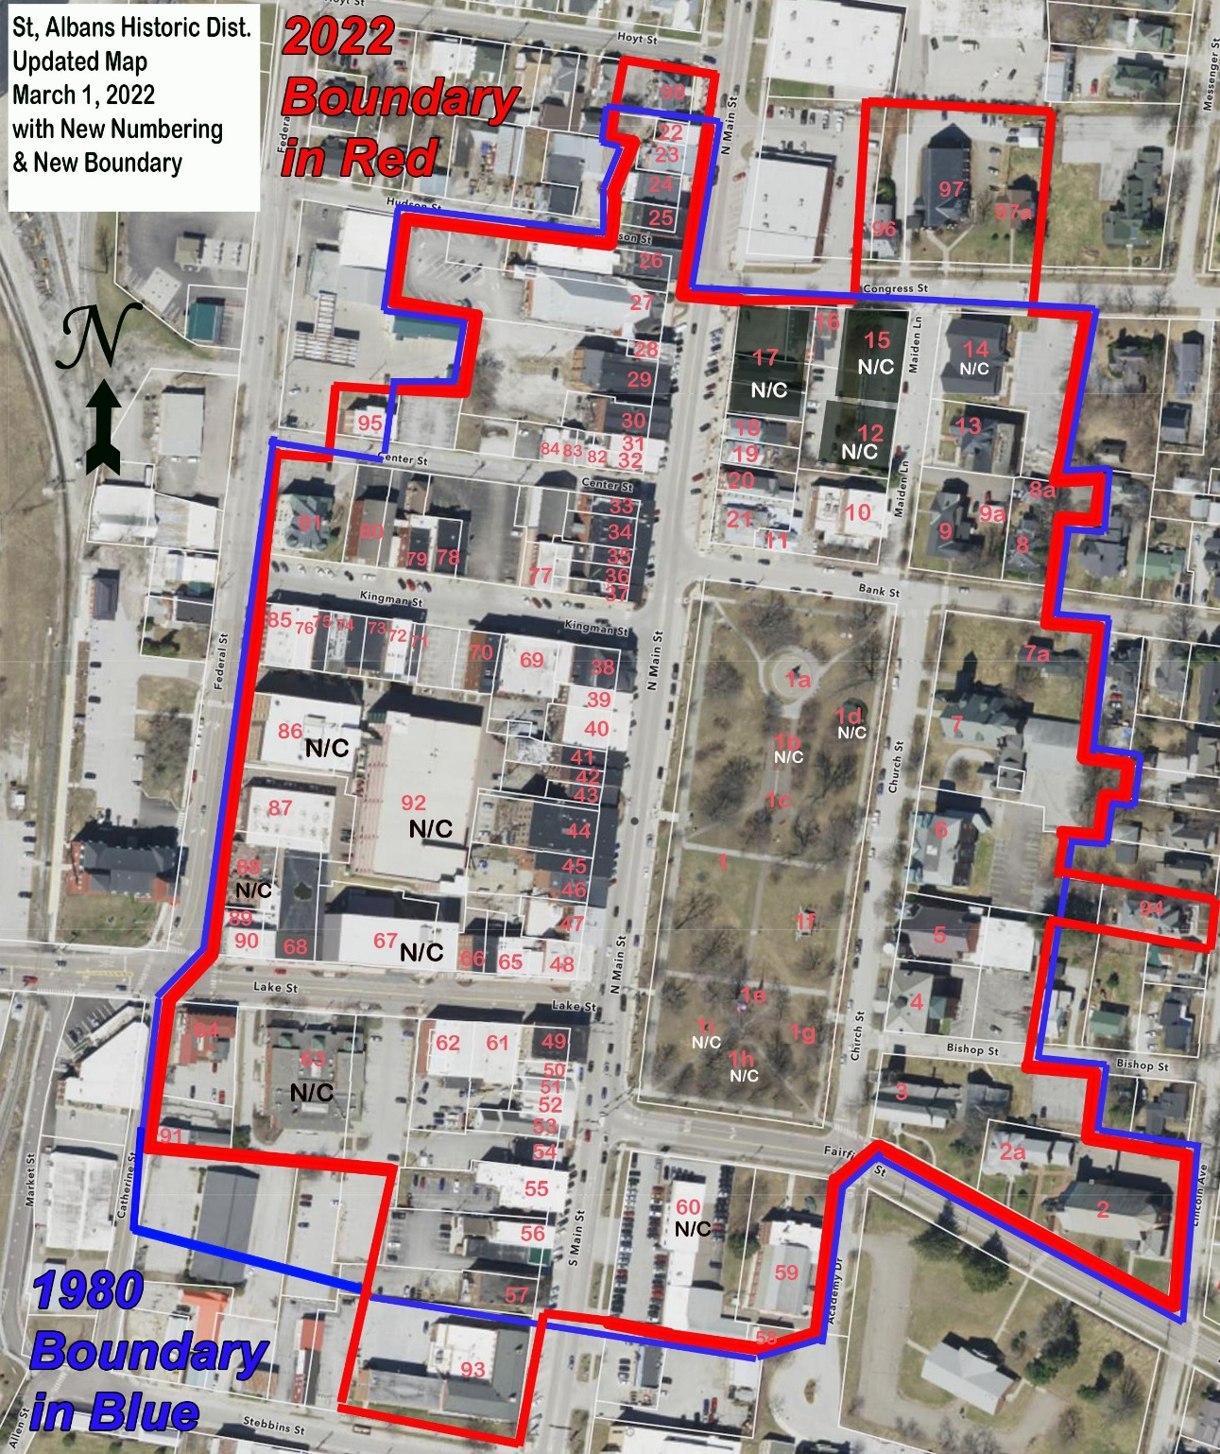
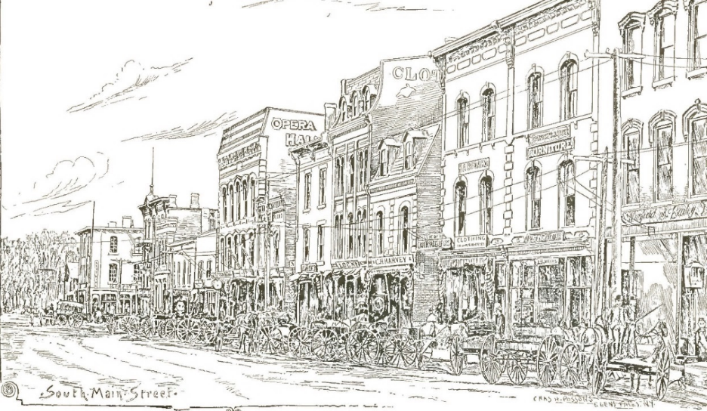
Criterion C: Architectural Variety
1st Generation (red)
Early 2nd Generation (blue)
Later 2nd Generation (yellow)
3rd Generation (green)

Slide 19
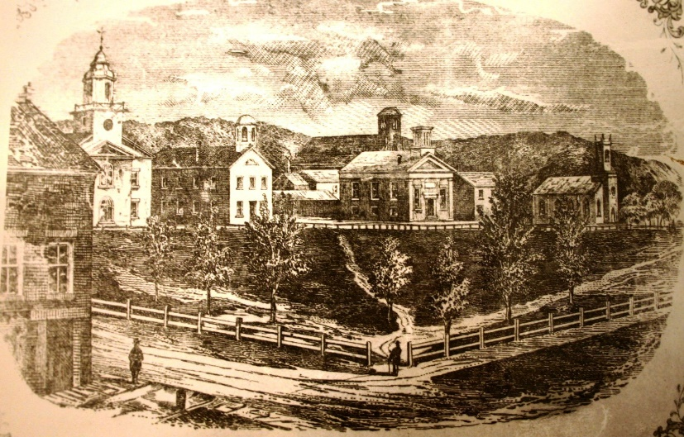




Criterion C: Landscape Architecture: Taylor Park
  Evolution from Town Common in 1792 to Late 19th c. Urban Park.
  Main periods represented:
    Named “Taylor Park” in 1870: romantic “Landscape Garden” style
    1887: Philanthropic investment by Gov. J. Gregory Smith (Maiden Fountain, etc) & landscaping by Ladies Village Improvement Soc.: more formal Classical Revival style
    1910s – 1940s: memorial use

Slide 20






Criterion C: Outstanding Architecture

Slide 21



Criterion C
  Expanded history with further analysis by comparing historic maps and photos to identify buildings representing all periods

Slide 22



Criterion C:
Using historic photos to understand change in one of Main Street’s oldest extant blocks.

Slide 23


Criterion C:
Using historic photos to understand change in one of Main Street’s oldest extant blocks.

Slide 24


Criterion C:
Using historic photos to understand change in one of Main Street’s oldest extant blocks.

Slide 25



Criterion C:
Using historic photos to understand change in one of Main Street’s oldest extant blocks.

Slide 26






Criterion C – Themes: Canted Corners
Collins Block HD 26 110 N Main HD 25
Center & Federal - gone
Barlow St. School
43 Federal HD 85 Pierce Block HD 77

Slide 27








Criterion C – Themes: Decorative Masonry
Opera Hs 1892
HD 44
HD 32 c. 1860 HD 45 c.1892
Fishman HD 38 1896 HD 31 1896 HD 71 & HD 72 1896

Slide 28








Criterion C – Themes: Arches as Design
N Main HD 42 c1880 & HD 45 & 44 (Opera Hs) c1892 110 N Main HD 25
Kingman HD 79 & 78 & 72
N Main: HD 31 & 30 (Paige) & part of HD 23
Kingman: Pierce Block HD 77 & 69

Slide 29






Criterion C – 20th cent. storefronts
HD 37 c. 1910 HD 57 c. 1925 HD 33 c. 1950/1990s
HD 38 c. 1950 HD 35 c. 1940s HD 39 c. 1950-60

Slide 30





Transformation of Storefronts - Farrar/Morton Block HD 49
Top Left: Original – c. 1875; Center Top: Renovated early 20th c.;
Top Right: Modernized, as seen in 1980
Bottom left and right: Restored, as seen in 2022
Represents recent trends as well – discussed in Statement of Significance

