Slide 1

Operation Green Light for Veterans
Nov. 4-11, 2025

Slide 2
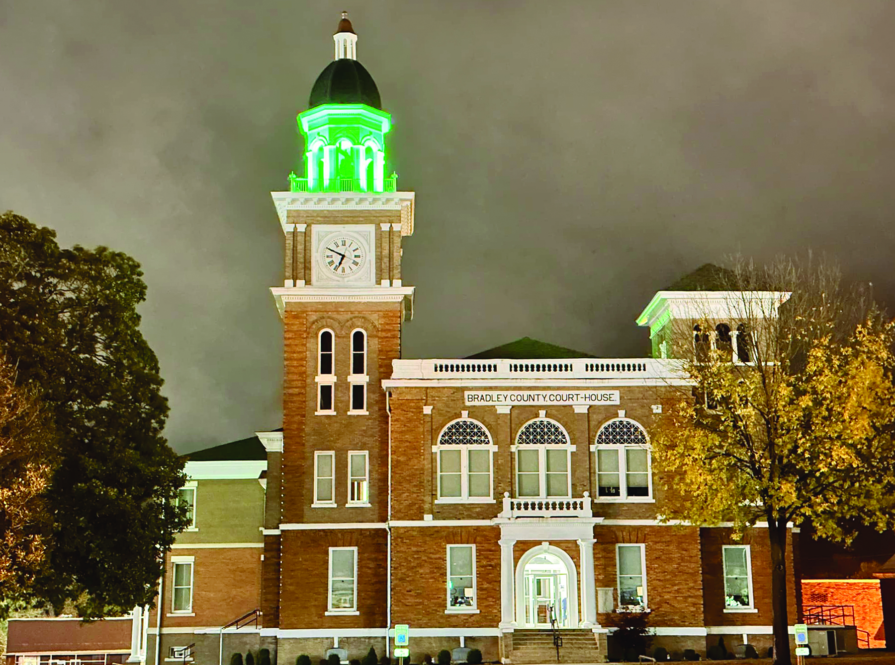
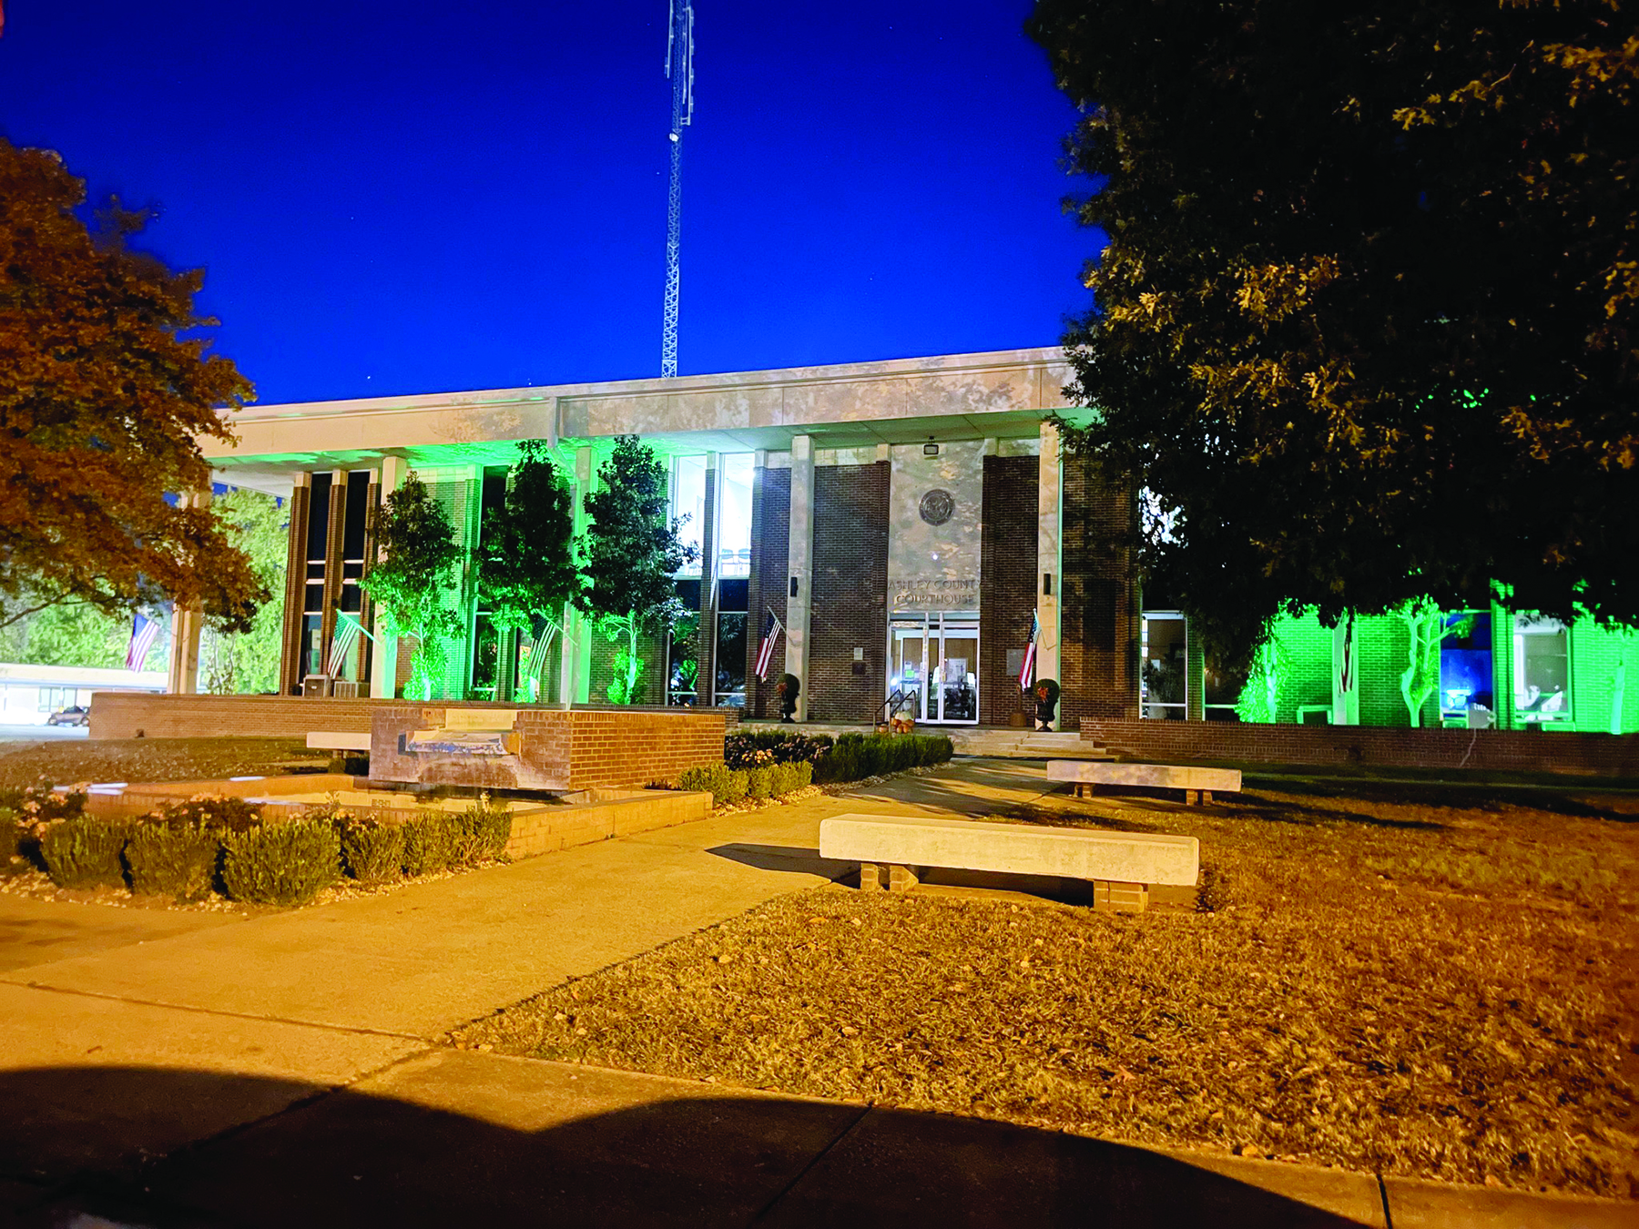
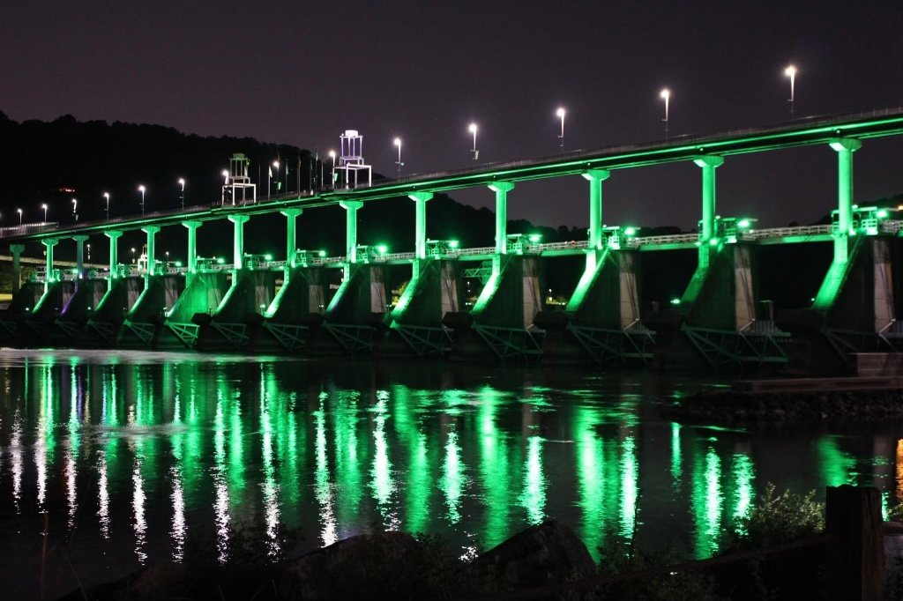
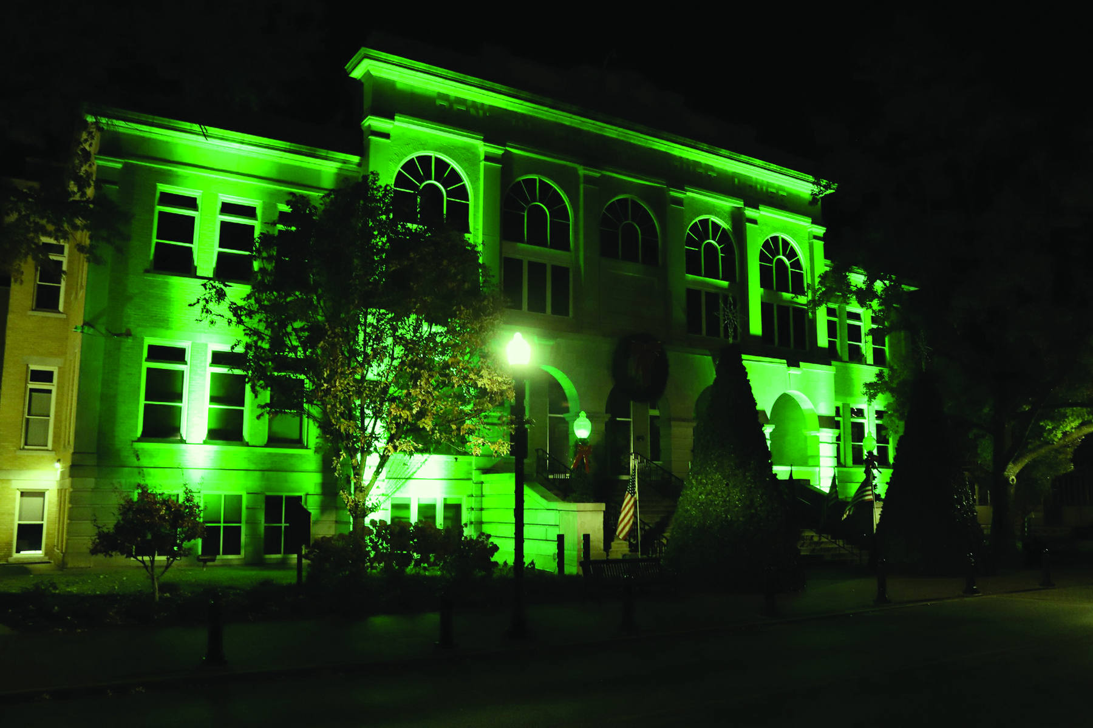

Slide 3
The Basics
Who? NACo and the National Association of County Veterans Service Officers is inviting counties to join Operation Green Light to show support for veterans.
What? Join Operation Green Light by lighting county buildings green and encouraging residents to install a green bulb at their home.
When? Nov. 4-11

Slide 4
Why?
- Shows support for veterans
“By shining a green light, county governments and our residents will let veterans know that they are seen, appreciated and supported.” -NACo
Supports a positive message
Engages community and is an opportunity to share information about resources available in your community for veterans

Slide 5
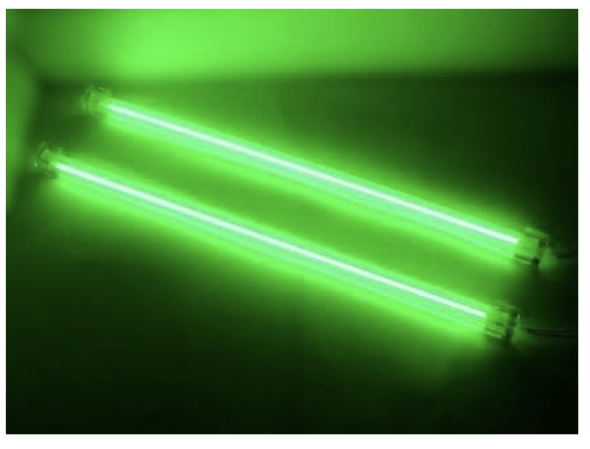


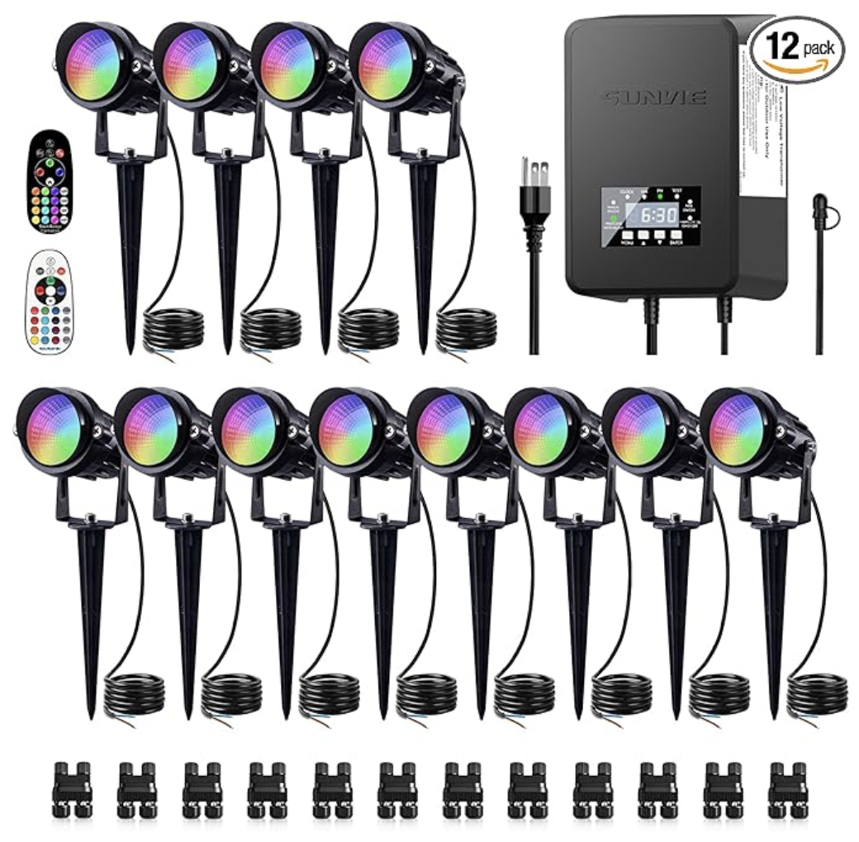

How?
Suggested Materials

Slide 6
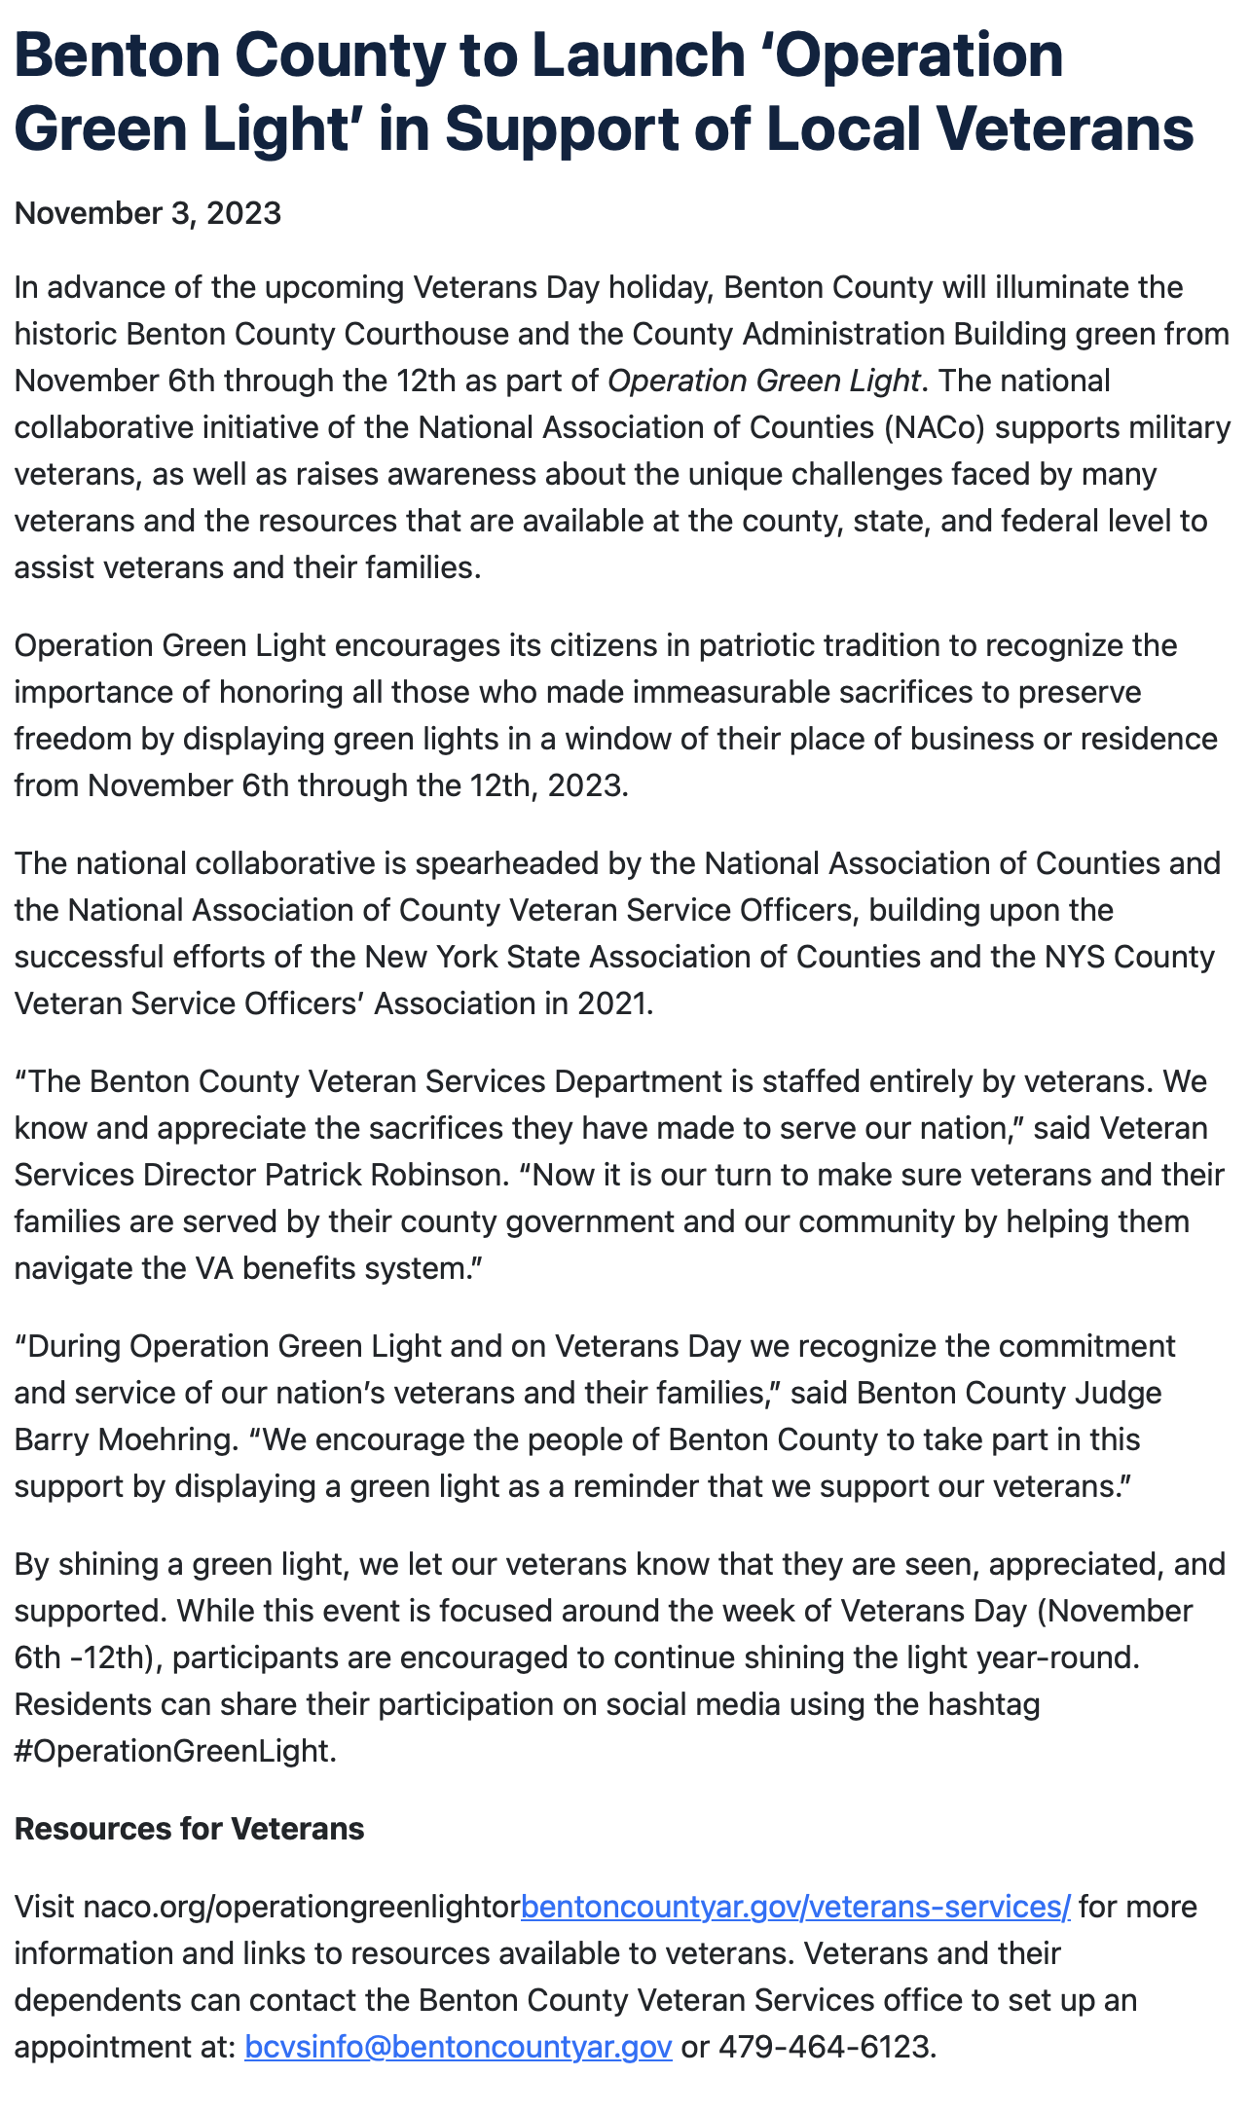
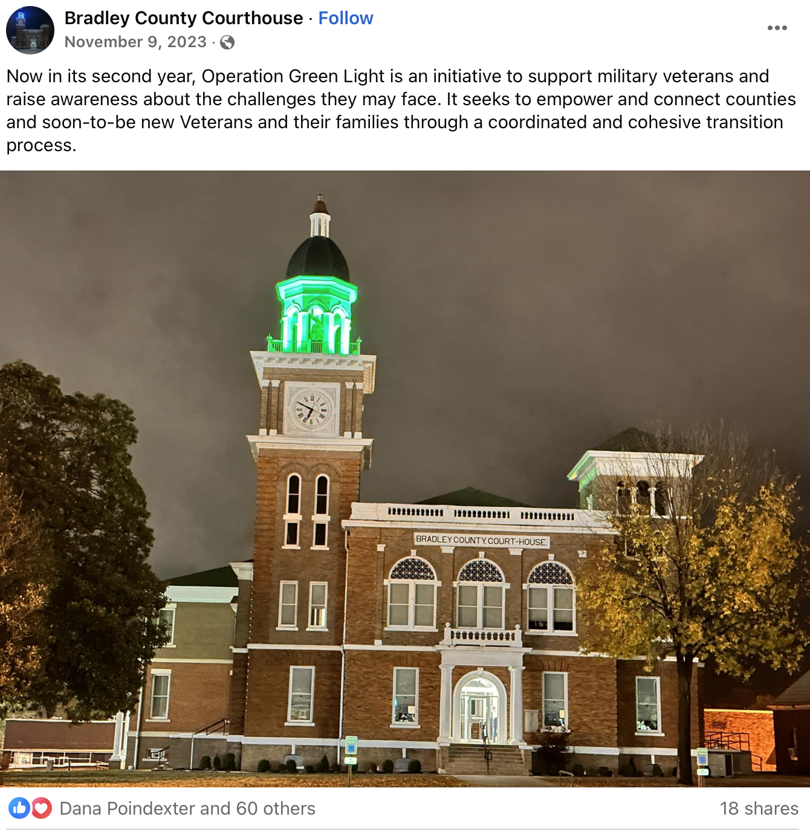
Communicating with your community
Proclamation
Press Release
Social Media Post

Slide 7
Contact us!
Counties that participate should inform the AAC Communications Team.
Christy L. Smith, Communications Director
csmith@arcounties.org
Sarah Perry, Communications Coordinator
sperry@arcounties.org

