Slide 1
Recent Arrests & Calls for Service: City Hall Parking Lot & Citywide Loitering Enforcement

Slide 2
Arrests at City Hall
8 Aug. 2026
6 arrests- 5 for Loitering and one for Open Container and Loitering.
9 Aug. 2026
8 arrests - 7 for Loitering and one for Pedestrian in Highway.
In the following photos, loitering violations in the posted area of the city hall, alcohol violations in the parking lot and violation of Pedestrian on Highway are clearly visible.

Slide 3
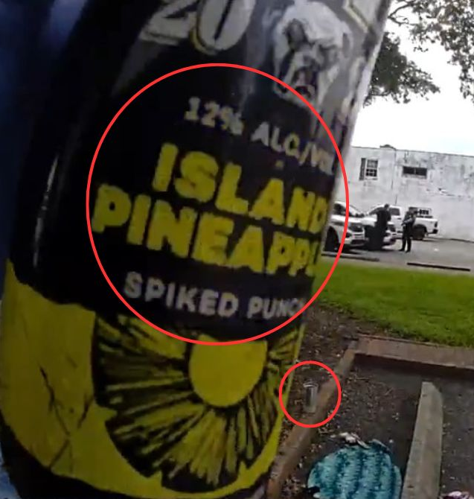
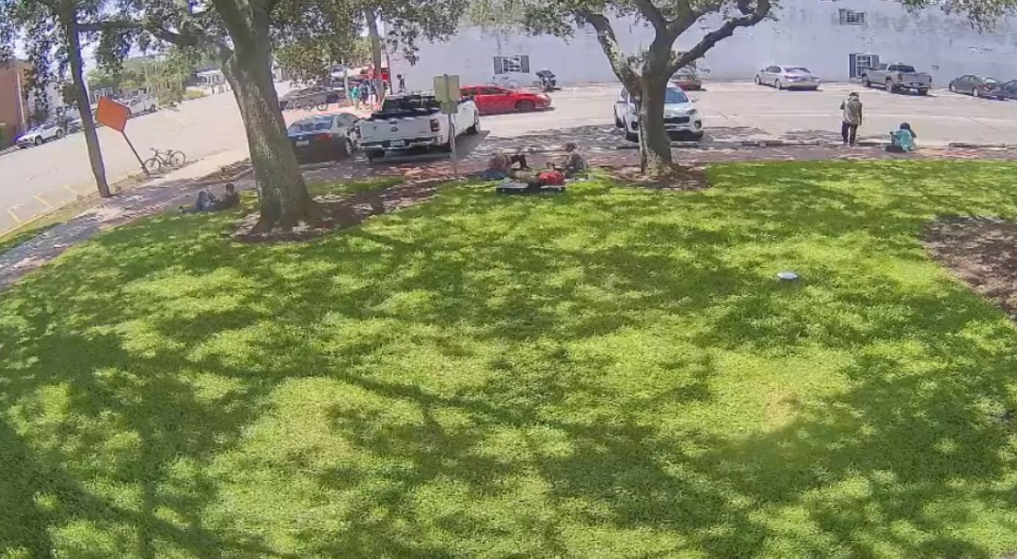
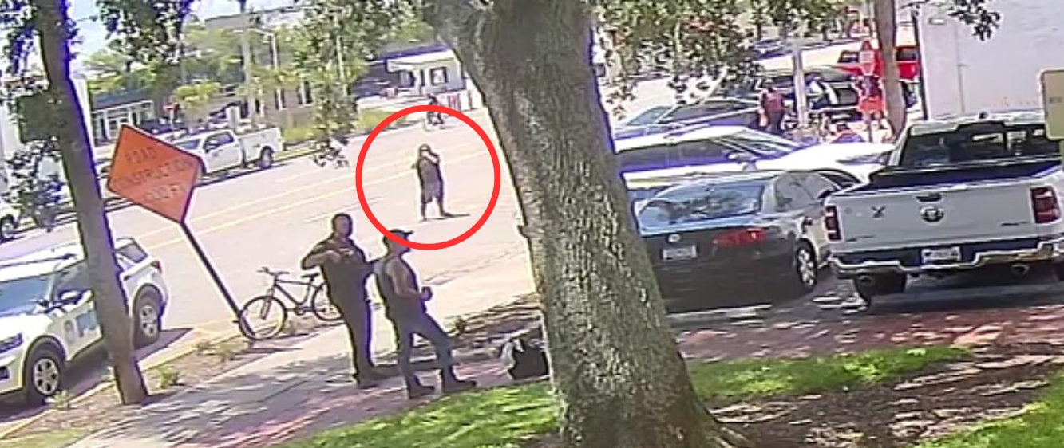

Slide 4
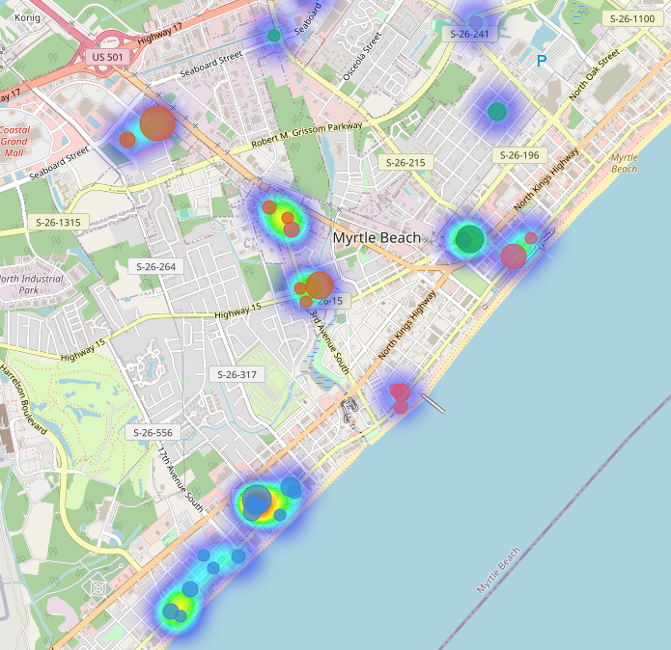
Citywide Loitering Enforcement
From February 1, 2026 – August 9, 2026, officers have made 369 arrests for loitering citywide.
From February 1, 2026 – August 9, 2026, Police and Fire have responded to 205 calls for service at the Fresh Brewed location / adjacent City Hall property.
*Keep Checks and Public Education calls have been removed from these totals

Slide 5
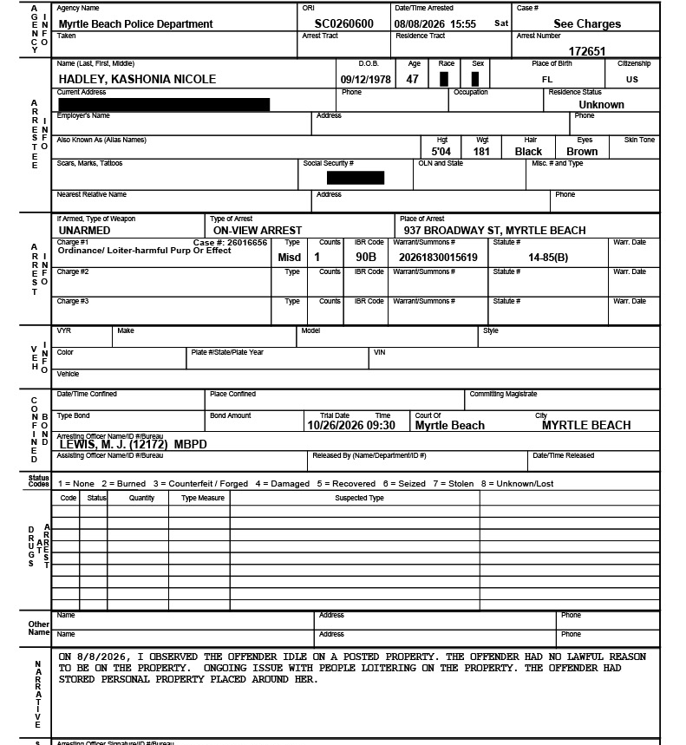
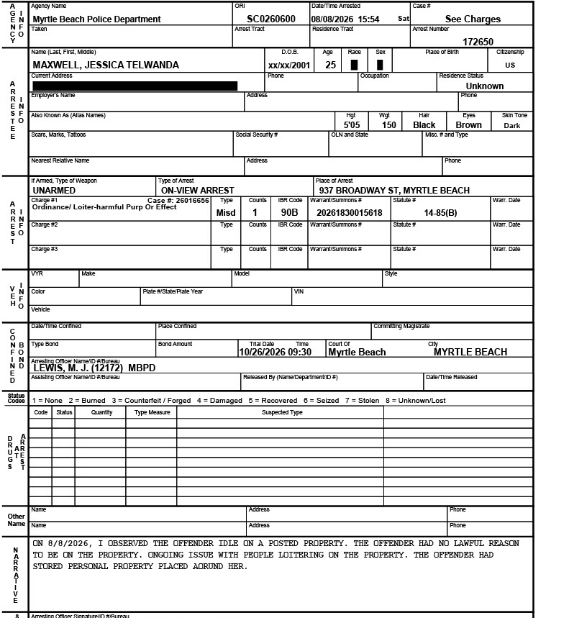

Slide 6
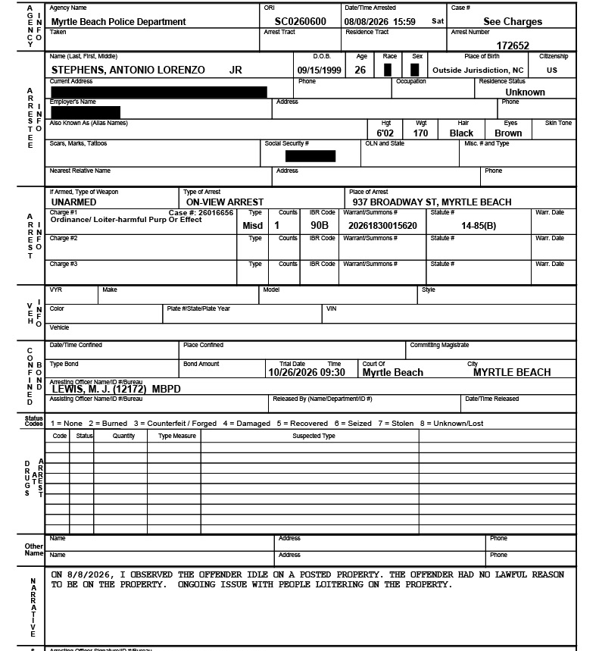
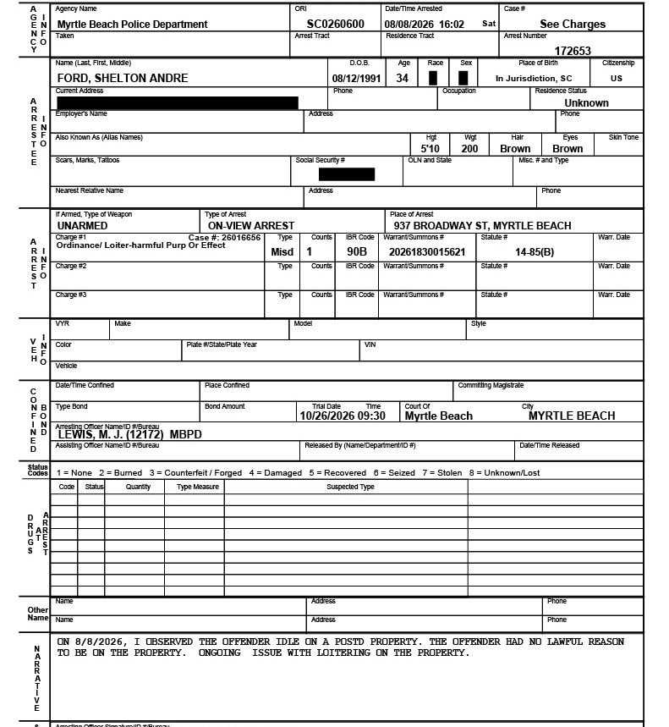

Slide 7
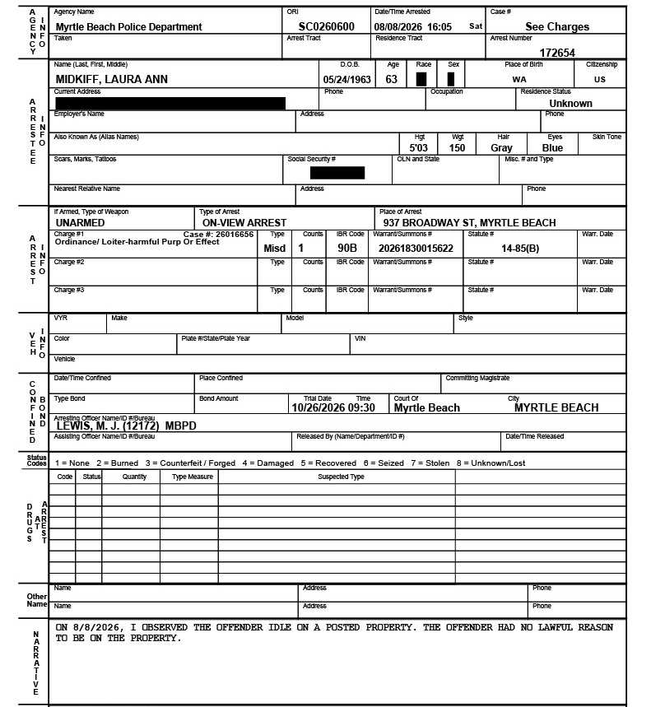
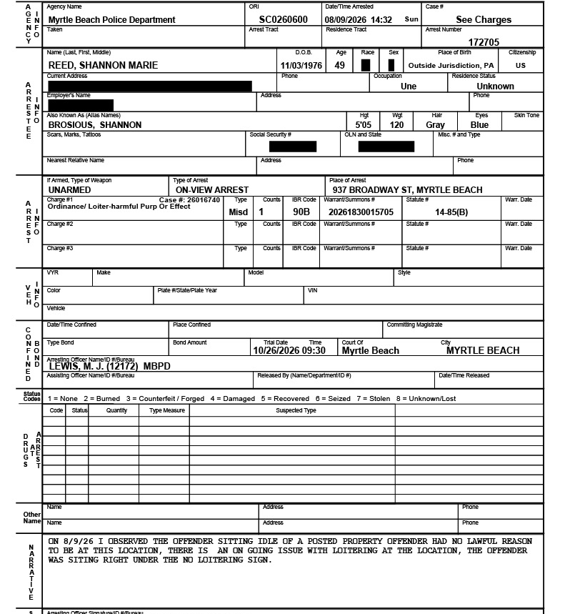

Slide 8
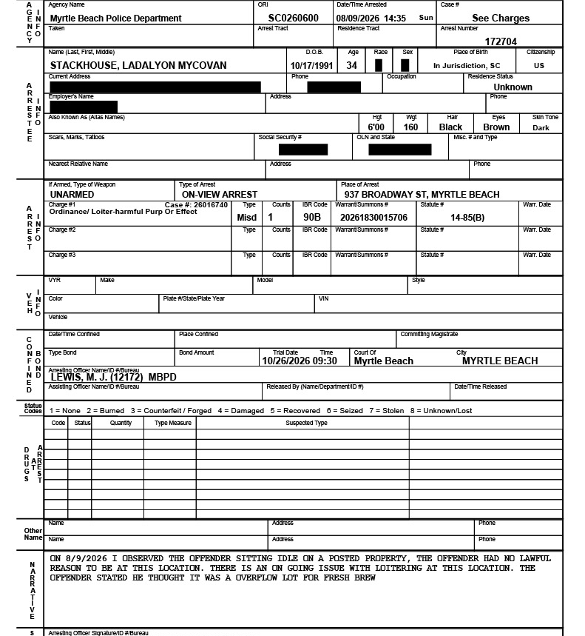
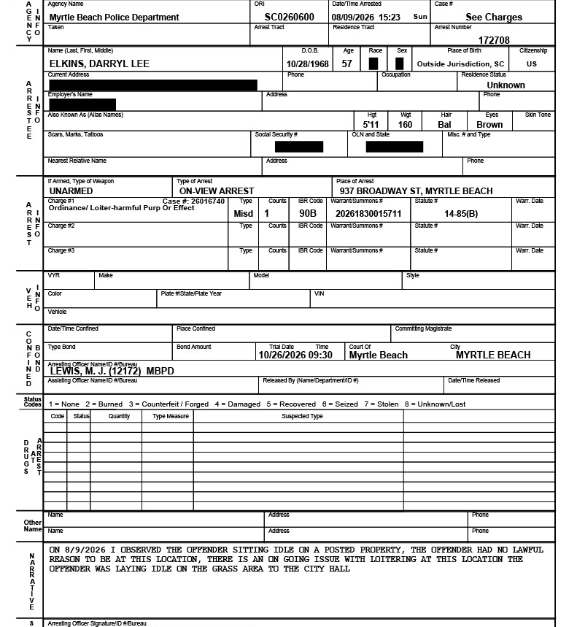

Slide 9

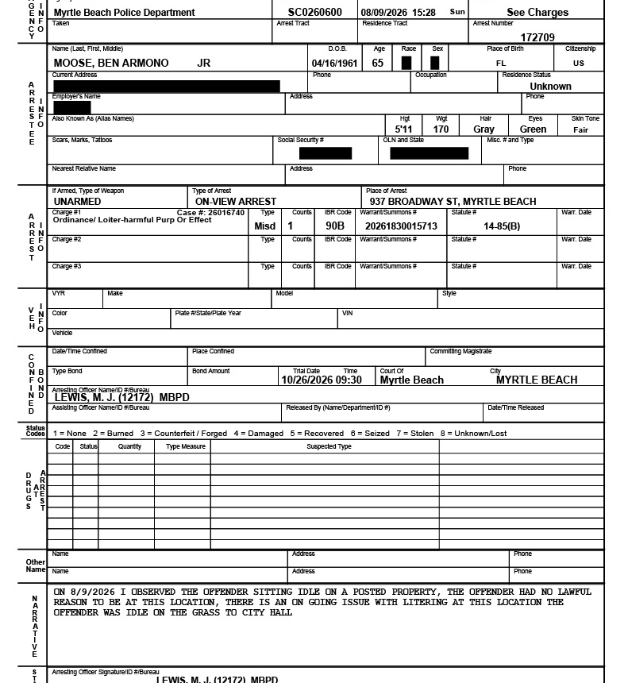

Slide 10
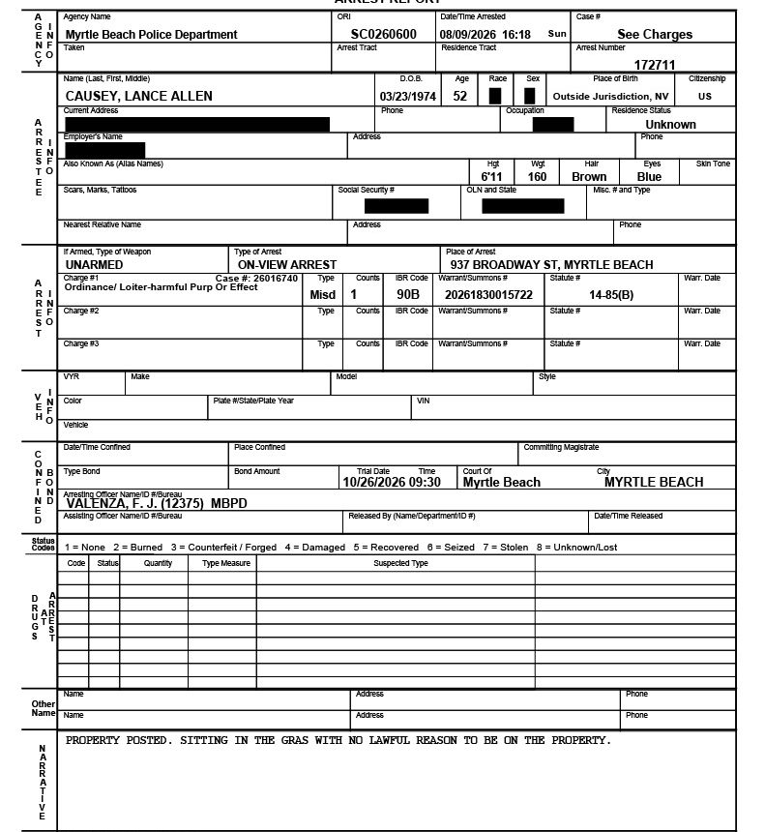
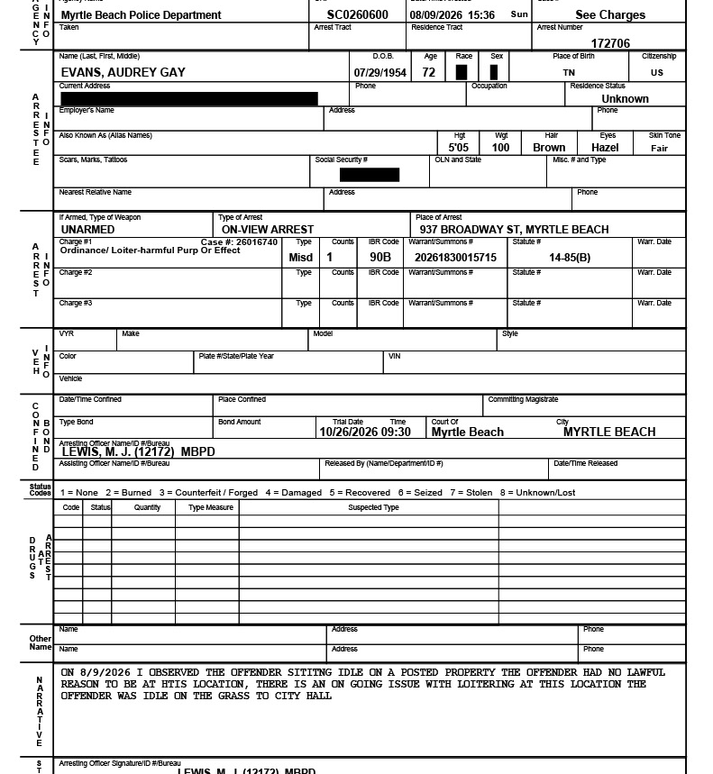

Slide 11
