Slide 2
Action Plan
Recommendation to the Board of Education
December 19, 2022
Notes:
‹#›

Slide 3
THANK YOU
To the Board for creating this process
To our community partners, especially the Chamber of Commerce, for believing in our schools and city
To staff who worked so hard on our program
To all volunteers who worked on the Vision Forward Facilitating Team
To members of our community who rolled up their sleeves and contributed to our program

Slide 4
A New Day in St. Joseph School District!
Review of the Vision Forward program and process
What We Learned
Recommendations

Slide 5
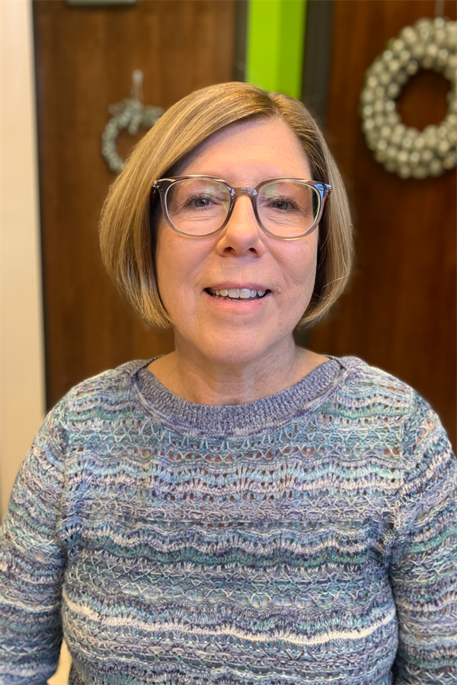
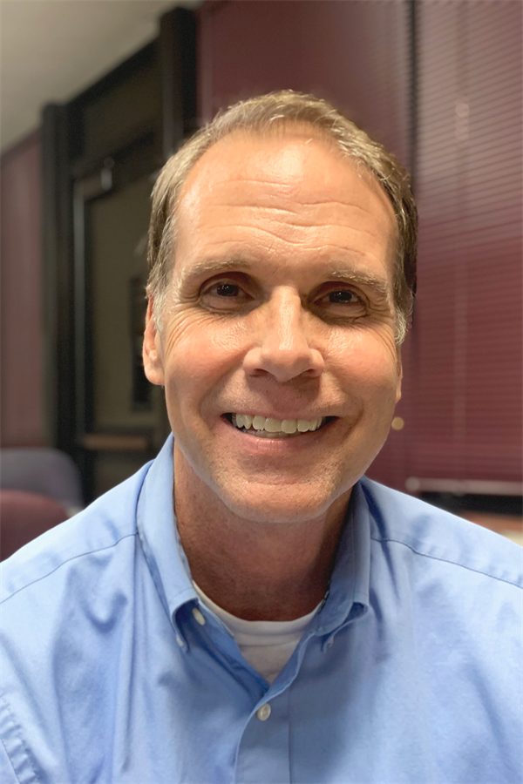
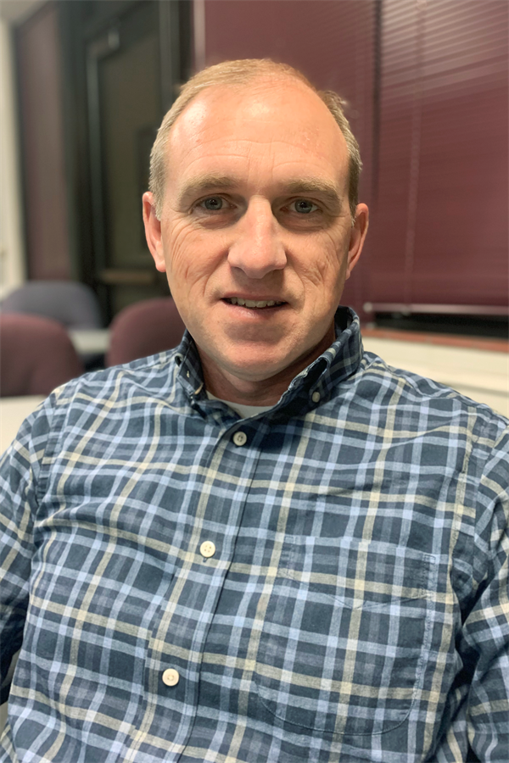
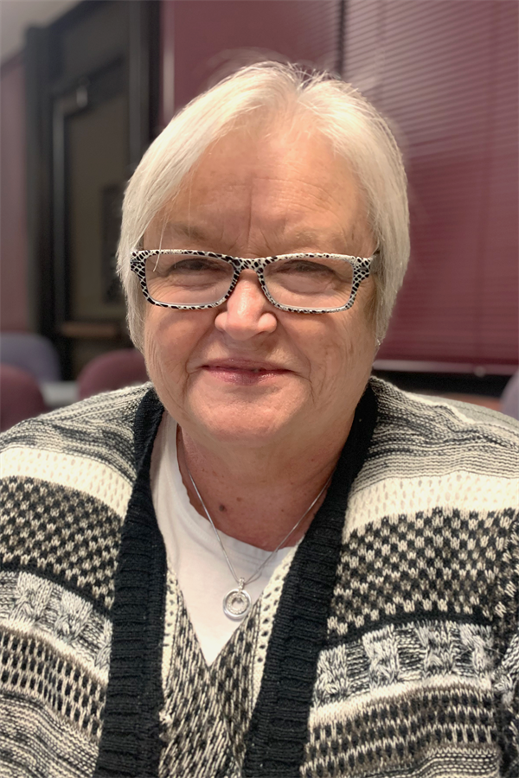
Community Engagement Team Co-Chairs
Linda Bahrke
David Hinde
Bob Miller
Teresa Simmons
Notes:
Thank you to the Vision Forward co-chairs — Linda Bahrke, David Hinde, Bob Miller and Teresa Simmons.
‹#›

Slide 6
Community Engagement Team Members
Community Members
Reid Barnett Colette Cox Don Crabtree Chad Crooks Courtney Cruz Jenny Goss Chad Higdon Steve Hofferber Rebecca Lobina
District Representatives Dr. Gabe Edgar
Superintendent Eileen Houston-Stewart
Communications Director
School Board Members LaTonya Williams Rick Gilmore
Jacob McMillian Mia Murry Mackenzie Norton Annie Roseberry Dennis Rosonke Joanne Snapp Brenda Steidel Alex Tomes Lynnea Wootten
Notes:
Thank you to the many community members and district employees who served on the Vision Forward team.
IDEAS - Thank for leadership, commitment to school district, hard work, vision, believing in a better St. Joseph School District
Beginning last November, our Community Engagement Team began the Vision Forward program. On the screen is a list of members. At this time I would ask the Community Engagement Team members to stand and be recognized. (Applause)
Our thanks to each of them for their support and important assistance they bring to our Vision Forward process.
While this Team is responsible for putting the program together, I want to emphasize that decisions about the Action Plan were made at community engagement sessions. This team created the process — the plan was developed by the community.
‹#›

Slide 7
Thank You to Our Vision Forward Partners
St. Joseph Chamber of Commerce
Word of Life Church
Mosaic Life Care
Notes:
In addition to the many individuals who brought Vision Forward to the finish line, we are fortunate in St. Joseph to also have great partners who support our work everyday. Our thanks the St. Joseph Chamber of Commerce, the Word of Life Church and Mosaic Life Care for their support and important assistance they brought to our Vision Forward process.
‹#›

Slide 8
Vision Forward
Our Action Plan for Success

Slide 9
Vision Forward Is a Partnership
All of Us Working Together
Vision Forward was the result of a sincere desire to improve the educational opportunities for our children. Over the past year, residents, business and community leaders, parents and educators reviewed information that reflects the community’s priorities to improve SJSD.
Notes:
It is hard to believe that our Community Engagement Team has been working over a year with our community to develop priorities and ideas to impact the education of our students.
‹#›

Slide 10
Vision Forward Is a Partnership
All of Us Working Together
We believe Vision Forward is a strong partnership and it’s efforts will make a difference for our schools and city.
Tonight we are pleased to present to the St. Joseph Board of Education the result of Vision Forward program - the recommended Action Plan.
Notes:
Tonight, we are pleased to present to the Board of Education the Vision Forward Action Plan.
‹#›

Slide 11

Key Outcomes of Vision Forward Action Plan
A plan that is responsible
A plan that is progressive
A plan that is financially appropriate

Slide 12
Action Plan
The Vision Forward Program
Our Process for Success
Notes:
‹#›

Slide 13
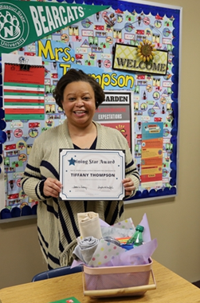
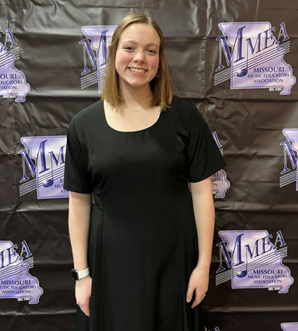
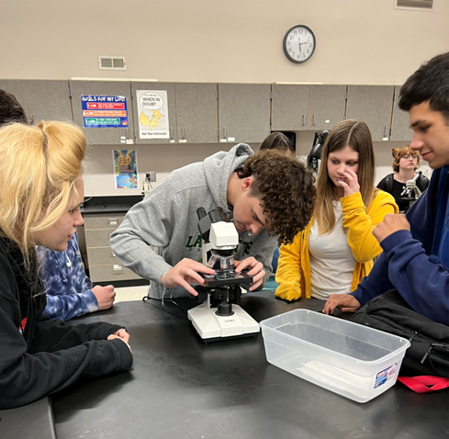
How We Got Here
Seven Community Engagement Sessions
Consensus Points from Sessions
Priority Statements Developed by Community Engagement Team
Notes:
I’d like to spent a minute or two talking about how the Action Plan was put together. Following each of the seven community engagement meetings last winter and spring, consensus points were pulled from the work activity. Our Engagement Team took those points and developed Priority Statements
‹#›

Slide 14
Process To Develop Action Plan
Consensus Points from Engagement Sessions
Priority Statements Developed by Community Engagement Team
All Day Workshop on August 12th Facilitated by District Leadership Solutions
Initial Draft Developed by District Leadership Solutions
Reviewed/Edited by Community Engagement Team on September 13th
Community Engagement Session #6 on September 20th
Notes:
Then, at an all-day workshop session, based on those priority statements, a large group of educators and members of our Team brainstormed Action Plan steps. Professionals from District Leadership Solutions, who had facilitated the all-day work session, then developed an initial draft of the Action Plan. We reviewed and edited that document at our Team meeting in September. Next we brought the first draft to the community for additional input and ideas. Those suggestions were included in the final Action Plan recommendations and that final plan is what we will present tonight.
‹#›

Slide 15





What We Learned
Feeder schools a major concern and priority
Teacher, Staff recruitment and retention priority
Strong support for middle school reconfiguration
Early childhood education expansion is needed
Capacity and efficient use of schools are top priority

Slide 16
Priority Statements
The Vision to Move Forward
Session 1: Work toward enhanced pride and improved community commitment to the importance of public education.
Session 2: Improve staff recruitment and retention including additional staff support and payment of competitive salaries.
Session 3: Expand the availability of quality early childhood education programs citywide.
Session 4: Provide a consistent middle school/junior high model both in configuration and curriculum to improve academic achievement. Address discipline and low attendance challenges.
Session 5: Consolidate, right-size and make more equitable and functional facilities at all levels (elementary, middle school and high school) so that curricula and programs are equivalent and buildings at optimum efficiency.
Notes:
Here are the Priority Statements developed from each of the first five sessions. These statements became the foundation for our recommendations to improve our district.
‹#›
On the screen, you will see the five Priority Statements developed by our Community Engagement Team. They are not listed in order of importance — all are equally important. They are listed by how the lined up to the community engagement sessions we had — Please note that two statements were pulled from the consensus points of the 4th session.

Slide 17
Priority #1
IMPROVING DISTRICT CULTURE
Notes:
I’m not going to read all action steps, just briefly cover each priority area. Again, I want to remind you that these are presented in the order of our engagement meetings — they are not in priorities order — the fifth priority is no less important that the first. And the first area is about district culture.

Slide 18
Priority #1
#1
Action Plan Items
Communicate a new Vision for District that reflects the new administration and opportunities
Reflect the Vision within the work of the District
IMPROVING DISTRICT CULTURE
Notes:
There are two categories of Action Steps for District culture.

Slide 19
Priority #1
Action Plan Items
Define the desired culture and vision
Identify branding opportunities to represent the new Vision
Revise and utilize social networking visuals and strategies
Utilize every communication opportunity
Regularly engage and involve the community
#1
IMPROVING DISTRICT CULTURE
Collectively develop and communicate a new Vision for the District that reflects the new administration and opportunities.
Notes:
The first involves communicating a new vision for our District that reflects our new leadership, our new opportunities and our Action Plan.

Slide 20
Priority #1
Action Plan Items
A. Align standards, curriculum, professional development, assessments, and policies
B. Allocate and reallocate resources
C. Eliminate processes, programs, and mandates that no longer reflect the new direction
D. Monitor growth towards the new Vision and goal attainment
E. Specify to the business community its role and can support district efforts
F. Partner with families with specific strategies for success
G. Assure communication reflects the newly developed communication strategies
#1
IMPROVING DISTRICT CULTURE
Reflect the vision within the work of the District.
Notes:
The second addresses the various areas in the district and the community to foster improved practices and a better understanding of the new vision and climate within the district.

Slide 21
Priority #2
HIGH QUALITY STAFF
Notes:
The second priority area is about High Quality Staff.

Slide 22
Priority #2
Action Plan Items
Prioritize identified compensation
Identify and communicate advantages of SJSD
Evaluate mentoring programs
Evaluate coaching
Staff that reflects District values
Align evaluation of employees to expectations
Align professional development to District goals
Ensure effective principals in every building
Hire support staff as needed
Support student teachers
Evaluate job descriptions at all levels and define workflow
#2
HIGH QUALITY STAFF
Notes:
Action steps in the high quality staff priority area include statement about compensation, communications to prospective staff, mentoring, coaching, aligning employee evaluations to expectations, professional development, building level leadership and support staff.

Slide 23
Priority #3
STUDENT PERFORMANCE &
WELL-BEING PK-5
Notes:
The third priority area is PK-5 student performance.

Slide 24
Priority #3
Action Plan Items
Identify optimal school size and capacity
Expand Early Childhood opportunities
Support and improve instructional practices
Create environment for success
Audit current practices
Identify goals, instructional practice, and curriculum
Attendance initiative
Root causes of learning problems/practices
Strategies for improved student behaviors
Equitable programming options
Alternative instructional plan for K-2
#3
STUDENT
PERFORMANCE
& WELL BEING
PK-5
Notes:
In third third area, action steps cover optimal school size and capacity — how many kids should we optimally have in elementary schools, early childhood, education, improving instructional practices, improving the environment for success, auditing current practices, identifying goals, instructional practice and curriculum, and improving attendance, finding causes of learning problems and strategies for improving student behavior.

Slide 25
Priority #4
STUDENT PERFORMANCE
& WELL-BEING 6-12
Notes:
The fourth area is improving student performance in secondary schools.

Slide 26
Priority #4
Action Plan Items
Implement Middle School model with teaming
Transition to 9-12 High School model to block scheduling
Ensure equity
#4
STUDENT
PERFORMANCE
& WELL-BEING
6-12
Notes:
The major Action Plan item here is transitioning to middle schools with teaming. Other items deal with high school block scheduling and assuring equity. Five Action steps deal with transitioning to new grade structures both with respect to impact on staff and students and their families.

Slide 27
Priority #4
Action Plan Items To Change Grade Structures
Identify optimal school size and capacity
Define philosophy at each level
Identify enrollment goals
Study impact on students and families
Develop financial profile for middle school transition
Identify needs for transition of staffing
Alternative school plan for Grades 3 through 12
Maximize the growth of Hillyard Technical School
Identify facility needs
Develop professional development, curriculum, and instructional needs
Identify extracurricular, athletic, activity, alternative, career and technical, STEM, and fine arts needs
#4
STUDENT
PERFORMANCE
& WELL-BEING
6-12
Notes:
The plan also includes steps to successfully change grade structures including transitioning to middle schools with teaming. Other items deal with enrollment goals, school size and capacity, professional development for staff, high school block scheduling and assuring equity. Five Action steps deal with transitioning to new grade structures both with respect to impact on staff and students and their families.

Slide 28
Priority #5
FACILITIES
Notes:
The fifth and final priority area — again remember that this is just as important as the first — it is just listed fifth — has to do with facilities.

Slide 29
Priority #5
#5
FACILITIES
Action Plan Items
Utilize existing architectural/demographic studies
Develop comprehensive plan of which buildings need to be maintained, renovated, retired, converted, or replaced
Consider transportation and feeder school patterns
Notes:
With previous action steps having to do with grade configuration, and optimal size and capacities of schools, we will need to look at our existing facilities and how to go about improving them to enhance our educational program. In a nutshell, this Priority area deals with development of a comprehensive plan.

Slide 30
A Plan To Improve Our Schools
A plan that is responsible
A plan that is progressive
A plan that is financially appropriate
Notes:
Facilitating team recommends approval of the Vision Forward Action Plan by the Board of Education

Slide 31
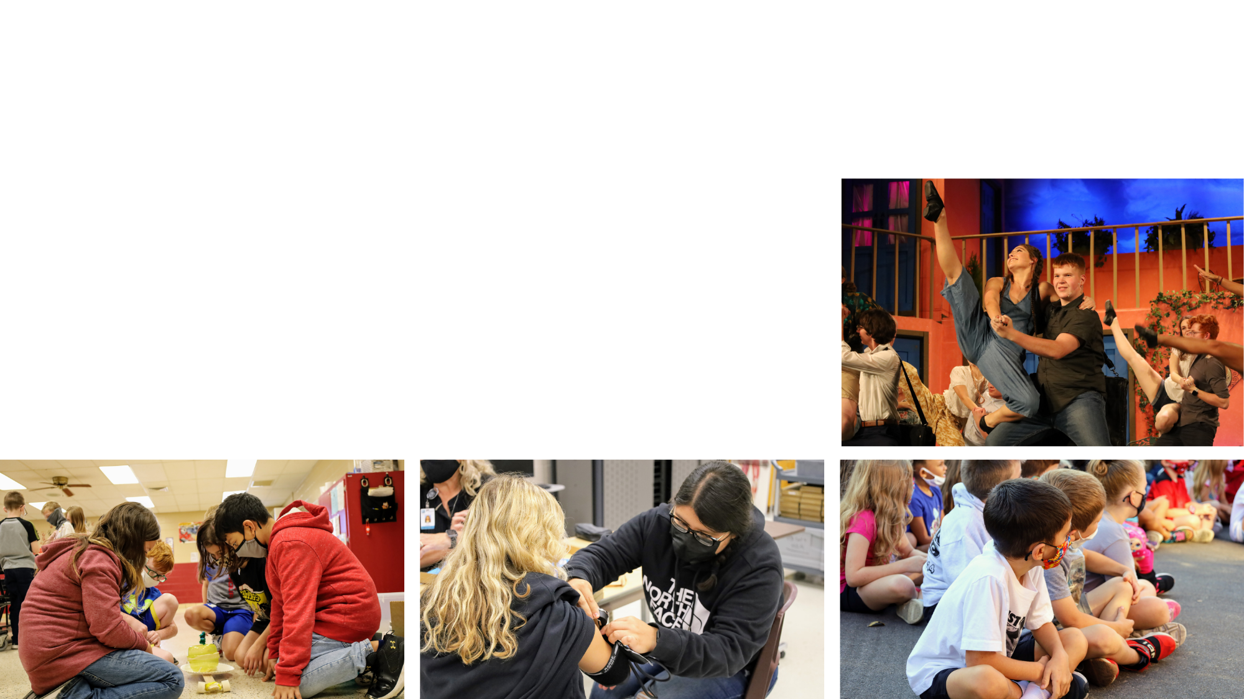
An Exciting Future for SJSD Students, Staff and our Community
THANK YOU!
Notes:
Tonight, we are pleased to present to you the Vision Forward Action Plan for your approval. On behalf of the Vision Forward chairs and each of the committee members, thank you! Thank you for believing in a better St. Joseph School District and working to ensure our children have an exciting future ahead.

Slide 32
Notes:
‹#›

