Slide 1


Watertown Police Department
E-BIKES

Slide 2
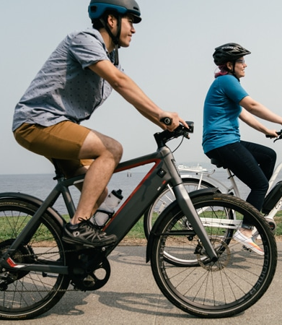
Promoting Safety
Between 2017 & 2022 (nationally)
Helmet use by e-bike riders declined by 6% each year
Only 44% of injured e-bike riders wore helmets
E-bike riders with head trauma seeking hospital care was 49 times higher in 2022 (7922) compared to 2017 (163)
JAMA Surgery - 2024
The number of injuries from electric bikes has doubled every year from 751 in 2017 to 23,493 in 2022 (nationally)
JAMA Network Open – July 2024
Notes:
Why we are focusing on e-bikes and similar devices this spring and summer.
Injuries are on the rise nationally

Slide 3

In Codington County
Since August 2020
SD Office of Accident Records
12 Vehicle vs Pedalcyclist crashes
2 Incapacitating Injuries
8 Non-Incapacitating Injuries
1 Possible Injury
1 No Injury
Notes:
We’ve seen an increase is bicycle crashes and injuries locally.

Slide 4
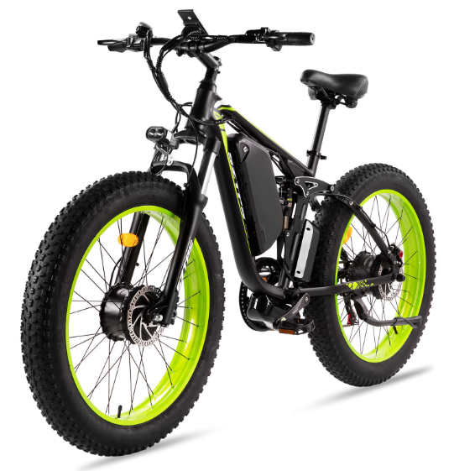
What are E-Bikes?
Bicycles or tricycles with operable pedals and with an electric motor of 750 watts or less.
SDCL 32-20B-9

Slide 5
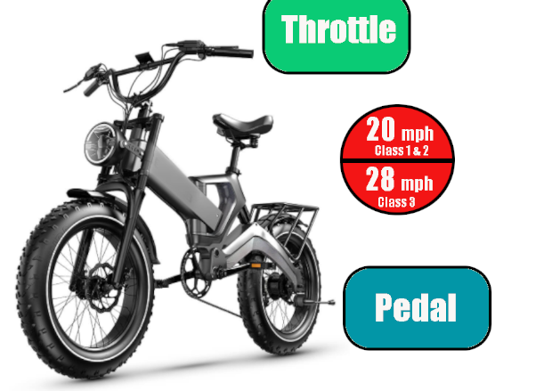
Classes of E-Bikes
Class I
Motor assistance only while pedaling and ceases to provide assistance at 20 mph
Class II
Motor propels with or without pedaling (throttle) and ceases to provide assistance at 20 mph
Class III
Motor provides assistance only while pedaling and ceases to provide assistance at 28 mph
SDCL 32-20B-9

Slide 6
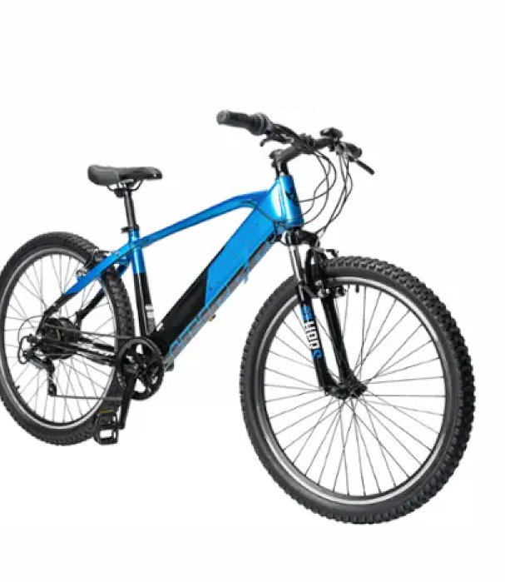
E-Bikes on Bicycle Paths
Unless prohibited by local ordinance, Class I and II E-bikes CAN be operated on any bicycle path or multi-use path
Watertown has no ordinance prohibiting Class I and II E-bikes from the bicycle trail system
Class III E-bikes CANNOT be operated on a bicycle path or multi-use path unless:
The path is within or adjacent to a highway or roadway, or
The local government expressly permits the use
(Watertown does not expressly permit this)
SDCL 32-20B-12

Slide 7
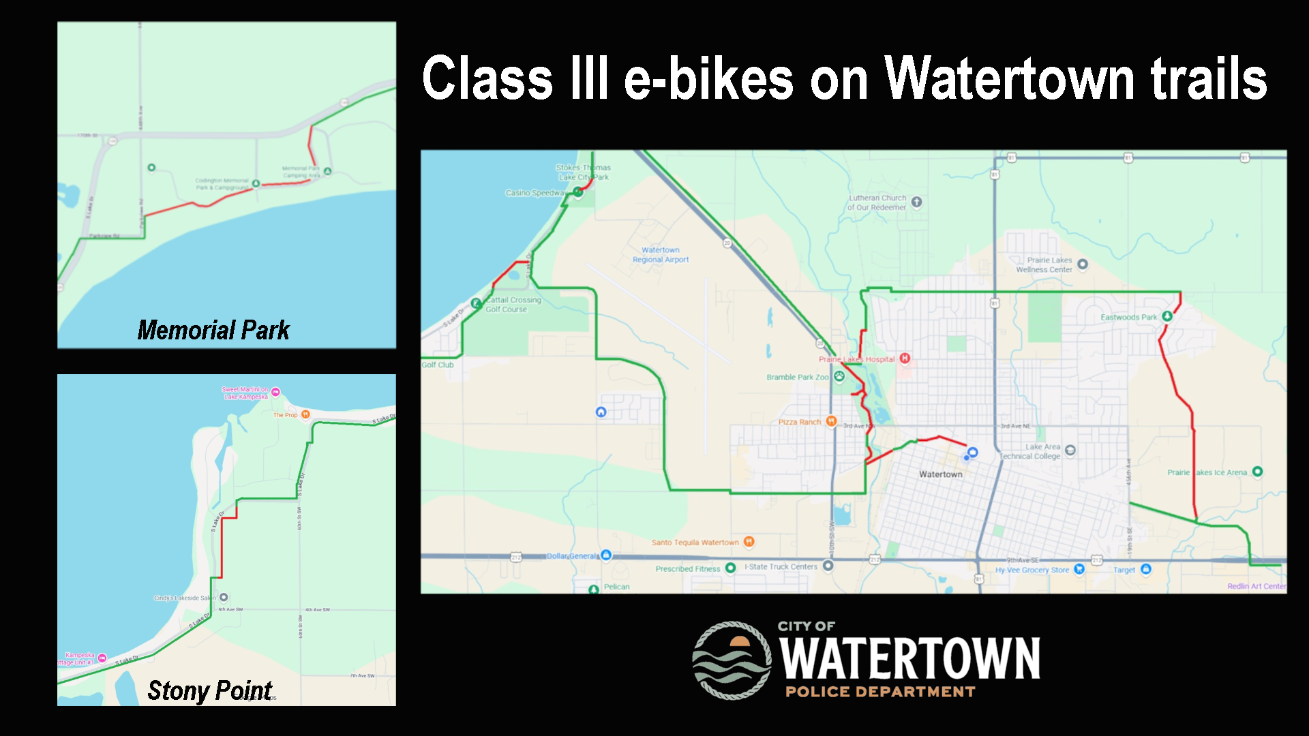

Slide 8
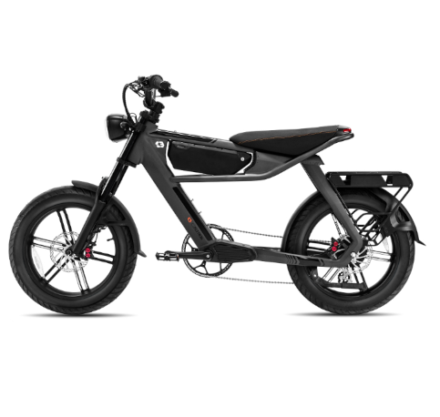
Class III E-Bikes
Operator must be at least 16 years old
Operators less than 18 years of age and any passenger, regardless of age, must wear a helmet
Must have a functioning speedometer
SDCL 32-20B-13, 32-20B-14, 32-20B-15

Slide 9
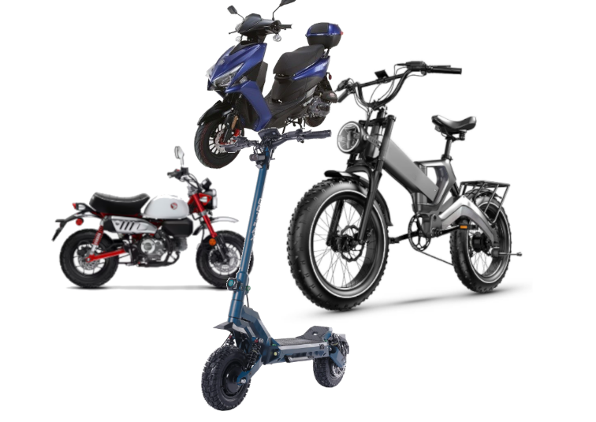
City Ordinance
19.0700 Defines “Personal Conveyances” as bicycles, electric bicycles, rollerblades, roller skates, non-self-propelled scooters, carts, skateboards, and like vehicles.
These Personal Conveyances must:
Not interfere with pedestrians – 19.0704
Not be operated faster than is reasonable and proper or in a manner that may cause injury to the operator or other persons– 19.0705
Obey traffic laws – 19.0706

Slide 10

Watertown City Ordinance currently does not
Prohibit Personal Conveyance on roadways – But State Law does prohibit certain types of what Wtn calls Personal Conveyance (electric foot scooters)
Prohibit Personal Conveyance on sidewalks, provided it is operated carefully and at a reasonable speed
Define a maximum allowable speed of bicycles or E-bikes on the bike paths

