Slide 1

Utility Billing / Meter-to-Payment Audit
Findings, recommendations & actions
David Allen | SLserco
Findings – Public Meeting (first draft)
February 3, 2025

Slide 2
Agenda
Overview of Findings
Findings
Key Observations
Next Steps
Scope
Questions
Context
Approach
Notes:
* Social media strategy – Public pages, level of communicate on other forums – Next door, share clear information,
* Cleared danger, learning and problem solving

Slide 3
Scope
Meter Accuracy
Billing Accuracy
Meter test
Track meter to bill
Rates
System transition
Proration
Communications
Transparency
Challenge call volume
Decision – making
Summary bill process
Utility Billing

Slide 4
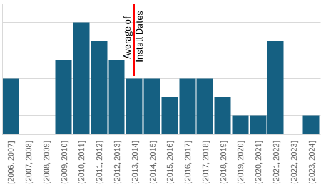
Context
Meters are 10 years old
Strong meter service team
Meters changed at 20 years of use
Approach
On site account meter visits
Meter test
Findings
Data is accurate
Meters are performing well
Data
100% data retained accuracy through the flow
Meter
Weighted
99.36% Revenue realized (Weighted Accuracy)
46 meters tested in three flow rates
40/46=87% Pass revenue test
None overbill
Written meter maintenance plan
Meter Accuracy

Slide 5
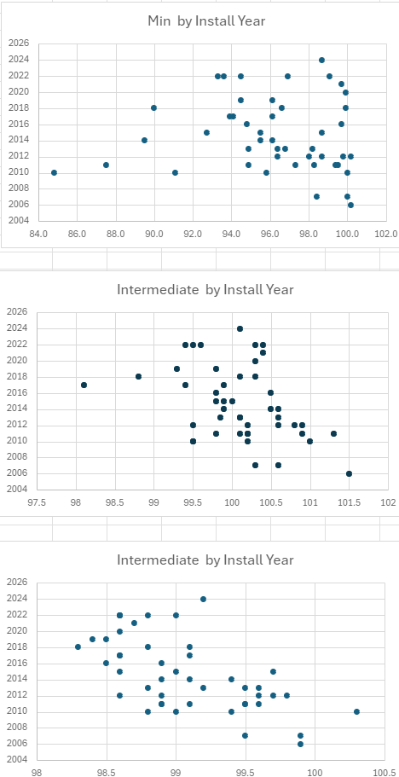
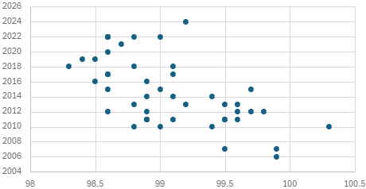
Meter Test Results
Minimum – 15% of Flow
Intermediate – 70%
Maximum – 15%
Notes:
Remind all that meters were not changed – Not a part of the process
Did not expect meters were the source

Slide 6
Meter selection?
Criteria | Value
Level of confidence | 95
Expected Standard Deviation | 5
Precision or Margin of Error | 1.5
Number of meters | 46
Meter change out not part of the implementation
Industry does not expect meters to speed up
To move from a level of confidence of 95 to 99
multiply cost of testing 2.39 times current cost
SLserco selected random meters to test
This process was different than site visits

Slide 7
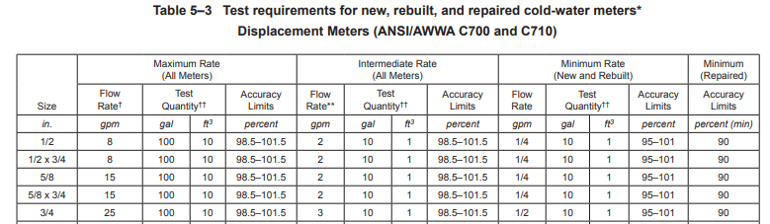
Random Sample Size
Level of confidence
Method of selection
Testing Firm Used
Certified
Respected
Available
Findings
Strong revenue performance without overbilling

Slide 8
Context
Approach
Findings
Meters are Accurate
Meter Accuracy

Slide 9
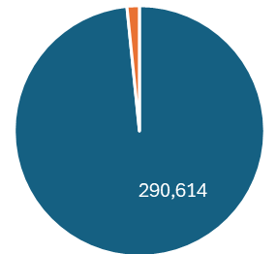

Bills – Water and Wastewater
98.4% accurate
Solid Waste and Storm
Proration
Long bills calculated correctly
Solid waste had slow application of new rates or inconsistent rounding
Low estimate caused high prorated amount (Credit issued)
Most of the differences were off by 2 cents or less
Storm appears correct
Context
Billing system install happening
Rate changes
Approach
Receive data
Justification of process
Evaluate results
Understand process weakness
Findings
System calculation accuracy is high
Inaccuracy favors resident
Billing Accuracy

Slide 10
Autopay
Partial payments when full payments expected
Decisions
Professional
Error on setup - corrected
Documentation – process, goals, performance indicators
Situational leadership
Context
Several larger issues coming from the operation of Utility Billing needed evaluation
Utility billing is experienced
Approach
Evaluated meters, bills and execution issues with an eye toward the decision-making process
Findings
Team works well together
Clear documentation needed
Overwhelmed with exceptions immediately after go live
Utility Billing

Slide 11
Transparency
Portal – Currently 17,882 registered
Call Volume
Performance indicators
Industry standards
Advertisements in local paper
25 Social Media posts
Phone tree messages
Auto email reply
Customer Service Representatives
Press releases
Website messages
Context
Trust gap
Approach
Discussed bill error handling
Reviewed call logs
Reviewed communications
Findings
Performance indicators
Communications
Meter Accuracy
Notes:
Transparency
Challenge call volume

Slide 12
Bottom line
Meters are accurate
System is calculating accurately
Exception overload
Project staff was too lean

Slide 13
Details
Lean project staffing
Core value send correct bills, forced delay
Accurate and favored the resident
Complexity increased with schedule changes
Exception overload

Slide 14
What happened on go-live day
Conversion part one - was provided by City
Conversion part two - missing critical parts
Third attempt for Go-live
appeared complete
processed as expected
Vendor performed test
Data was found by City exception checking
“not complete” after go-live evaluation decision
City could not go back
Context:
Legacy system data difficult to extract
Verifying vendor declarations would have caught this problem
Needed public works IT leadership available
Notes:
Underestimated complexity and leadership needed
Project kickoff – adding

Slide 15
Key Observations
Vendor / Billings’ relationship
Communication
Account holders
Leadership
Procedures and governance documents
Performance indicators
Written meter maintenance plan
System training
Notes:
Since the last audit presentation, we continue to improve our approach
The audit had eight action steps for us to take we will review the four with action steps remaining and are checked with a purple mark on this sheet.

Slide 16
Path Forward
Utility Billing continuing vision
Communication
Performance Indicators
Stewardship
Notes:
Focus on information and time
Findings
Organize information
Tech analysis
Pre-briefing with press – release on - Victoria will work on approach – Have one pager from report – Staff one page response – 4K refunds were issued
$6,200 underbilling – Do not chase underbill action
Bills were right – # of bills overcharged and credit back
Looked at all of the data and calculations
Shared calculation of bill processes

Slide 17
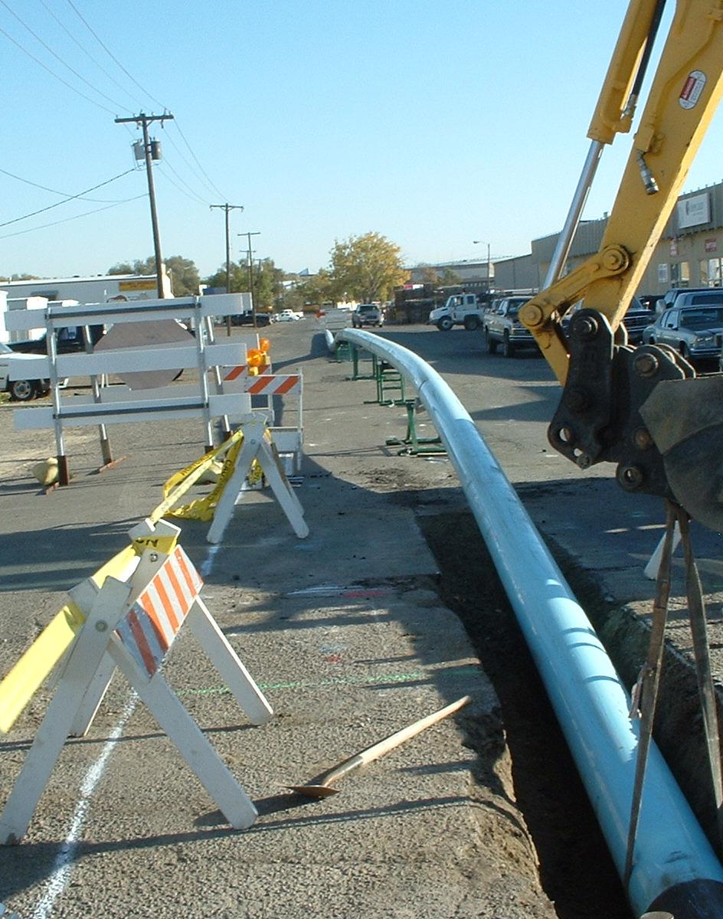
Conclusion & Questions

Slide 18

City Slides

Slide 19
If we could do it over
One IT employee in PW
Contracted a 3rd Party software conversion expert to represent the City throughout the project
Improved communication with public and executive staff
Moved implementation to October once we missed April
Requested a delay in rate adjustments to triage exceptions
Notes:
This slide needs significant work if it is to be used. These are just notes from our meeting.

Slide 20
Action Items
1) Revised IT Policy via administrative order
    Mandatory IT involvement
    (IT was included in this project but too lean)
    Expanded integration and migration guidelines
        (including 3rd party consideration)
    Testing standards (change management policy)
    Training & awareness requirements
    Vendor accountability
    Increased IT resources for projects of this magnitude
Notes:
This slide needs significant work if it is to be used. These are just notes from our meeting.

Slide 21
Action Items (Cont.)
2) Add IT staff expertise to PW
3) Improved communication - External & internal
4) Determine when late fees and turn off dates are reinstated
      Minimum of 90 days out
      Payment plans encouraged
Notes:
This slide needs significant work if it is to be used. These are just notes from our meeting.

Slide 22
Action Items (Cont.)
5) Detailed utility bill
      Info necessary to verify calculations:
      Service periods
      Utility rates including tiers, K-gal & Cubic Feet
      Historic usage charts & graphs
      Integrate west end water plant and reservoir line item
      Listen and respond to customer feedback
Notes:
This slide needs significant work if it is to be used. These are just notes from our meeting.

Slide 23
Customer Information
Call center for audit questions
BillingsMT.gov/auditresults
Create your on-line account
Sign up for water notifications
Notes:
This slide needs significant work if it is to be used. These are just notes from our meeting.

