Slide 1
SLV Windfall Group LLC
Developer
February 2023 Update
Jim Walsh
SLV Real Estate Sales & Development Center

Slide 2


Slide 3
SLV Windfall Group Organizational Chart
Jim Walsh
Co-CEO
Robert Bradley
Co-CEO
Sales & Marketing
Accounting/IT/Title
Agents
Krishna Dorr
Director of Marketing
Anne Hughes
Controller
Nadine Gilchrist
Broker In Charge
Cam Mclemore
Marketing Consultant
Cody Griffith
IT Specialist
Agents (10)
Michael Sherrard
Tom Shea
David Skidmore
Karl Narveson
Kerry Hall
Eddie Addison
Charlie Bushmaker
Deborah Powell
Caleb James
Dawn Burton
Tina McQueen
Sales Admin
Anne Barron
Title Manager
Kenzie Taylor
Sales Admin
Marty Slager
Property Manager

Slide 4
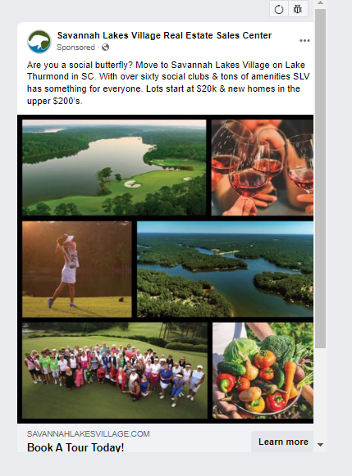
Sales & Marketing Update: What Have We Been Up To?
Our aggressive marketing plan is focused on attracting new neighbors to SLV by reaching out locally, regionally and nationally.
Social Media- Ads on Facebook & posting closes on our FB page
Digital Ads- Ads run across the web and on newspaper websites
Online Search- Ads on Google, Bing & Yahoo to those searching for communities like SLV
Trade Shows- Boat show in Atlanta, Golf shows in Cleveland and Michigan, Home shows in NY, NJ, & Chicago.
Direct Mail- Postcards mailed to FL, NY, NJ & Chicago
Email Campaigns- Frequent emails to our current database and emails sent to the databases of our marketing partners Ideal Living, Golf Course Homes & Private Communities
Print Ads- The Augusta Chronicle, Augusta Magazine, Columbia County Magazine & Shorelines

Slide 5

Sales & Marketing Update: How’s It Working?
Tours are up, Sales are up, and People are Moving to SLV …
Discovery Tours –
Average 60 first time tours each month
22% of tours convert to a sale
Booked 38 new tours over the past 2 weeks
On average it takes a new lead 5 months to visit SLV from the time they first request information
Active Leads in our Databases –
8,595 in our Primary Database of potential residents
40,860 in our Secondary Database of potential residents

Slide 6



Sales & Marketing Update: What Does It All Mean?
Savannah Lakes Village is getting noticed!
Your Community Continues to Win AWARDS!!

Slide 7
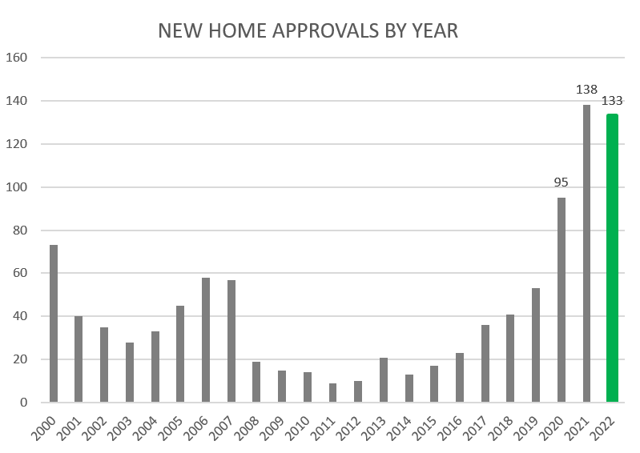

Slide 8
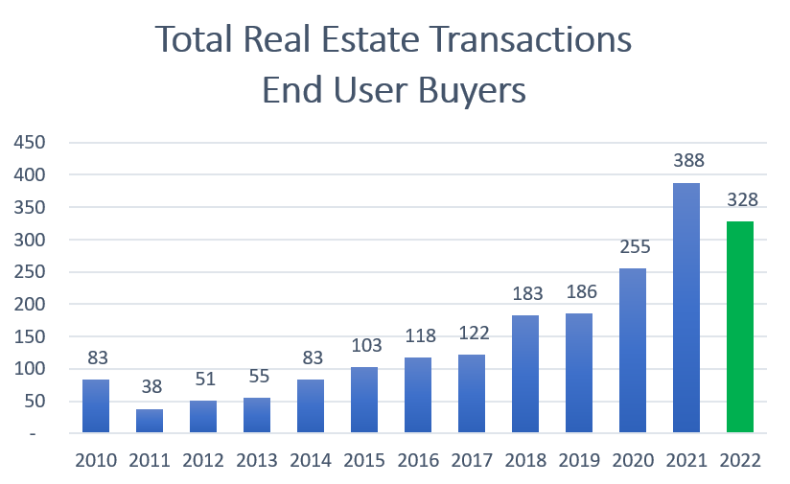

Slide 9




Preferred Builders
Petersen
Builders
Non Performing Performing Lots
(Paying POA Fees)
145
Converted & Paying
POA Fees
224
Total Lots Released
79
Released, Sold
& In Process of Converting

Slide 10
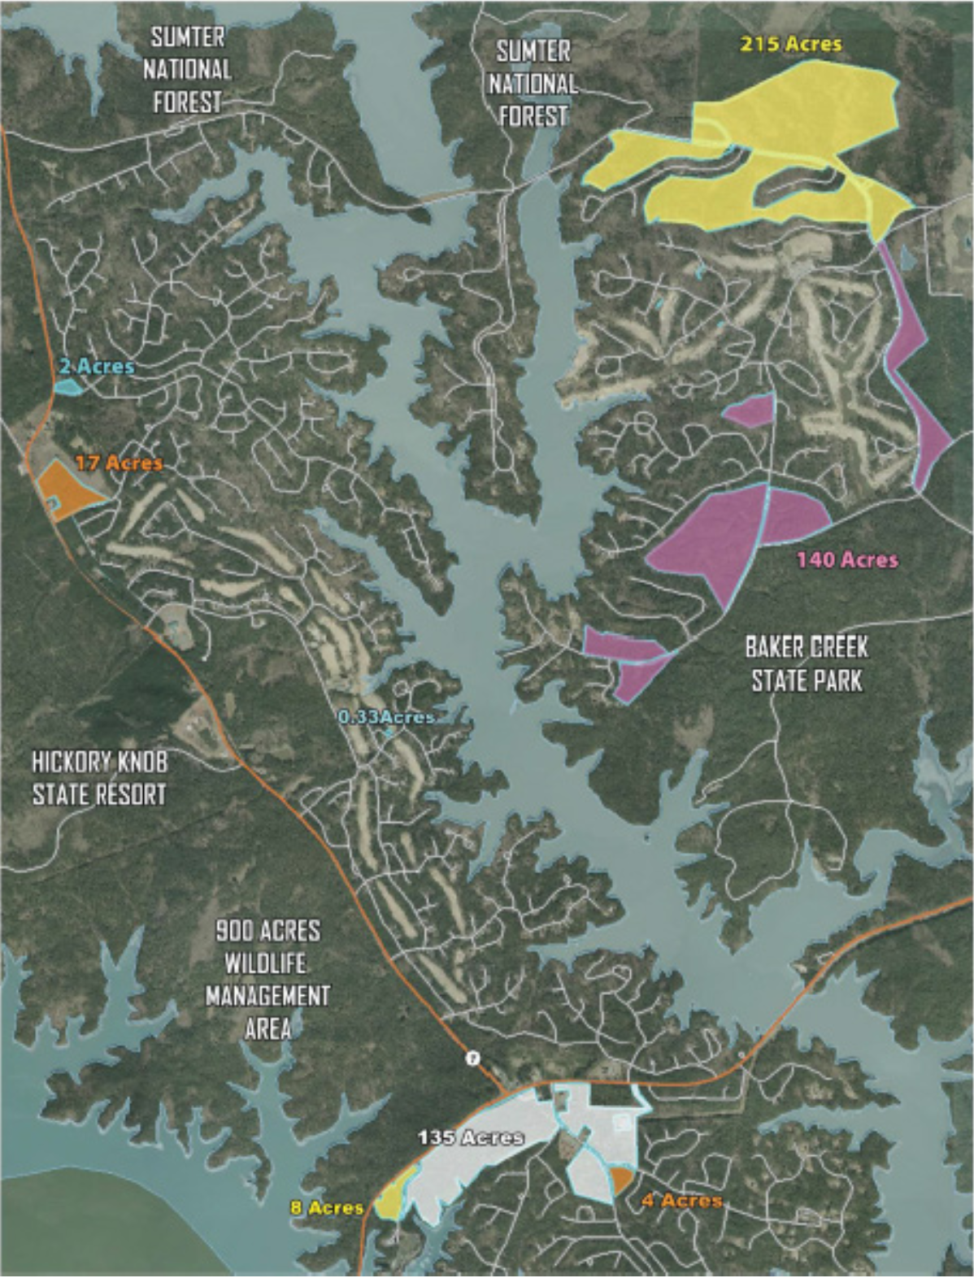

Slide 11
Sale of SLV Windfall Group LLC (SLVW)
ALL Development on the 500 Acres of undeveloped land acquired by AnPac will be required to adhere to ALL applicable Architectural Control Committee Rules and Regulations, Covenants and Restrictions of Savannah Lakes Village and the Planned Development District defined within the County Zoning Ordinance.
Anpac contract to purchase SLV Windfall Group was signed on 2/12/23. We met with the POA Board on 2/15/23 to discuss the contract. We will continue to discuss/meet with the POA Board throughout the entire due diligence.
James Walsh and Robert Bradley, under an employment contract for a minimum of 2 years, will continue to manage SLVW as CO-CEO’s and our Staff and Agents will remain in place in the current positions.
AnPac will bring much needed Capital for SLVW to move forward with important projects: Peninsula Development, Single Family Home Construction, Senior/Assisted Living Campus, etc…
Converting Non Performing Lots to Performing Lots will be accelerated, resulting in recurring Dues Revenue to the Savannah Lakes Village Community/POA.

Slide 12
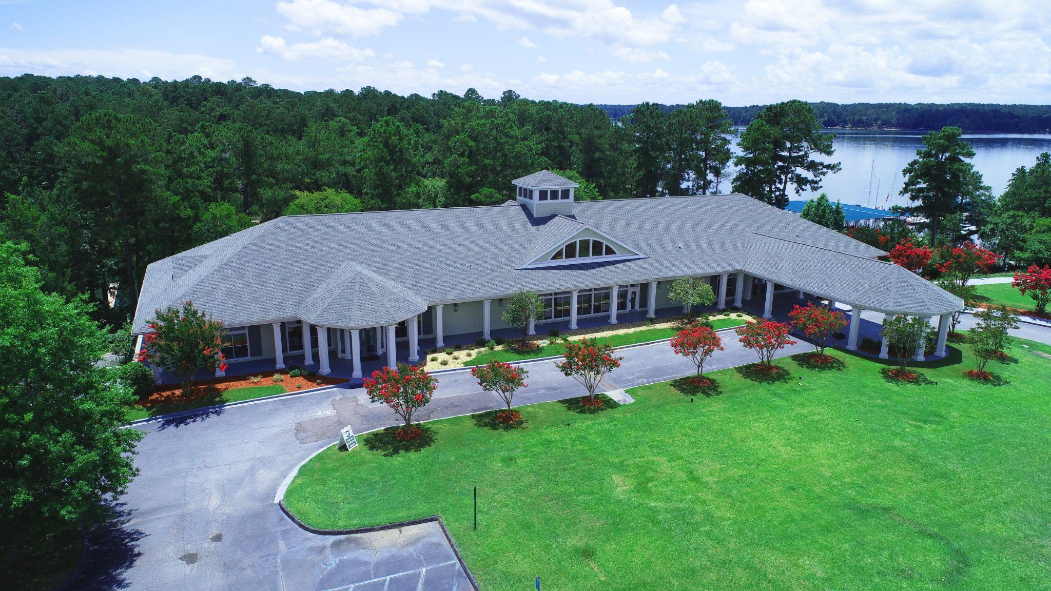
Thank You!

