Slide 1


FY 2026 Mayor’s Proposed Budget
Planning Department
Gabrielle Collard, AICP
Deputy Director for Planning
4/24/25

Slide 2
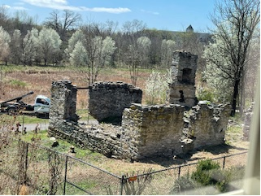
FY 2025 – In Review
Department Organization and “Infrastructure”
Completed Department Reorganization
Publication of the Department’s FY2025-2028 Work Plan
OpenGov Implementation

Slide 3
FY 2025 – In Review
Community Planning and Urban Design
Renewed City’s Sustainable Communities Designation
Kicked-off the Vision Zero Action Plan (SS4A)
Preparation for Golden Mile Small Area Plan Update
Initiated Comprehensive Plan Monitoring Program
Kicked-off the Jefferson Street Redesign

Slide 4
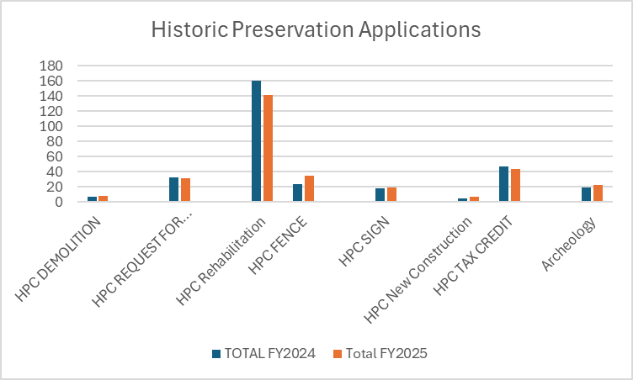
FY 2025 – In Review
Historic Preservation Planning
Implemented Sites of Enslavement Project Phase 1, Context Study
Kicked-off Sites of Enslavement Project Phase 2 and Context Study
Coordintaed with Frederick County on Tax Credit applications
Initiated Mill Pond House stabilization and engineering work

Slide 5
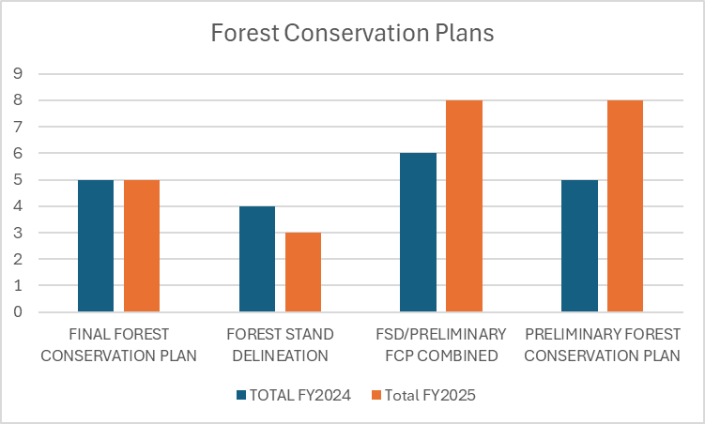
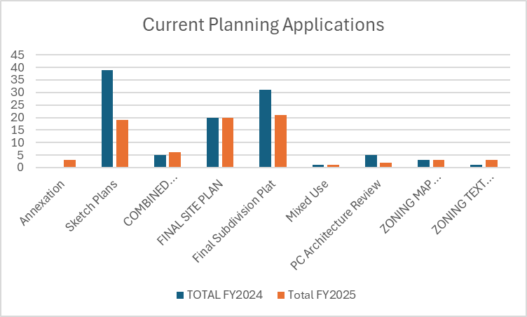
FY 2025 – In Review
Current Planning

Slide 6
FY 2026 Priorities
Complete OpenGov Implementation
Develop all Current Planning development applications and Demolition Review application
East Street Corridor Form Based Code
Establish regulatory framework for implementing the East Street Small Area Corridor Plan
Let’s Move, Frederick
Adopt a comprehensive bike and pedestrian plan

Slide 7
Performance Indicators
The key indicators of successful completion of the Department’s top three priorities are as follows:
Make available, online, the 10 remaining records/application types in OpenGov available by end of the calendar year.
Adopt ordinances that implement the vision of the East Street Corridor Small Area Plan and the Form Based Code.
Establishment of a policy framework that informs future grant applications and Capital Improvement Program (CIP) project investments in the areas of bicycle and pedestrian infrastructure.

Slide 8
FY 2026 Proposed Budget

Slide 9
5 year Historical Spend

Slide 10
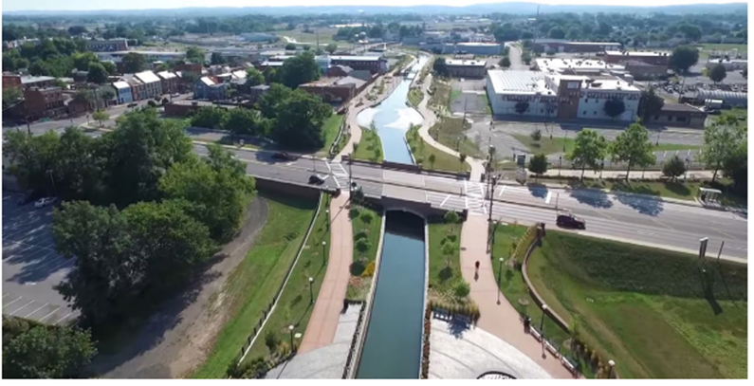
FY 2026 Additional Resources
Community Planning & Urban Design Planner Position
Funding for Sites of Enslavement Phase 2 project

Slide 11
Innovations, Enhancements and Resiliency
OpenGov Implementation:
Primary impacts of efficiencies and better customer service
Secondary impacts of resiliency

Slide 12
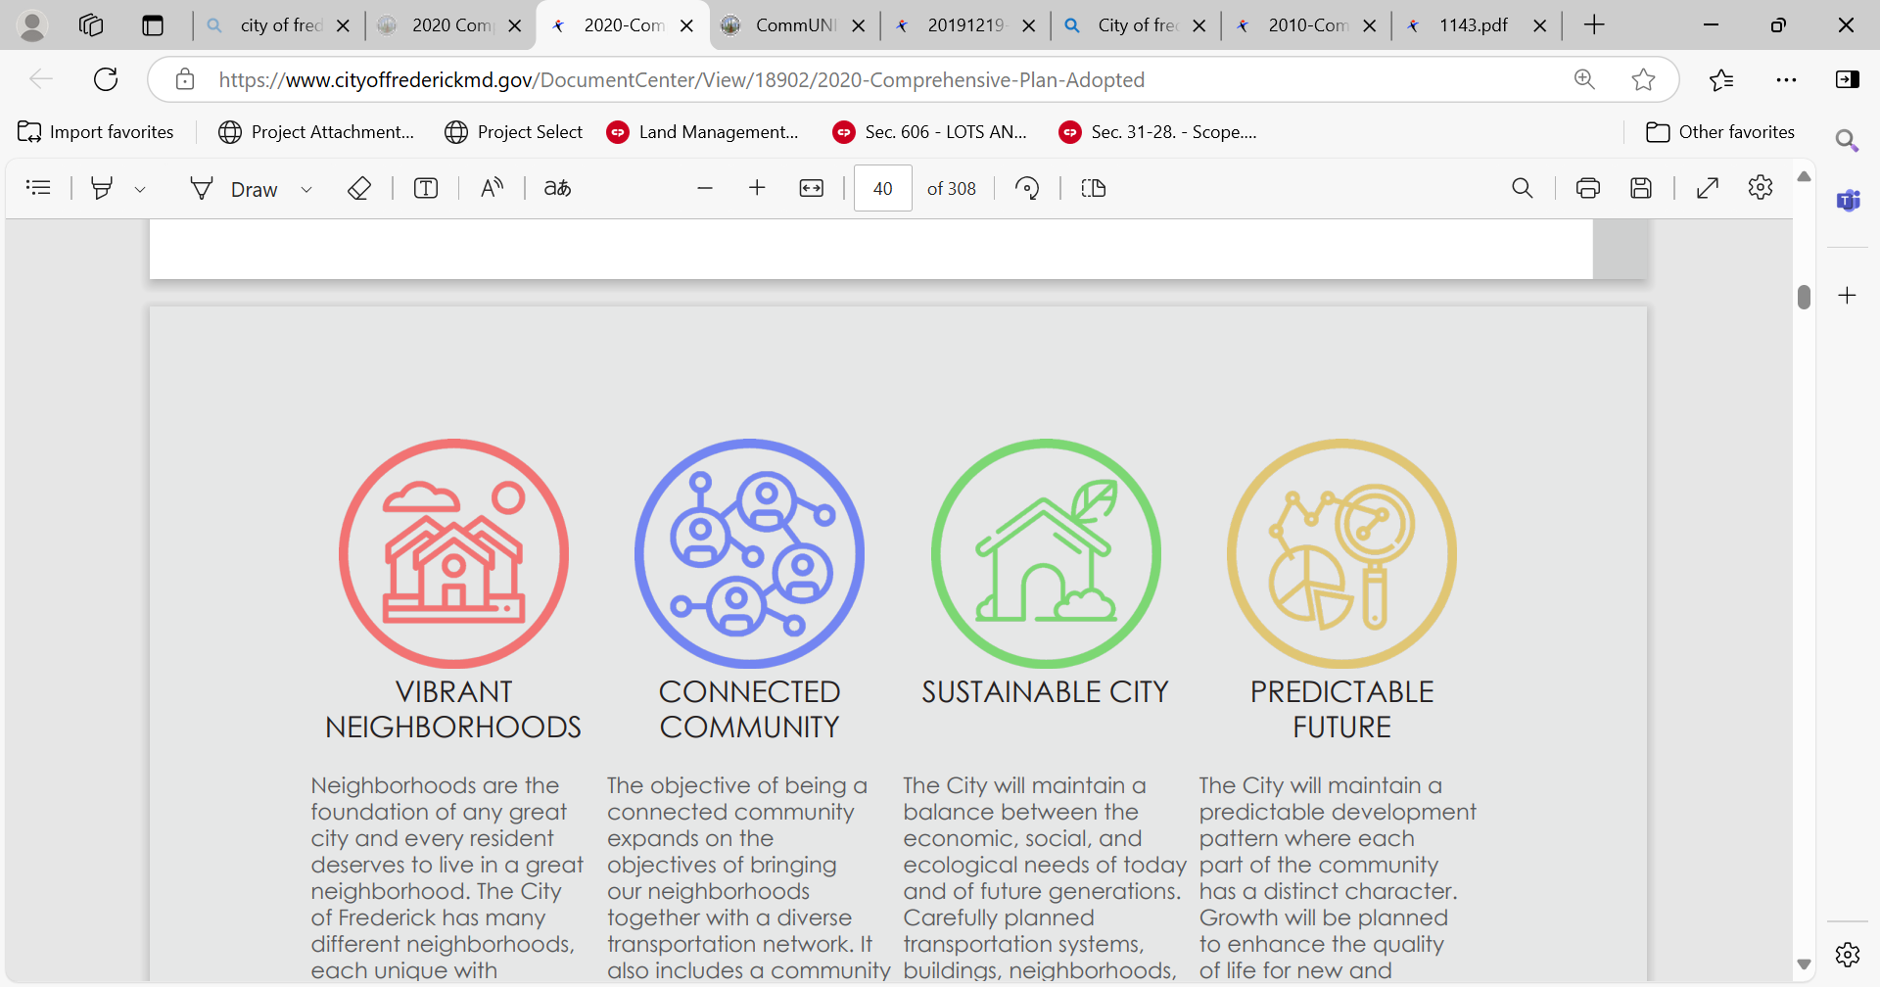
Resident Engagement and Transparency
Comprehensive Plan Monitoring Reporting
“Plain Language” Initiative

Slide 13


