Slide 1


FY 2026 Mayor’s
Proposed Budget
Pay Adjustments
Katie Barkdoll
Director of Budget and Administration

Slide 2
Past Decisions
Moved from grade/step system to an Open Range system in FY 2008 (Holtzinger Admin)
No salary increases in FY 2010, FY 2011, FY 2012 (McClement Admin)
FY 2023 – Implementation of Compensation and Classification Study
  Recommendations for pay bands, grades and % between grades were not accepted
  Adopted 15 grades, 7.5% between grades and pay bands were increased by a different rate
  COLA was applied at a flat dollar amount
  Current staff were not adjusted to the new pay scales (unless below min)

Slide 3
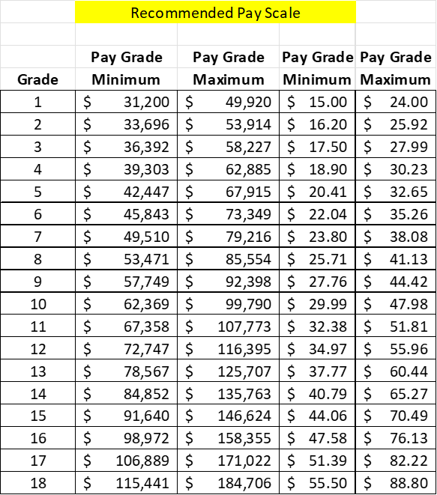
Study Recommended Pay Scale

Slide 4
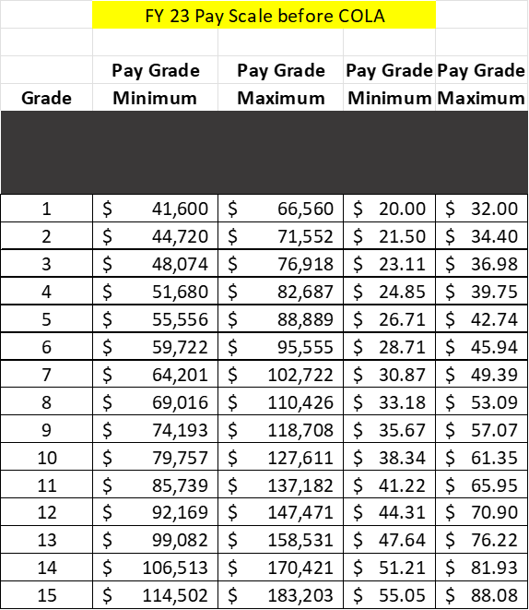
FY 2023 Adopted Pay Scale

Slide 5
FY 2025 Adopted Pay Scale

Slide 6
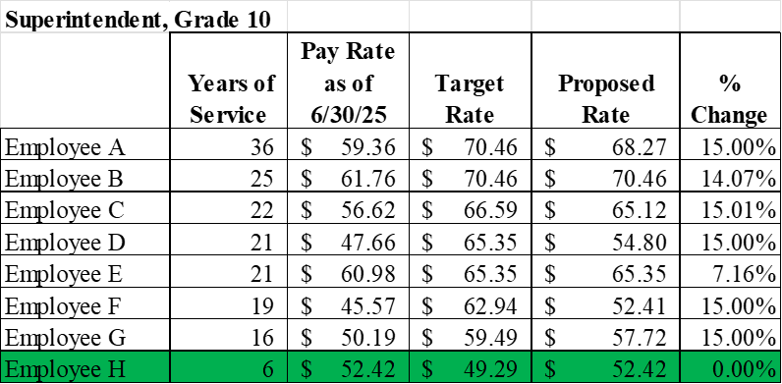
Pay Compression Examples

Slide 7
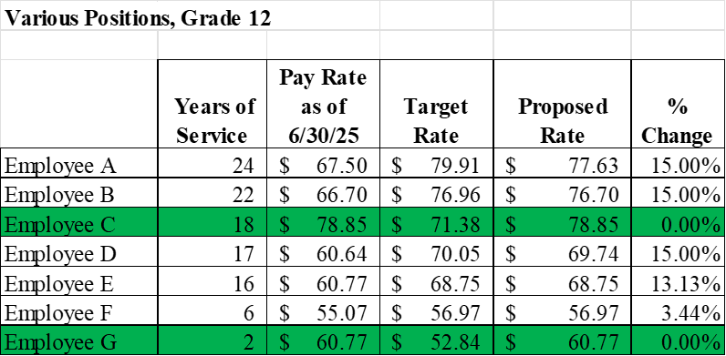
Pay Compression Examples

Slide 8
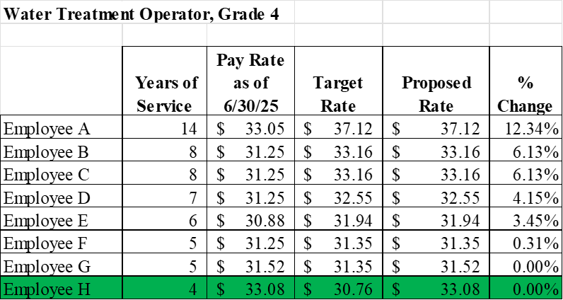
Pay Compression Examples

Slide 9
Pay Compression Examples

Slide 10
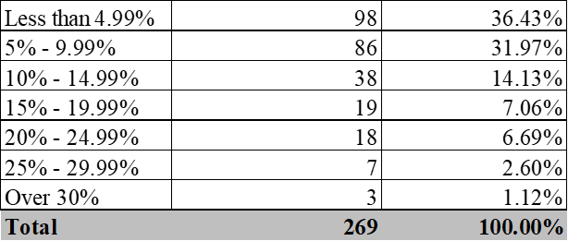
Pay Adjustment Methodology
Calculated a target pay scale placement for each employee using years of service and a 25-year career
Capped increase to 15% in FY 2026
Full implementation over 3 years

Slide 11
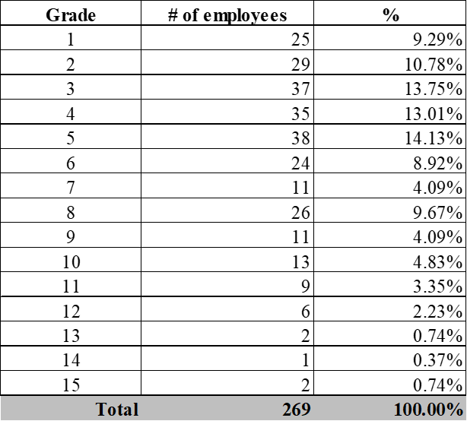
Pay Adjustment Methodology

Slide 12
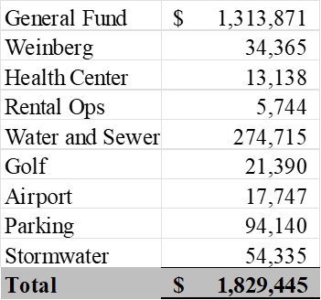
Pay Adjustment Cost

Slide 13


