Slide 1

Tenant Protection Webpages
Housing, Health and Education Committee
Allen Etzler
Deputy Chief of Staff
July 17, 2025

Slide 2



Background
On May 12, 2025, City Council President Katie Nash requested a comprehensive website that would serve as a centralized resource or renters, providing essential information and tools to navigate rental housing in the City.
The Public Affairs Department created a draft website, drawn from information collected from City, State and Federal online resources. Those webpages have been shared with HHS staff and community groups for review. Those draft pages are included in the following slides.
Next Steps: Staff await the review and feedback of those pages for accuracy and relevance and provide edits for inclusion into the final website.

Slide 3
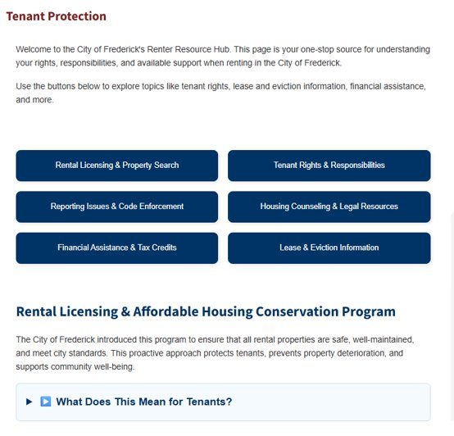
Tenant Protection Main Page
Includes:
Introductory information
Background on the Licensing & Affordable Housing Conservation Program
6 sub-navigation buttons that link to:
  Rental Licensing & Property Search
  Tenant Rights & Responsibilities
  Reporting Issues and Code Enforcement
  Housing Counseling & Legal Resources
  Financial Assistance & Tax Credits
  Lease & Eviction Information

Slide 4
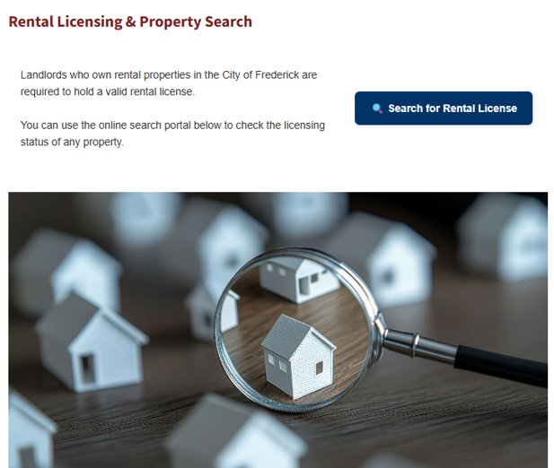
Rental Licensing & Property Search
Includes:
Rental License Search button (to OpenGov)
Background information
Related Ordinances:
  Ordinance G-23-09
  Ordinance G-22-12

Slide 5
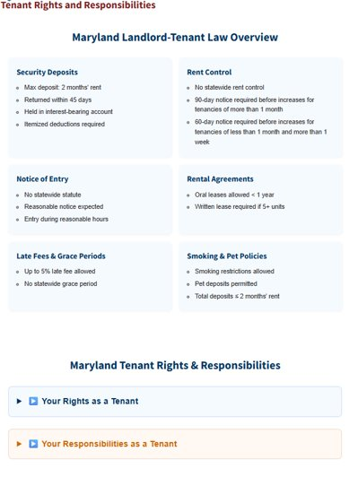
Tenant Rights and Responsibilities
Includes:
Overview information on:
  Security Deposits
  Rent Control
  Notice of Entry
  Rental Agreements
  Late Fees & Grace Periods
  Smoking & Pet Policies
MD Tenant Rights (notice, subletting, tenant organizations, MD Handbook)
MD Tenant Responsibilities (paying rent, keeping property clean, reporting repairs)

Slide 6
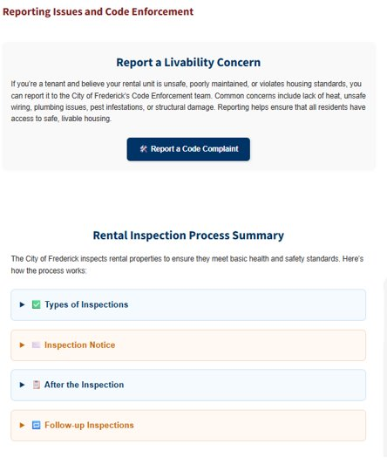
Reporting Issues and Code Enforcement
Includes:
Link to reporting a code enforcement (OpenGov)
Rental Inspection Process Summary:
  Types of Inspections
  Inspection Notice
  After the Inspection
  Follow-up Inspections

Slide 7
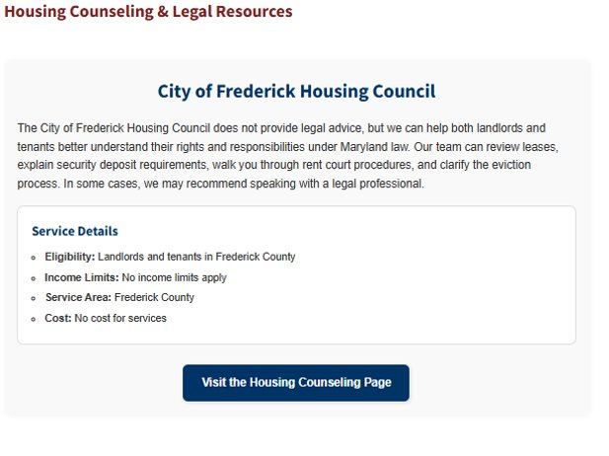
Housing Counseling & Legal Resources
Includes:
Information on the HHS City of Frederick Housing Council
Button link to Housing Council page

Slide 8
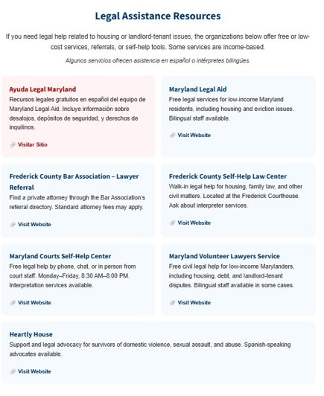
Housing Counseling & Legal Resources
Includes:
Resources, websites, available interpreter services, and information on if it is free to low-income residents for:
  Ayuda Legal Maryland
  Maryland Legal Aid
  Frederick County Bar Association
  Frederick County Self-Help Law Center
  MD Courts Self-Help Center
  MD Volunteer Lawyers Service
  Heartly House

Slide 9
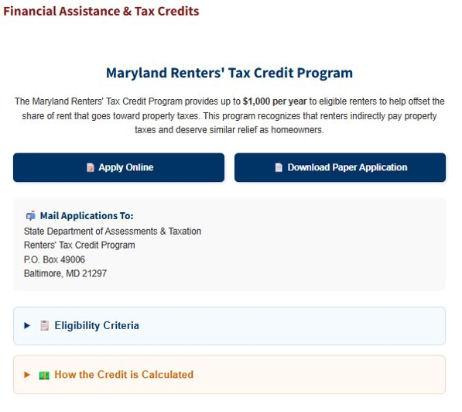
Financial Assistance and Tax Credits
Includes:
Button link to MD Renters’ Tax Credit Program online application
Button link to download MD Renters’ Tax Credit Program
Information on Eligibility Criteria (general residency, and net worth) and Specific Qualifications (age, disability, dependents)
Information on how the credit is calculated

Slide 10
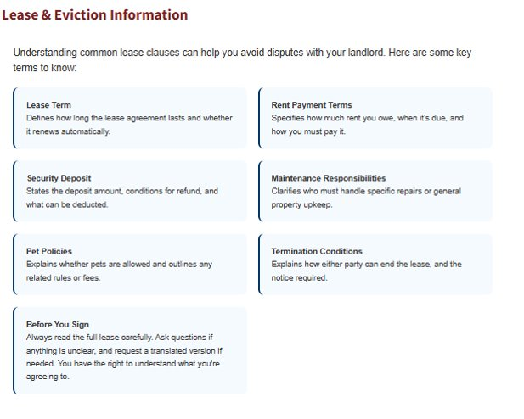
Lease & Eviction Information
Includes:
Information on common lease clauses:
  Lease term
  Rent payment terms
  Security deposit
  Maintenance responsibilities
  Pet policies
  Termination conditions
  Before you sign

Slide 11
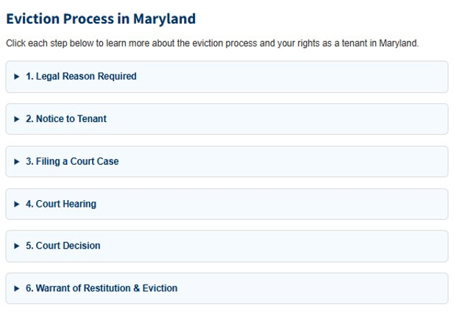
Lease & Eviction Information
Includes:
Information on the process and tenant rights:
  Legal reason required
  Notice to tenant
  Filing a court case
  Court hearing
  Court decision
  Warrant and eviction

Slide 12
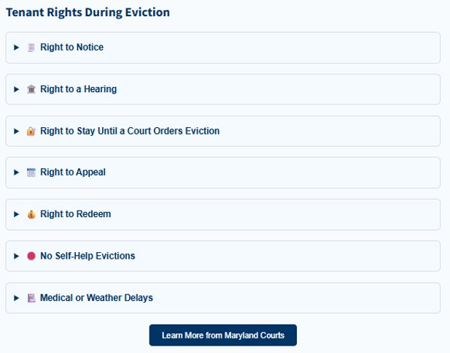
Lease & Eviction Information
Includes:
Information on the process and tenant rights:
  Right to notice
  Right to hearing
  Right to stay until court orders
  Right to appeal
  Right to redeem
  No self-help evictions
  Medical or weather delays
Button link to https://www.mdcourts.gov/legalhelp/housing

