Slide 1



FY 2026 Mayor’s
Proposed Budget
Frederick Police Department
Jason Lando
Chief of Police
4/10/25

Slide 2
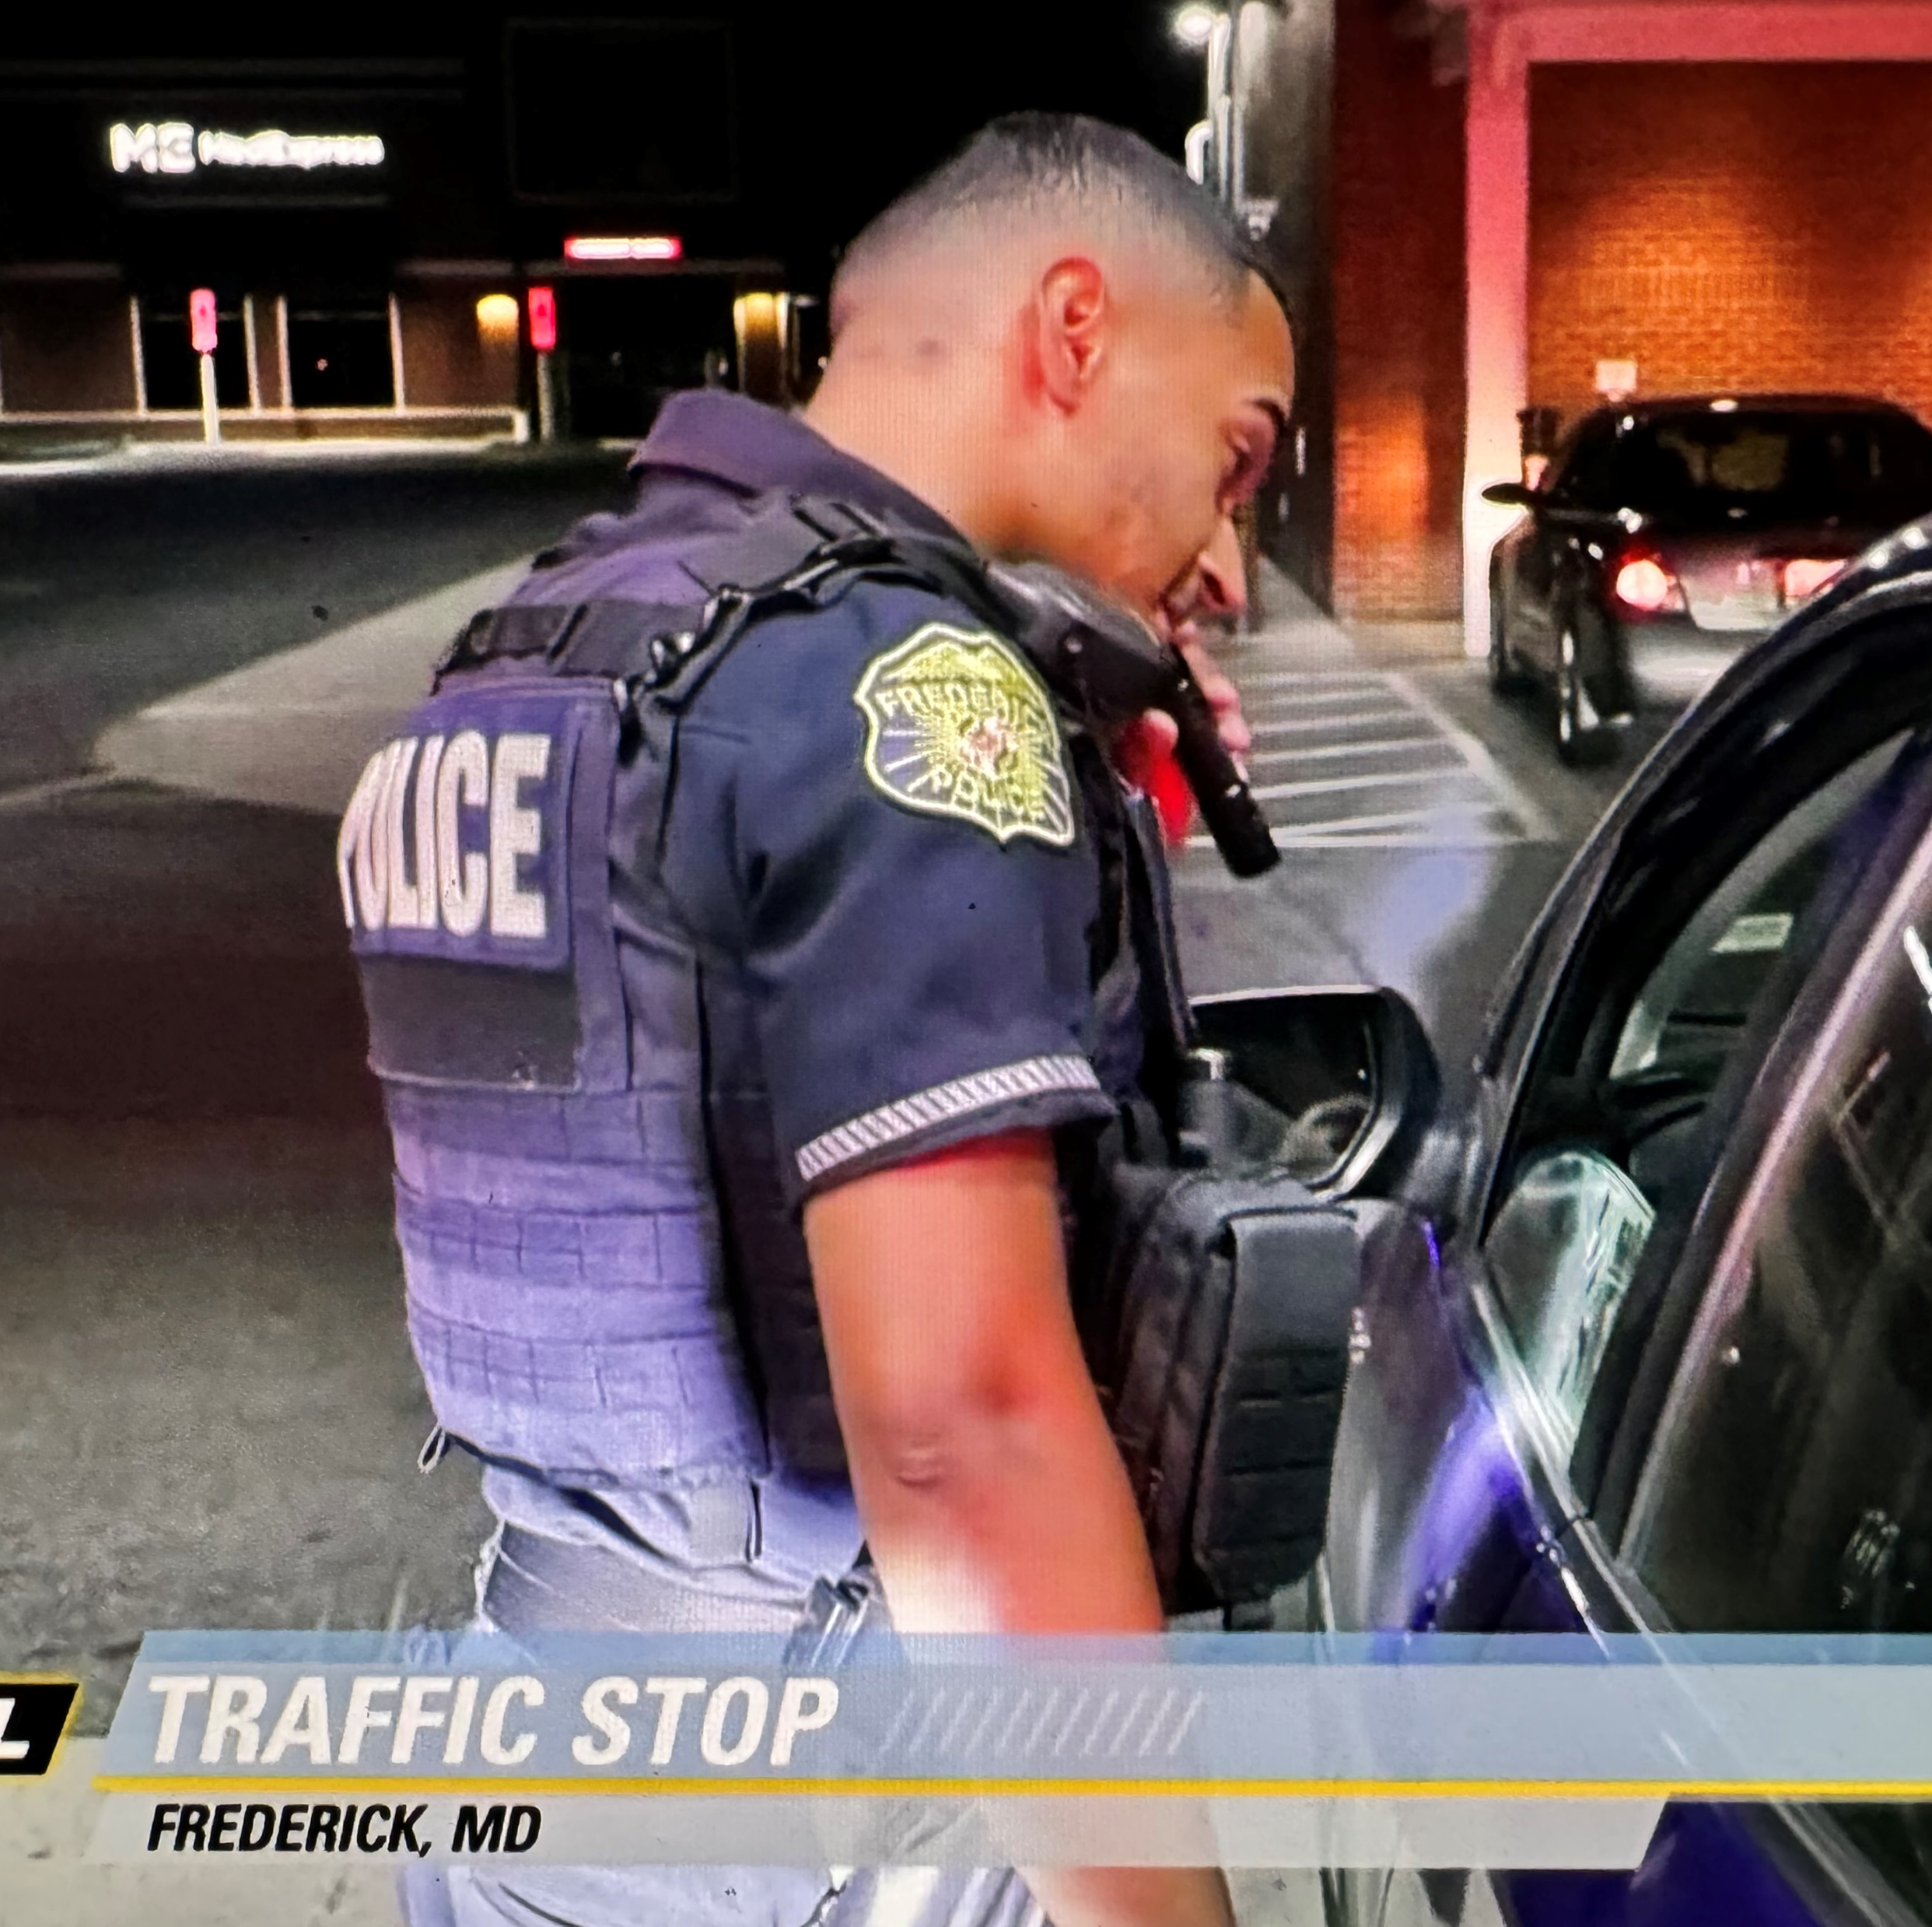
FY 2025 – In Review
Crime Reduction & Traffic Enforcement
Advancements in Technology
Community Outreach & Engagment

Slide 3
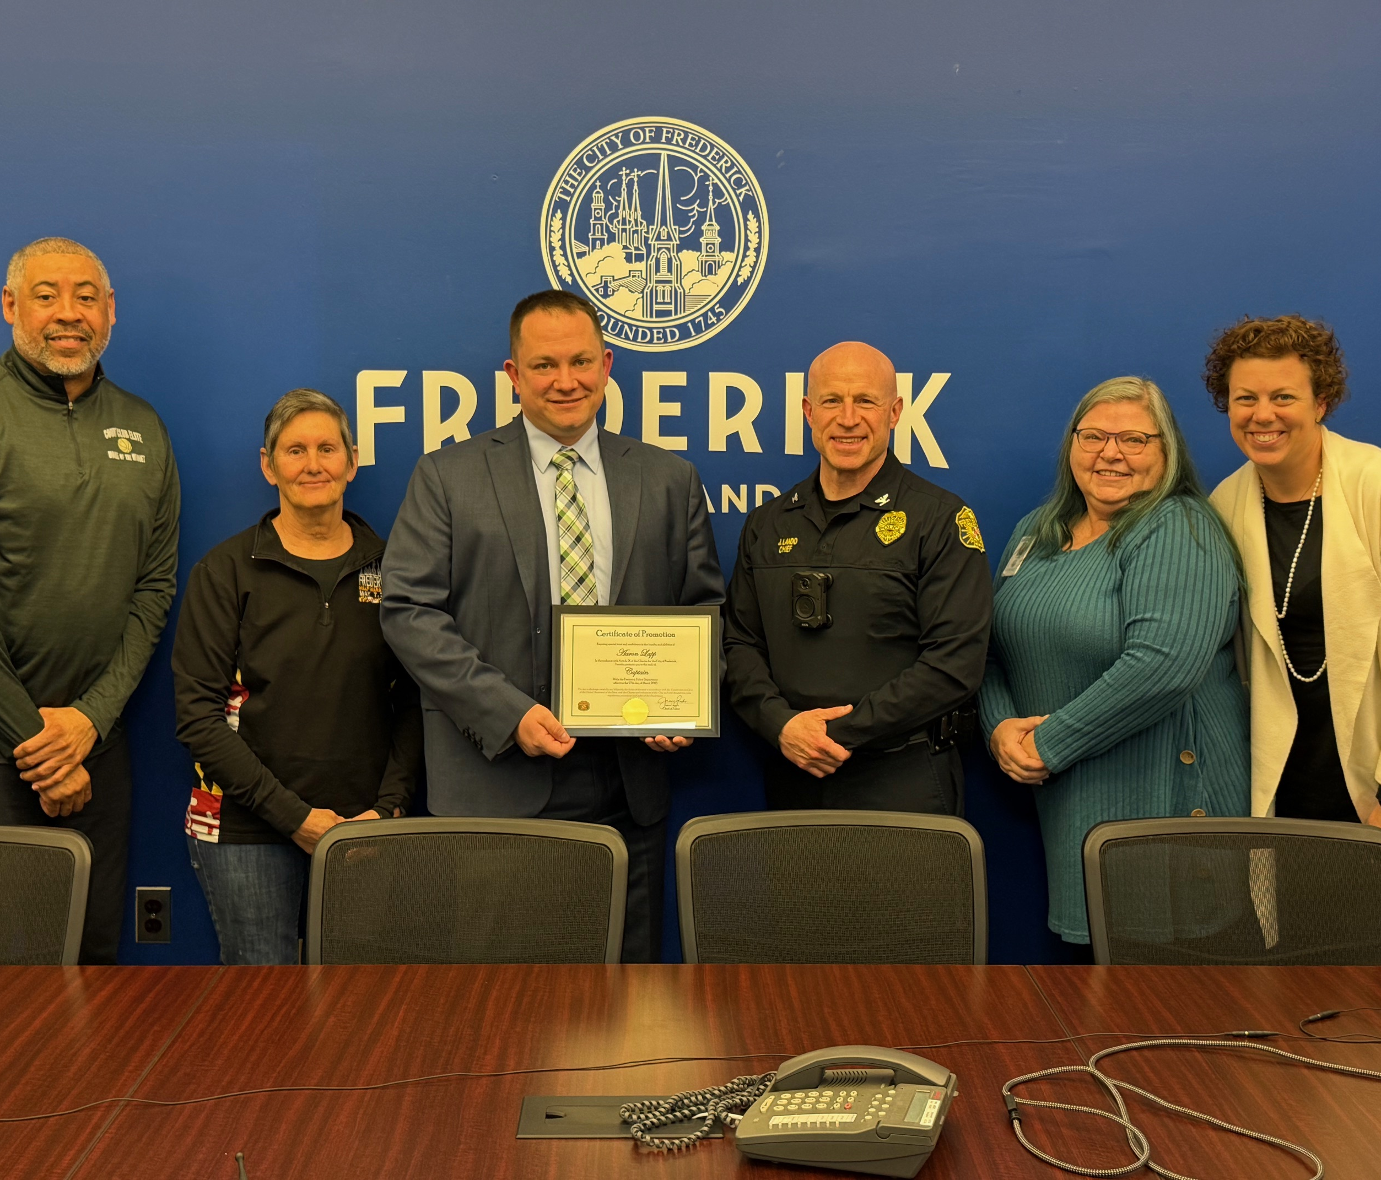
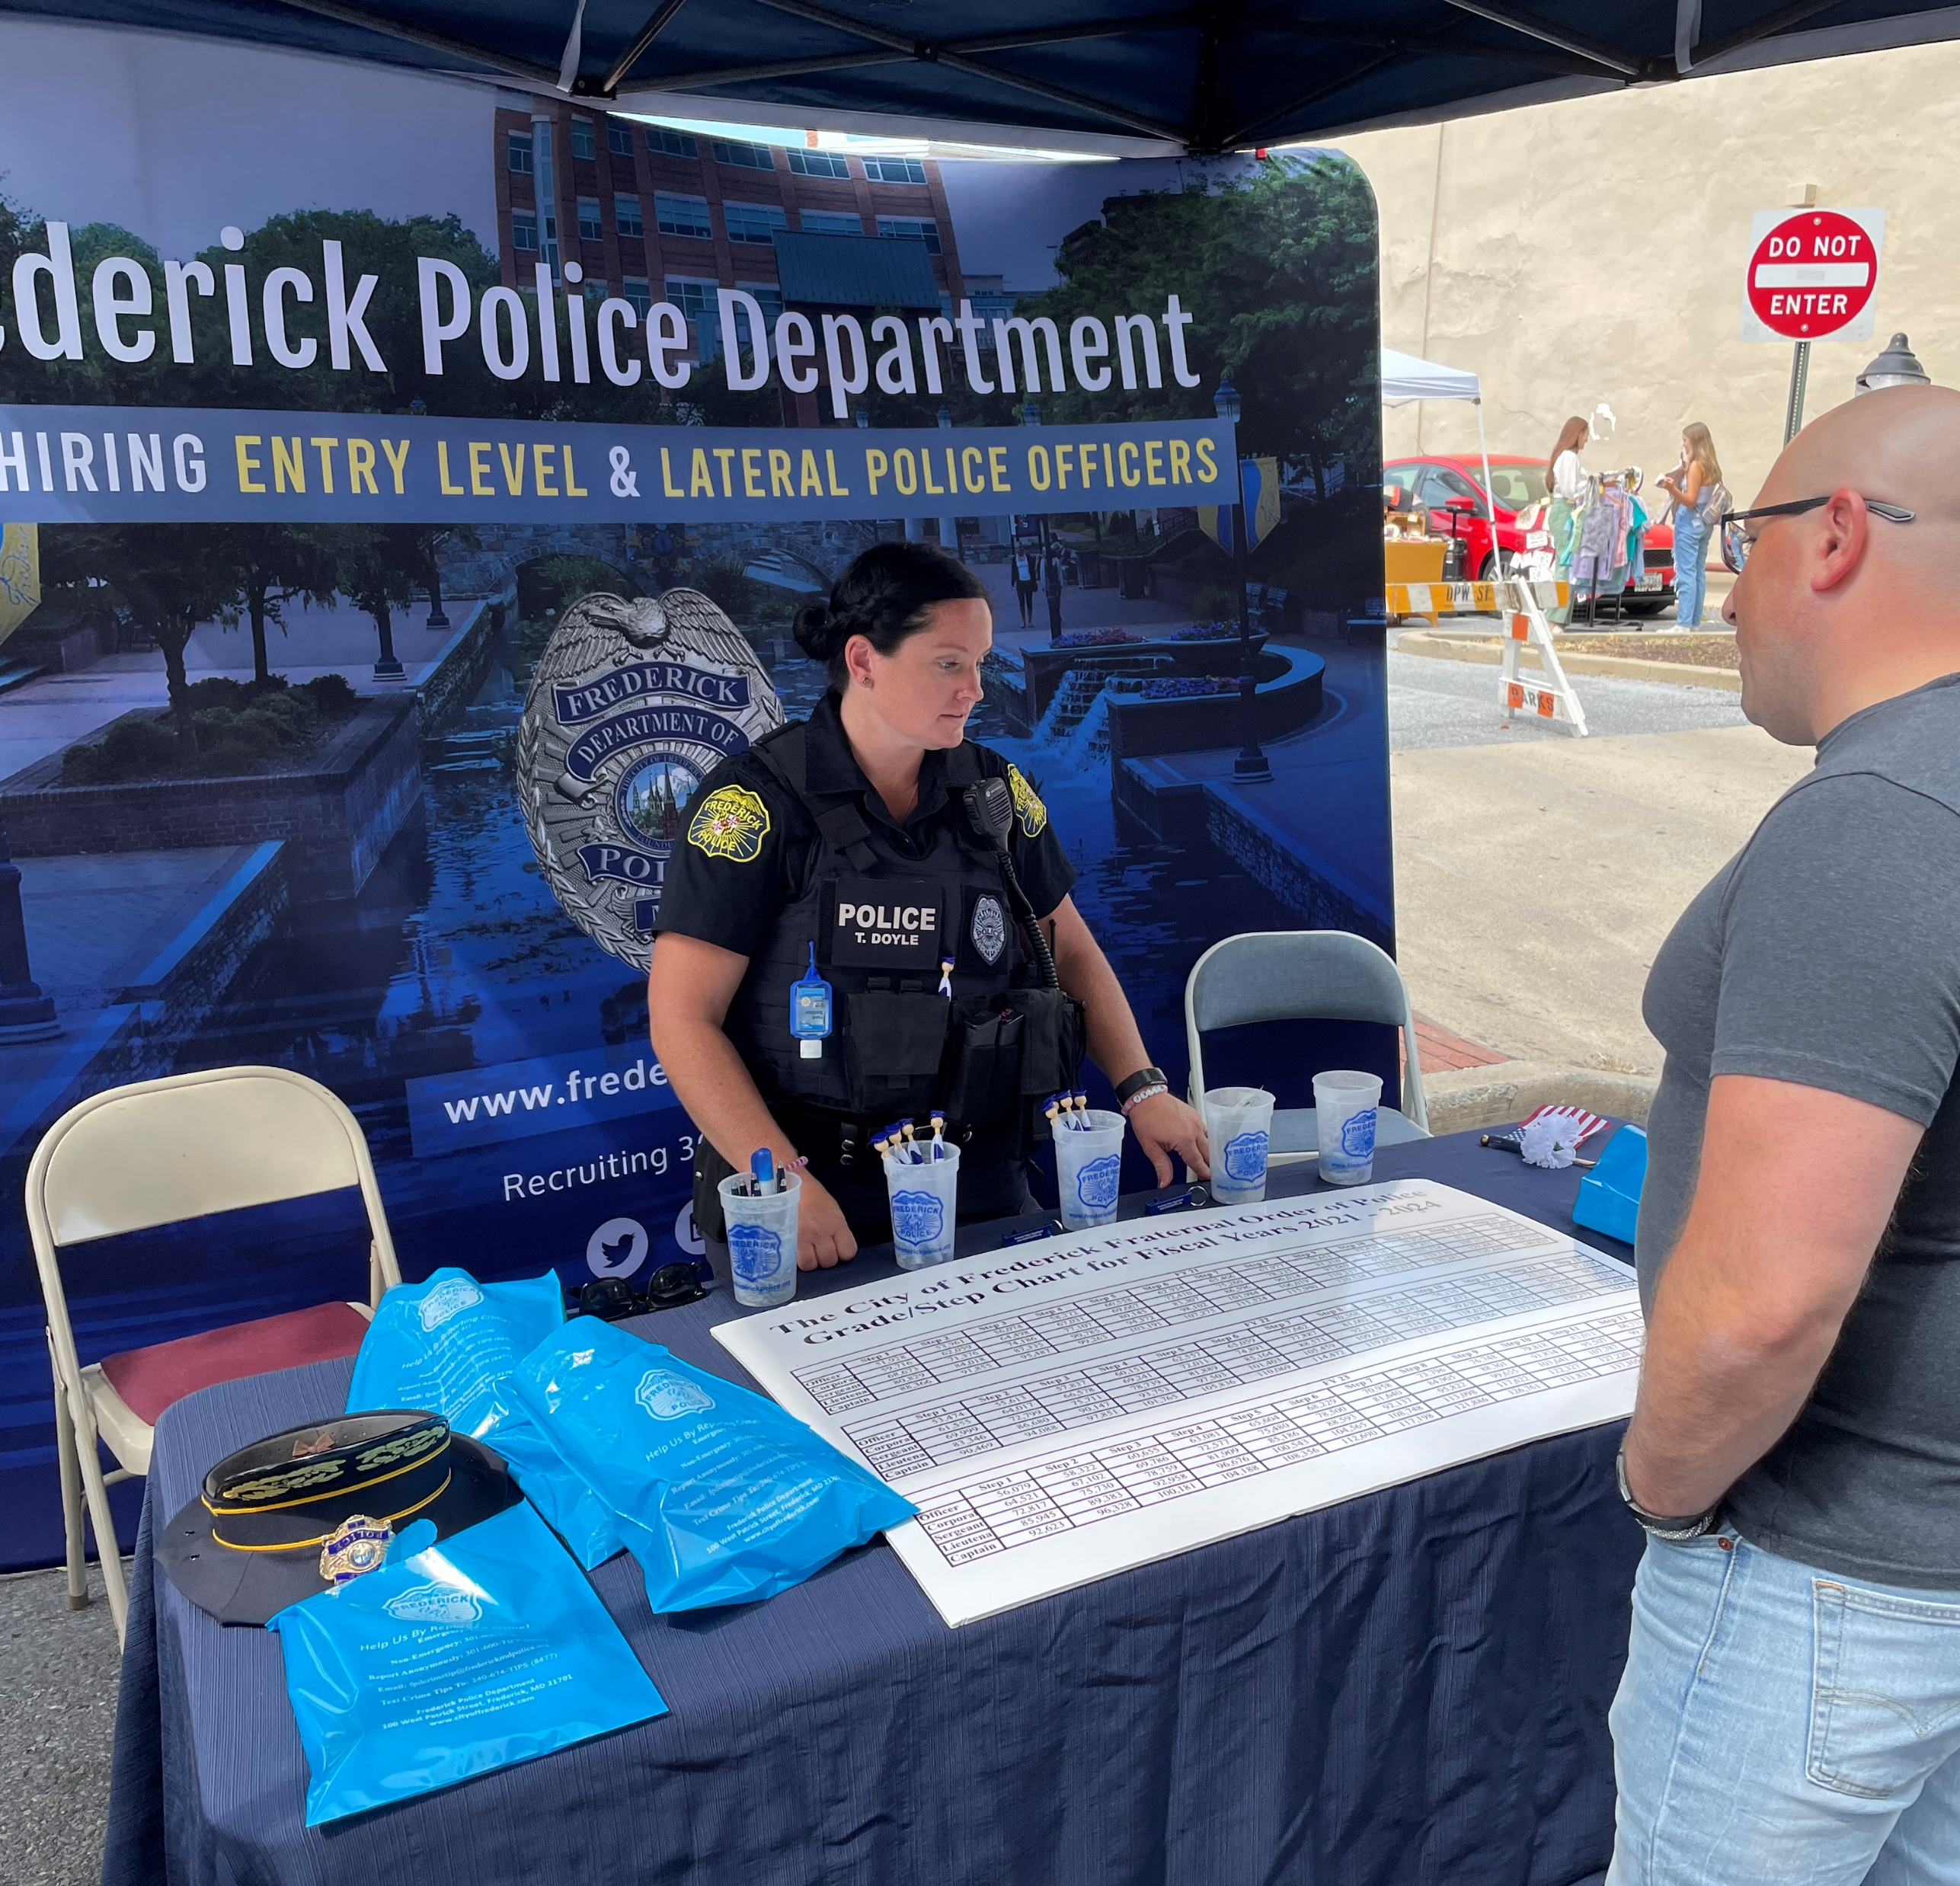
FY 2026 Priorities
Top Three Priorities
1. Crime reduction / Speed Enforcement
2. Recruitment / Retention
3. New Programs / Initiatives

Slide 4
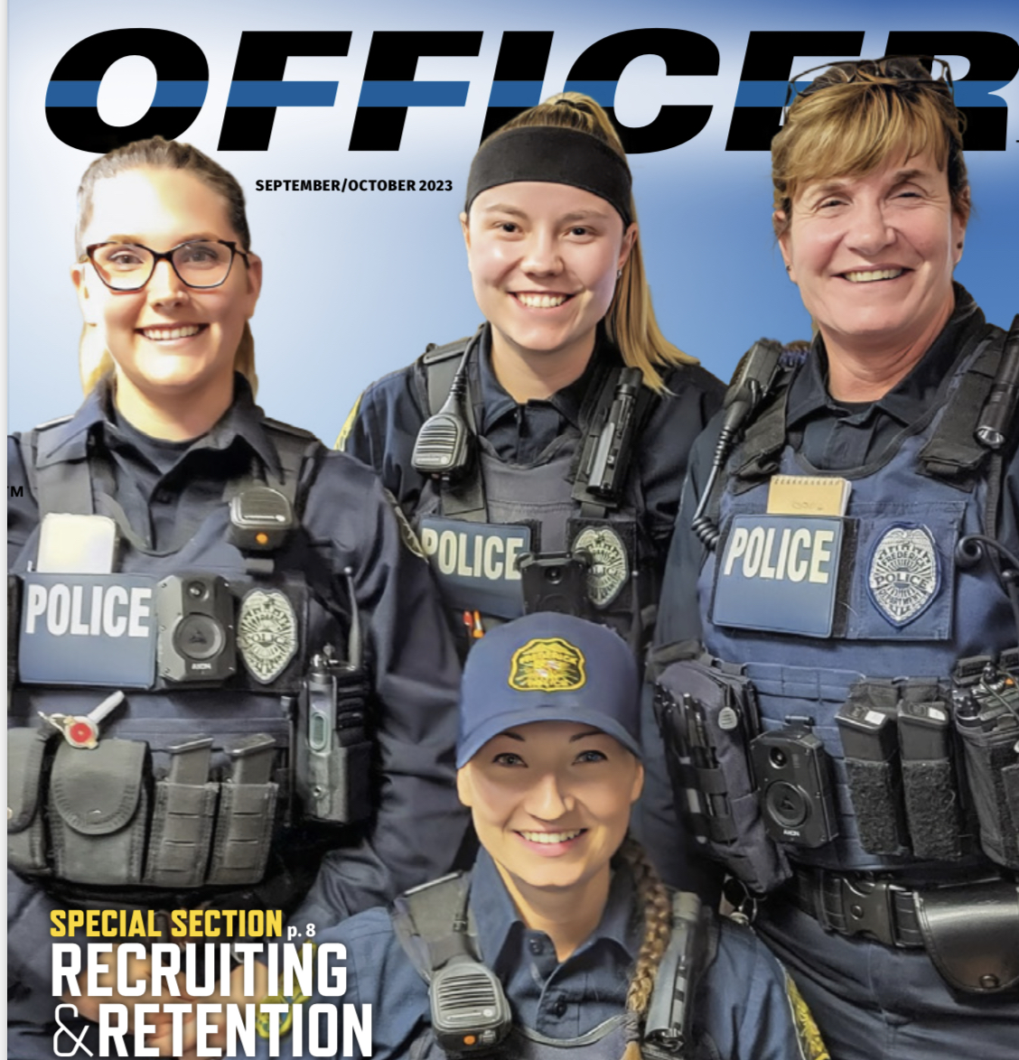
Performance Indicators
Crime statistics
Sustained complaints
Police vehicle collisions
Recruitment Data
SPIDRTech ratings

Slide 5
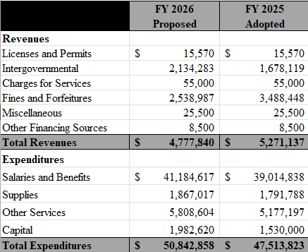
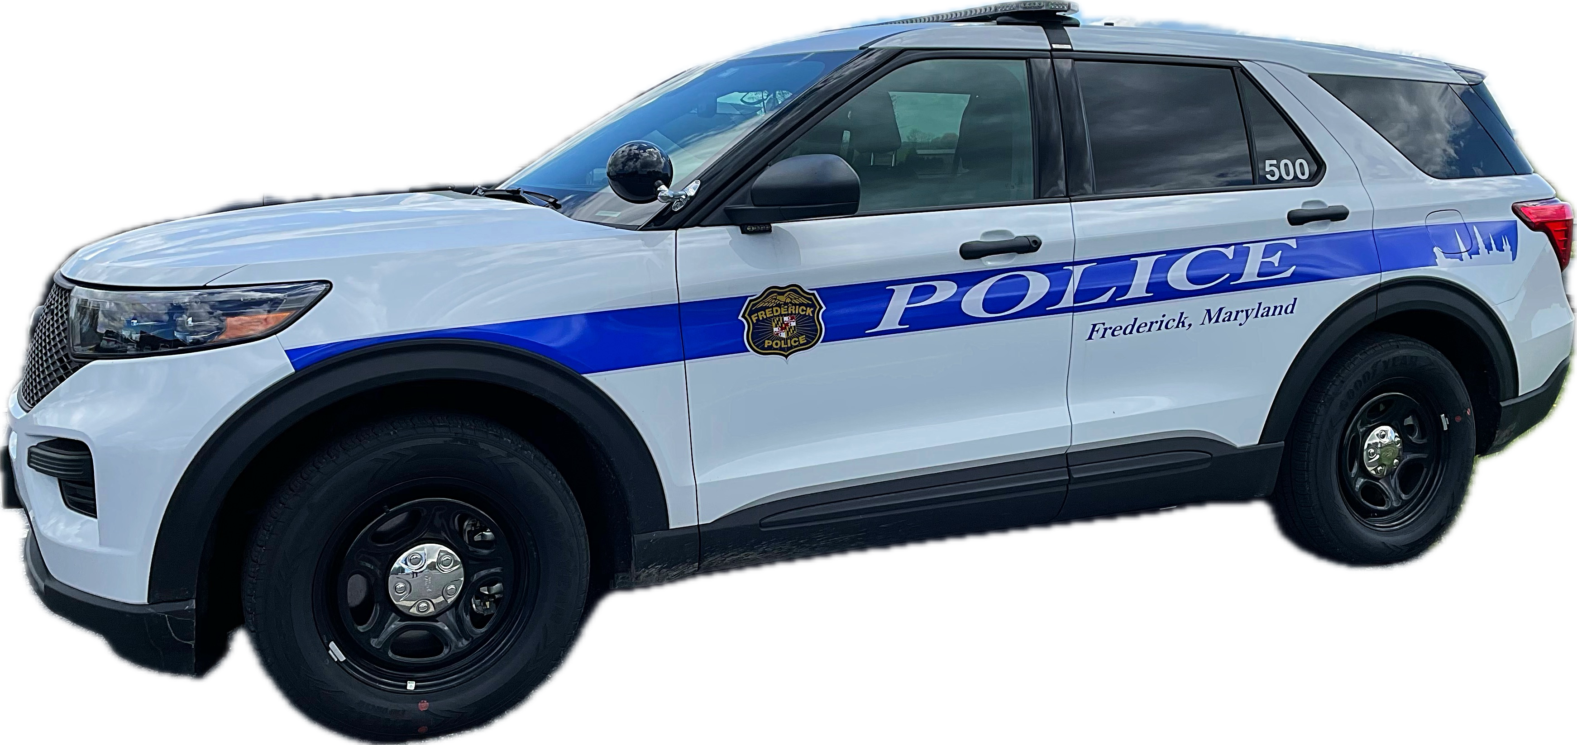
FY 2026 Proposed Budget

Slide 6
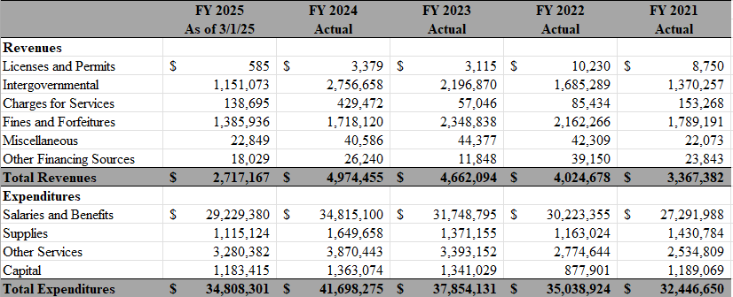
5 year Historical Spend

Slide 7
FY 2026 Additional Resources
Additional Resource | Justification
Police Vehicle Replacements | Continue replacing old unreliable vehicles to bring fleet within industry standards.
Automated Enforcement Position PT to FT
ALPR Vehicle Systems | Expand use of technology in crime reduction.
Stationary Radar Units | Increase traffic enforcement with technology.
Mobile AFIS Units | Increase crime reduction with technology.
AXON Upgrades | Increase command and supervision of officers in high stress situations. Add resources to BWC position.
Forenscope Latent Print System | Increase crime solvability with technology.
Command Unit Accessories | Increase scene control and resources.
Police Academy Carpet | Replace worn out carpet.

Slide 8
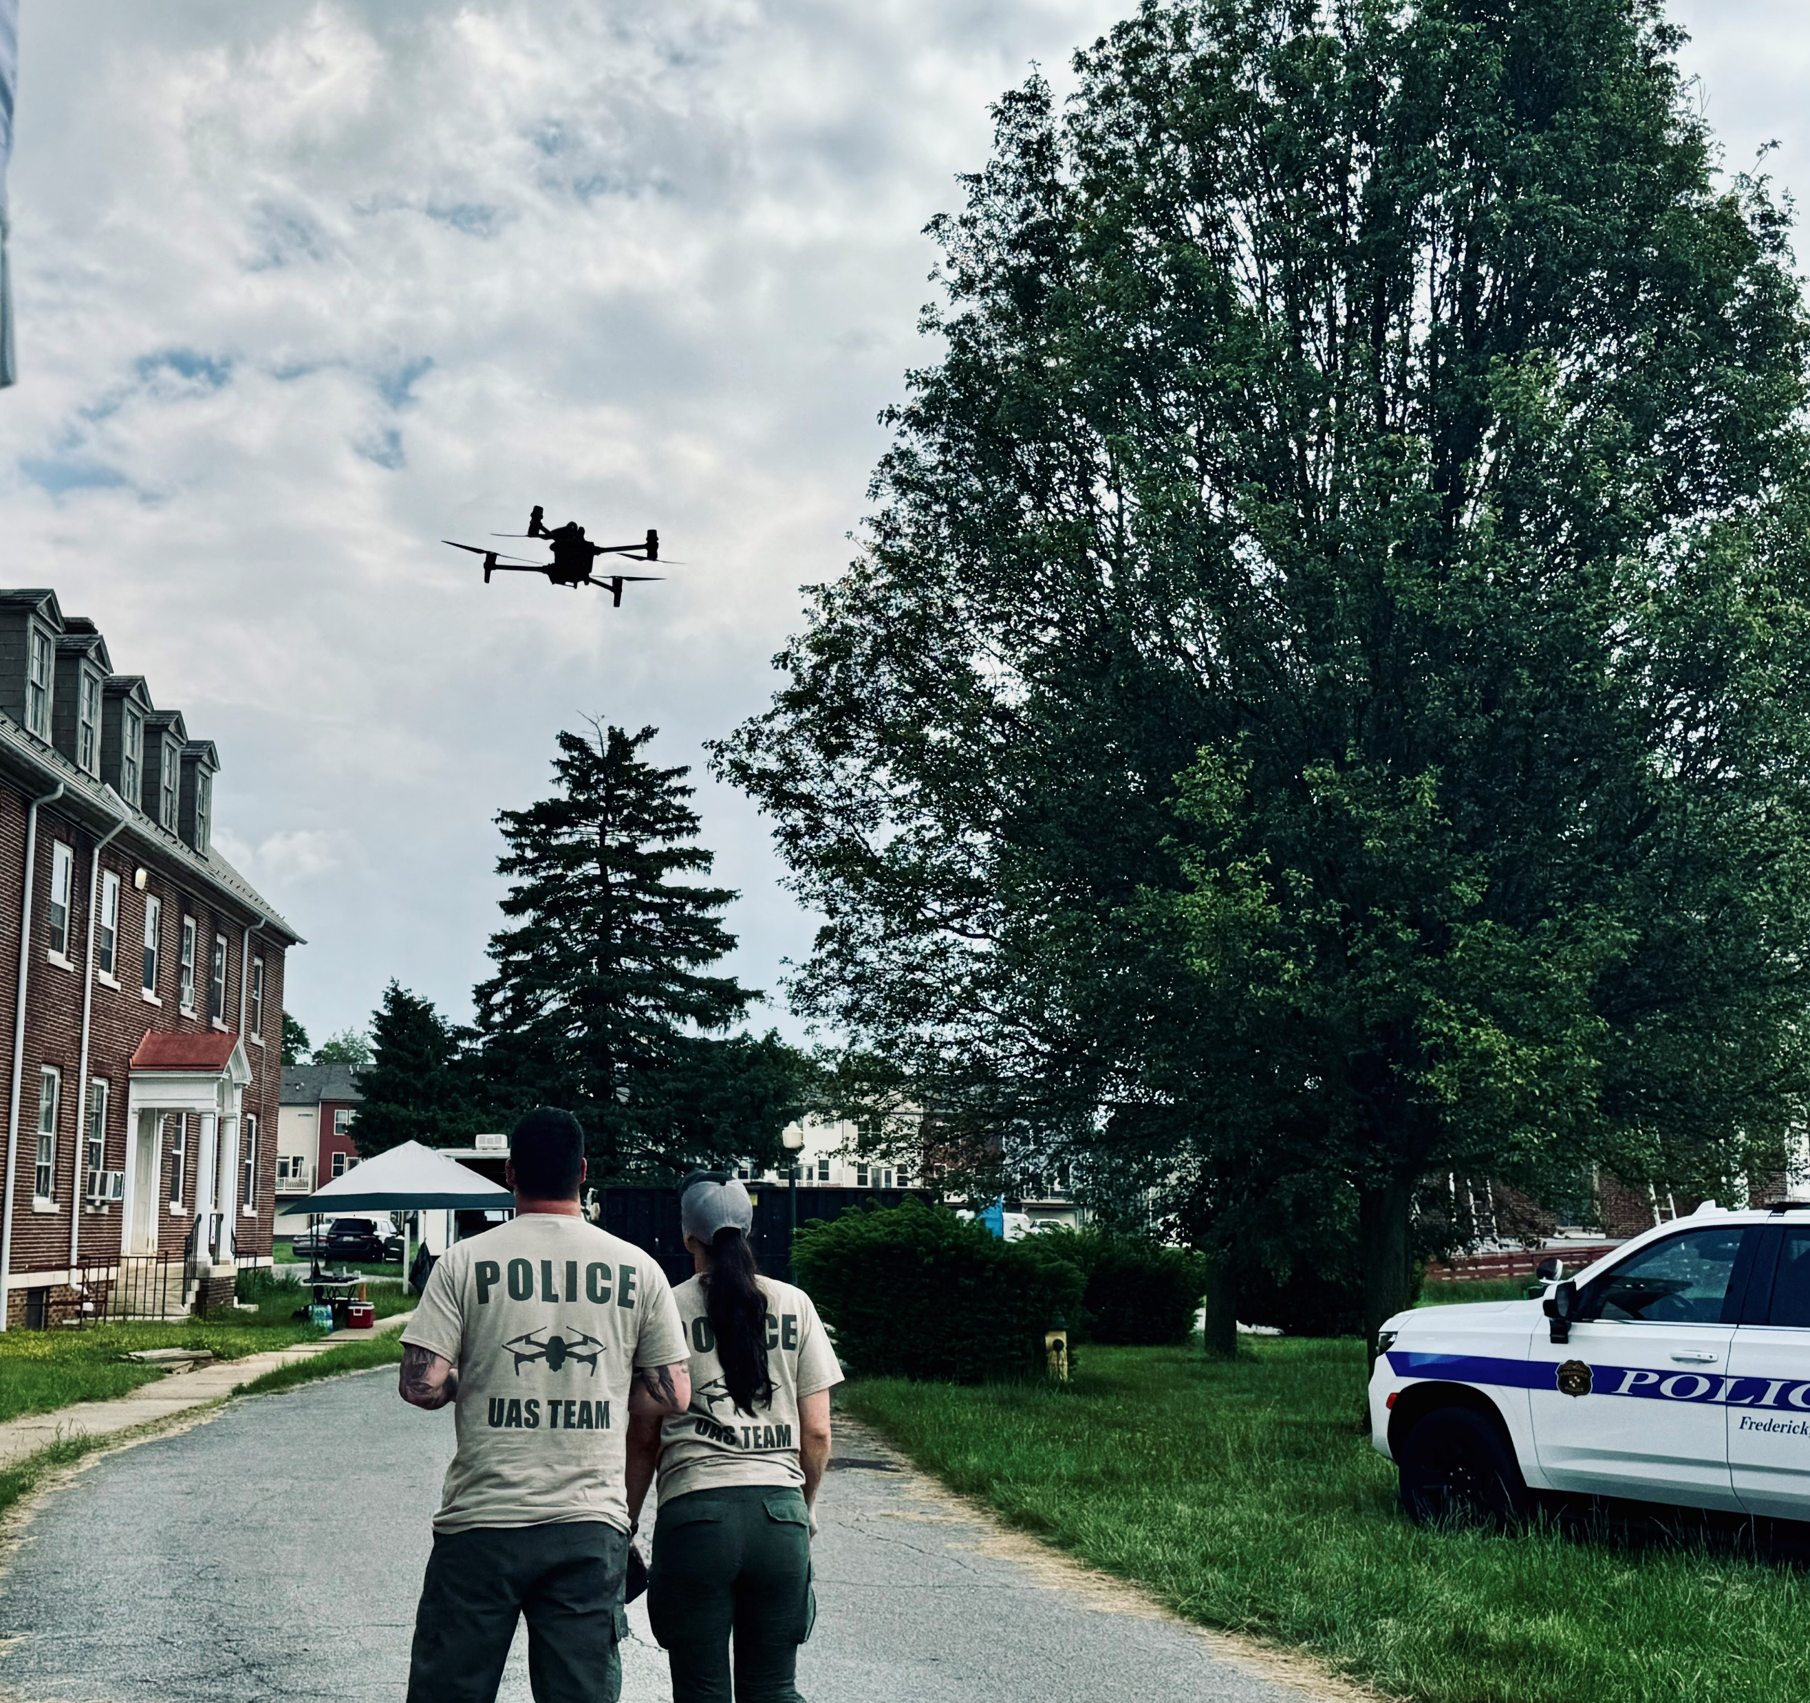
Cost Savings and Efficiencies
Utilizing Axon system to reduce workload. (Redaction)
Reduce downtime of vehicles due to maintenance issues.
Reduce repair costs of vehicles due to age.
Steps toward implementing Drone as First Responder (DFR) to supplement operations.
Review marketing strategies for recruitment.

Slide 9
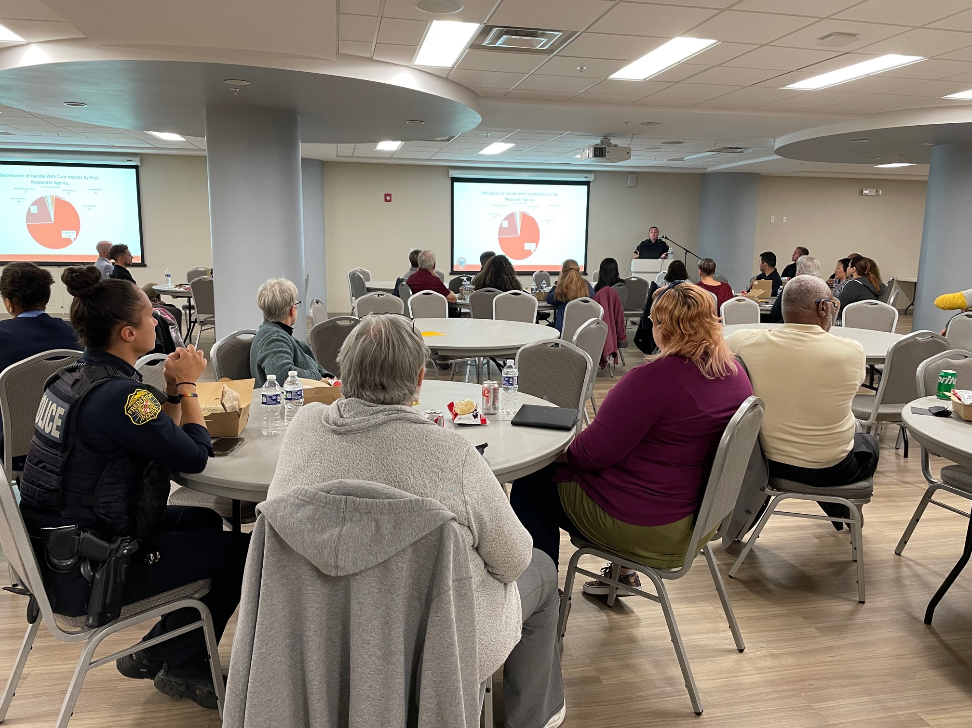
Resident Engagement and Transparency
Good SAM
Axon Respond
SPIDRTech
Chief’s Community Advisory Board
Multi-Cultural Liaison Unit
GovQA Portal (MDPIA)
New HQ Self Service Kiosk

Slide 10


