Slide 1
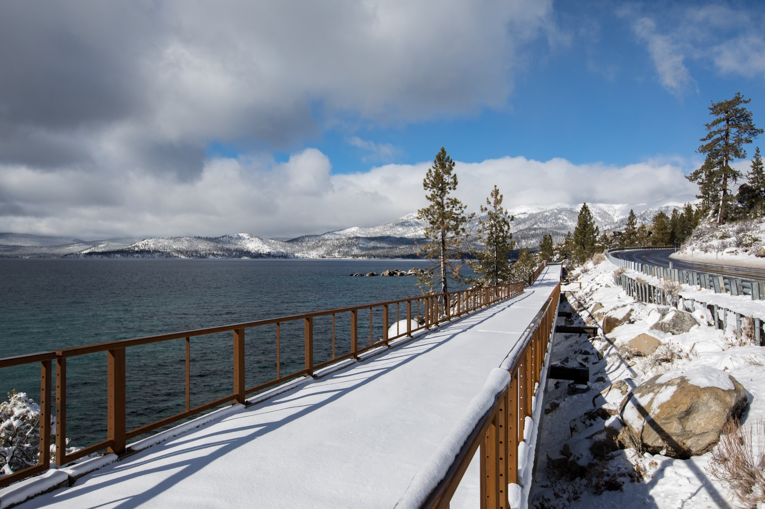
Nevada Legislative Oversight Committee TRPA and Marlette Lake Water System
By Julie Regan, TRPA Executive Director • March 8, 2024
Image: Tahoe Regional Planning Agency
Notes:
Good afternoon committee members. I am Julie Regan, TRPA’s executive director. I am joined today by Devin Middlebrook, TRPA’s government affairs manager.
Thank you for joining us today at TRPA’s offices here in Stateline, Nevada. as you heard at your January meeting and can see by today’s meeting attendance, today’s topic, transportation, is an important topic to the community.
Lake Tahoe’s transportation system is a relic of the past. Our roadway system was designed before our agency’s formation. The planners of the time built an auto-centric system with plans for massive highway expansions. Luckily that envisioned future for Tahoe never came into reality.
However, we are still burdened by the poor planning of the past. Our transportation system is the primary contributor to pollution that harms lake clarity and greenhouse gas emissions that drive climate change. Our rural roads can swell with visitor and local traffic and congestion that impacts quality of life, safety, and creates challenges for evacuation.
Today, you will hear more about these challenges, community concerns, and how TRPA and our partners at Tahoe are working to create a transportation system that protects the environment while supporting local communities and the economy.
Introduction
I am Julie Regan, TRPA’s executive director
Joined by Chris Keillor and Devin Middlebrook
Opening Statement
Transportation has long been a challenge at Tahoe
We play an active role
Comments from last meeting
Evacuation
Safety
TRPA wants to lower road capacity for bikes
Who is the bi-state?
777 is just more taxes on locals
Why should locals reduce trips when visitors are the problem
No Road diets
Us 50 east
VMT
No mobility hubs (IV)
Lack of transit options
We heard you and we plan to touch on all of these today.

Slide 2
TRPA’s Transportation Role
Bi-State Compact
Requires a transportation plan for the region
Must reduce dependency on the automobile
Preference for transit and alternative transportation
No roadway expansions
Metropolitan Planning Organization (MPO)
Designated in 1998
2015 – recognition of visitor population for formula funding
Notes:
Our Bi-state compact is the guiding document for our roll.
The compact calls for a transportation plan for the region to reduce dependence on the private automobile. We do this by prioritizing transit and other modes of transportation. We are also not allowed to expand roadway capacity for cars.

Slide 3
Transportation Connections
Regional Transportation Plan
Transportation Action Plan
Monitoring and Transparency
Adaptive Management
Bi-State Compact
Support Partner Implementation
Notes:
With the understanding of TRPA’s role. I will now walk through an update on ongoing work to implement transportation projects at Tahoe.
This graphic shows a bit of the phases, or hierarchy, of how we are approaching transportation.
At the top, is TRPA’s bi-state compact. It outlines our mission and directive when it comes to transportation.
Next, we implement the bi-state compact through our Regional Transportation Plan.
To implement the RTP, since 2017 both states have convened a bi-state consultation on transportation .
From this we developed an action plan and funding strategy. This helps to prioritize and implement projects.
Meetings like today provide oversight to ensure we are meeting our goals. And finally we continue to measure progress and adjust plans by updating our RTP every 4 years.
We are accountable but rely on our partners to implement. This is the core of our collaboration.

Slide 4
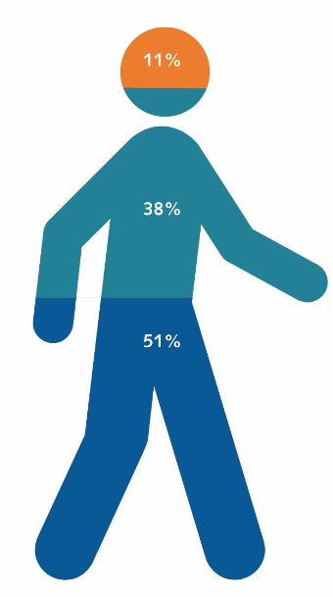
How Transportation Data Drives Planning: Regional Trips by Type
Regional Entry/Exit Trips
Recreation Trips (all users)
Resident and Commute Trips
Image: Tahoe Regional Planning Agency
Notes:
We have to plan for three different trip types. While resident trips make up half of the regions overall trips, we recognize visitors represent more vehicles and concentrated in certain times of the year.
Different trips require different transportation strategies. They need to work in tandem. Where as we want to connect visitior to beaches and businesses, we can’t forget about the elderly person needing to visit the doctor.

Slide 5
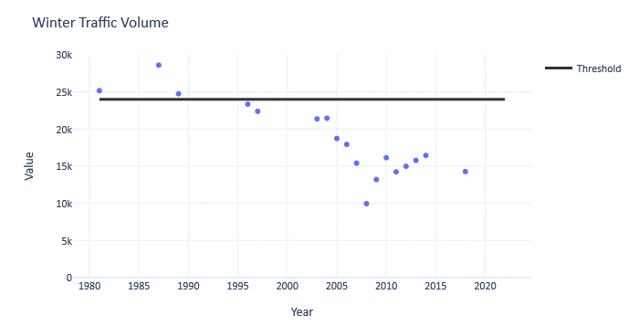
How Transportation Data Drives Planning:
Traffic Volumes
Sources: Tahoe Regional Planning Agency

Slide 6
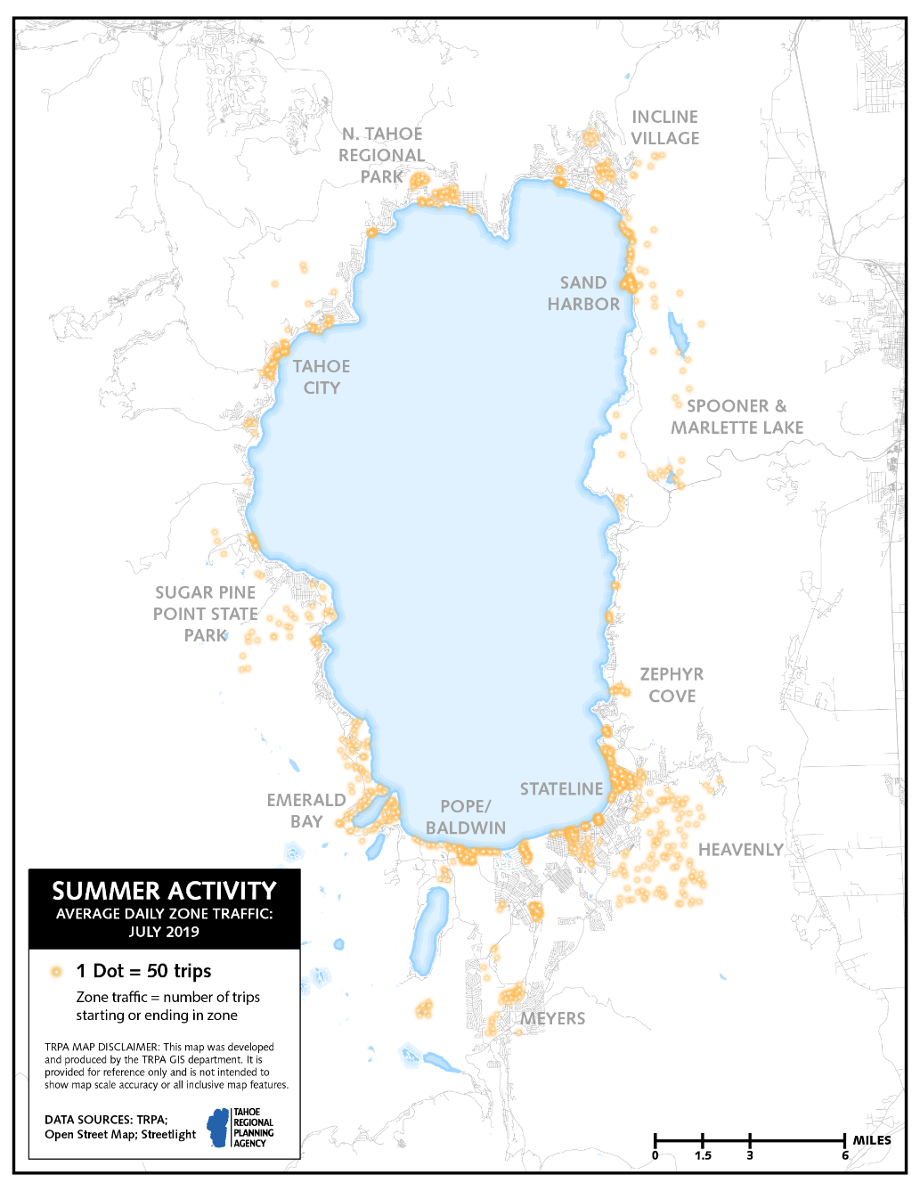
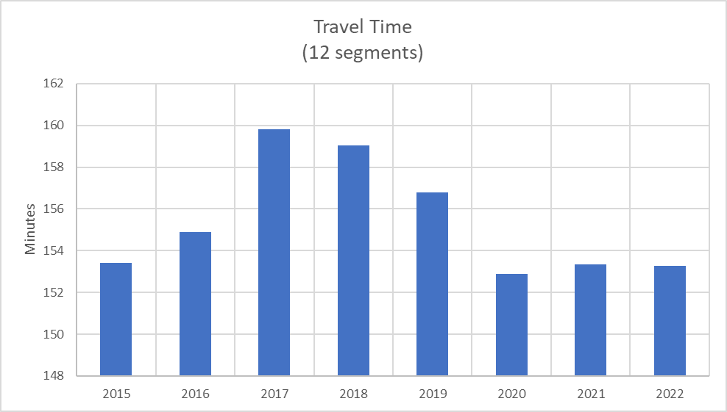
How Transportation Data Drives Planning:
Travel Time and Hot Spots
Notes:
Reality vs. urgency
Travel patterns have changed and infrastructure didn’t keep up
While all of these changes have occurred, one of the most visible impacts to quality of life is congestion.
TRPA monitors travel times across 12 different segments in the region. Since 2015 travel times remain largely unchanged. The largest impacts on travel time come from construction and local weather conditions.
But we understand and recognize that in reality, it doesn’t necessarily feel like this.
Possibly Why Tahoe Feels More Crowded
Increases in second home use
Increases in day-use visitation
People are recreating and staying at different places
More people at previously “local’s spots” because of information availability
Short-term rentals in neighborhoods
Changes in travel time and behavior
Parking lots fill up earlier…so it feels like it is more popular
Roadside parking
Commute patterns
12 Segments in the Tahoe Region
Travel times vary between season
Local impacts from weather and construction
Weekend vs. weekday travel patterns
Most travel times are unchanged over the past 5 years

Slide 7
Transportation’s Connection to Evacuation Planning
Support fire districts, police, and first responders
Require project-level review for safety and evacuation
Evacuation planning as part of the Regional Transportation Plan

Slide 8
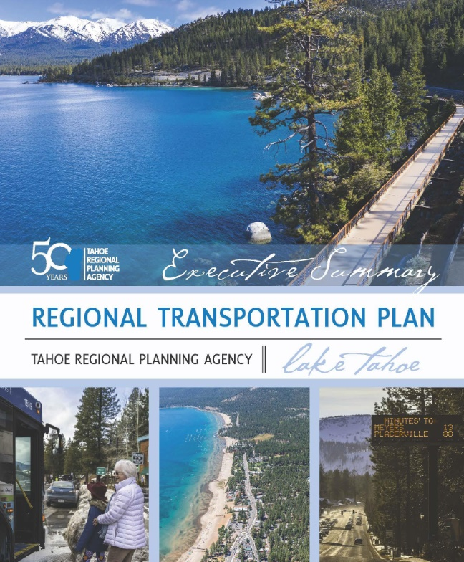
Lake Tahoe Regional Transportation Plan
Tahoe Transportation Goals
Reduce congestion
Preserve environment
Safety and evacuation
Equitable public access
Economic development – jobs and workforce
Climate resilience
Public Engagement from 2020-2023
9,724 people engaged
405 primarily Spanish-speaking residents
6,220 survey responses
Images: Tahoe Regional Planning Agency
Notes:
Tahoe’s transportation challenges are all encompassing
Lake Tahoe’s clarity and environment
Economic Development
Peak periods of congestion
Inequitable access
High local housing costs – unmet transit need for workforce
Safety
Climate Change

Slide 9
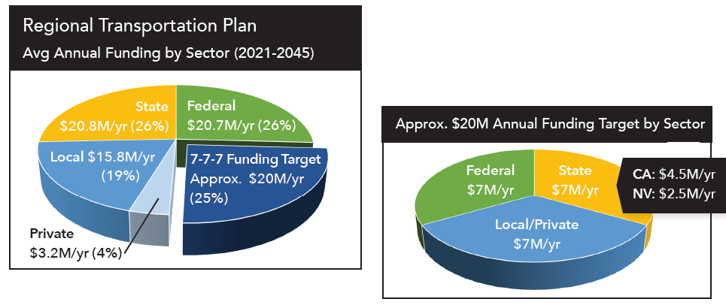
Transportation Funding
Graphic: Tahoe Regional Planning Agency
Image: Tahoe Regional Planning Agency

Slide 10
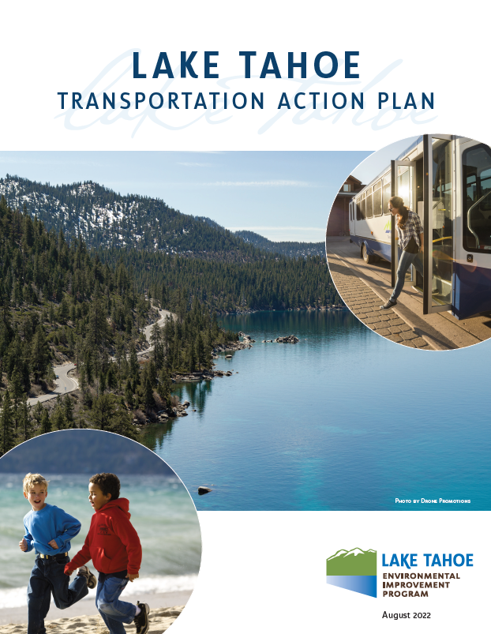
Transportation Action Plan and “7-7-7” Funding Strategy
Graphic: Tahoe Regional Planning Agency

Slide 11
Funding Progress – “7-7-7” Strategy
FY 23 | Federal | State - NV | State - CA | Local/Private | Total
Target | $7,000,000 | $2,500,000 | $4,500,000 | $7,000,000 | $21,000,000
Secured | $9,575,000 | $3,200,000 | $4,065,000 | $6,181,000 | $23,021,000
Difference | +$2,575,000 | +$700,000 | -$435,000 | -$819,000 | +$2,021,000
State of NV:
Legislative support in place:
ACR 5 NV support of Tahoe Transportation Action Plan and 7‐7‐7 strategy.
Funding:
NV Department of Transportation ‐ Spooner Mobility Hub/AIS $2,600,000
SB341 – Microtransit Funding ($1.2M over 2 yrs.) $ 600,000
Total FY23 $3,200,000

Slide 12
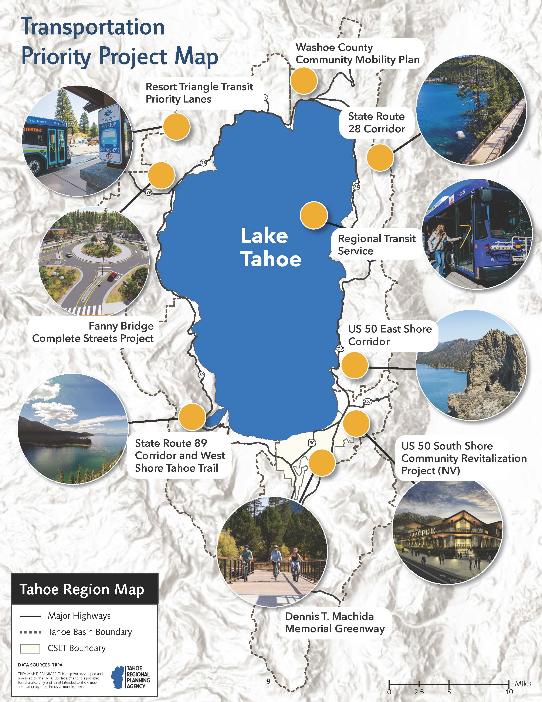
Project Map
Photos: Tahoe Regional Planning Agency
Notes:
The Action Plan identified priority transportation projects across the region in need of collaboration and funding to accelerate their implementation. I want to call attention to the Nevada projects on this map including regional transit, corridor safety and access improvements, and economic development opportunities.

Slide 13
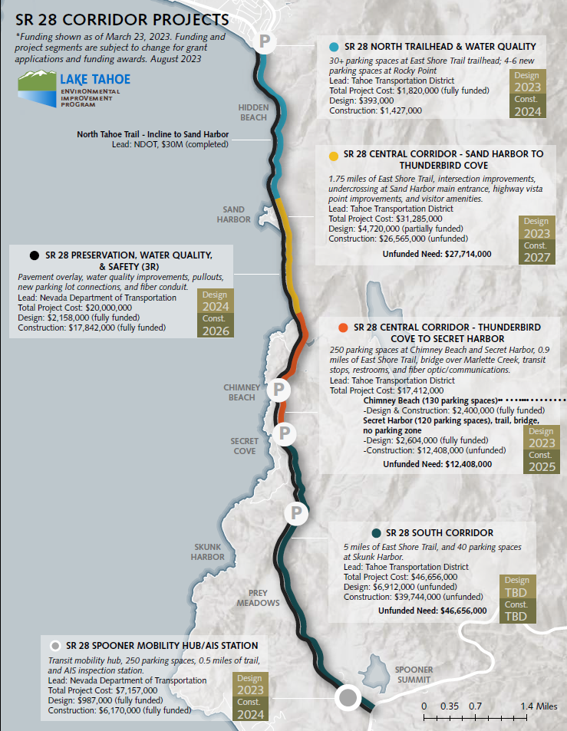
State Route 28
Photo: Tahoe Regional Planning Agency

Slide 14
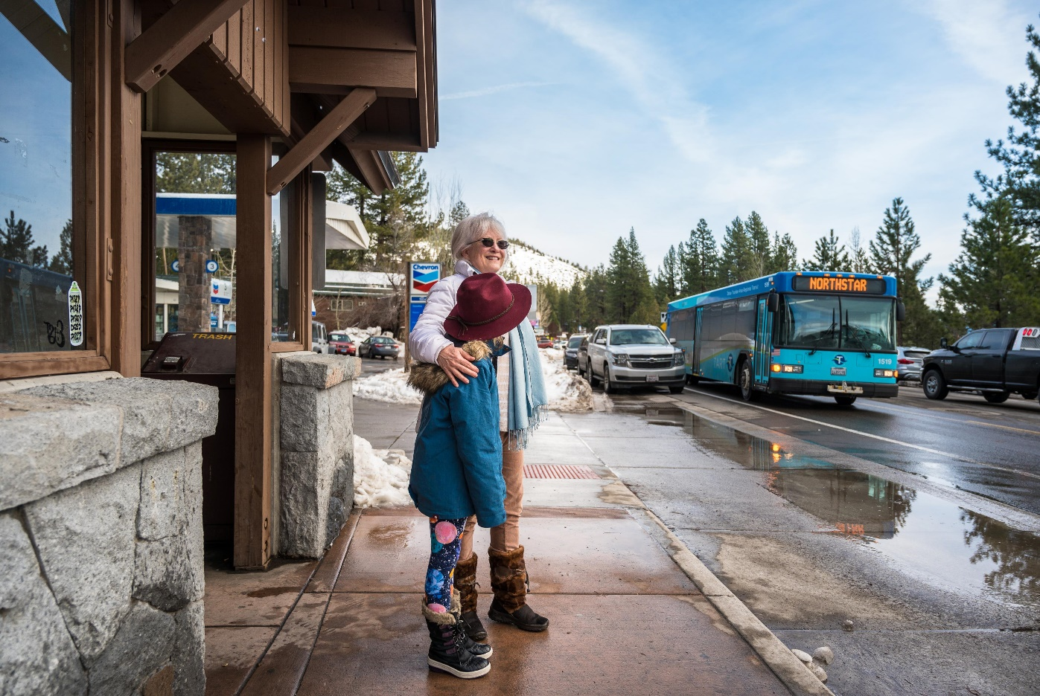
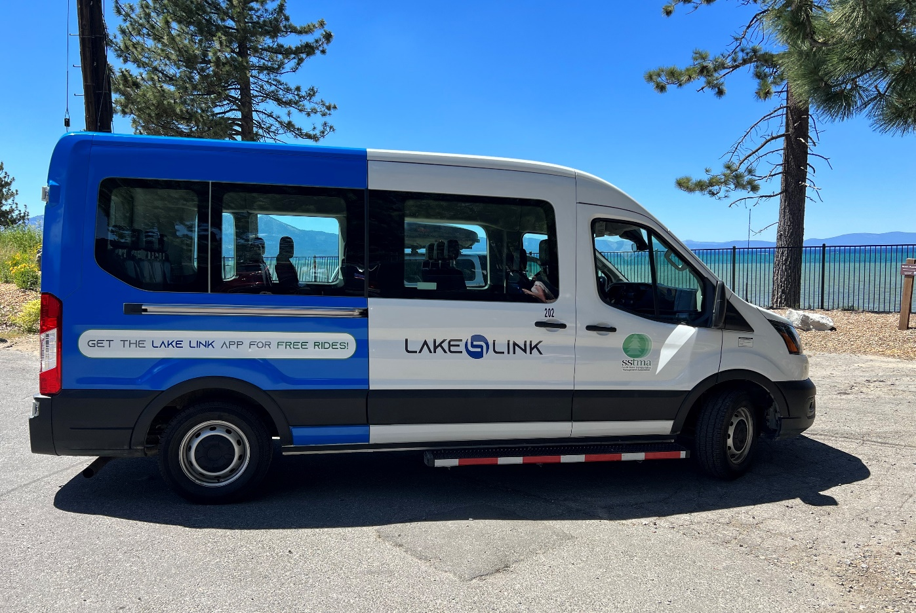
Transit Operations
Photos: Tahoe Regional Planning Agency

Slide 15
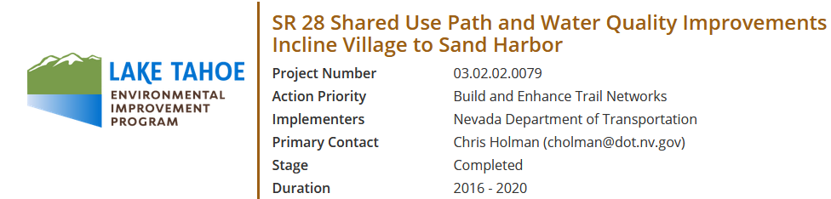
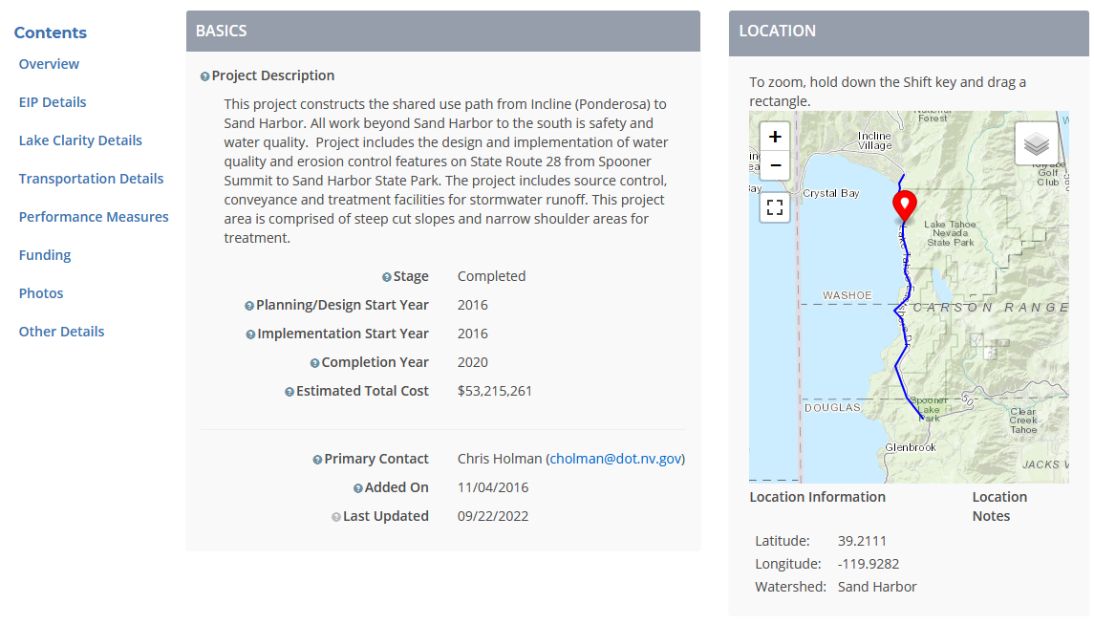
Monitoring and Transparency – www.laketahoeinfo.org
Images: Tahoe Regional Planning Agency

Slide 16
Transportation Support from the 2023 Session
ACR 5 – Endorsing Transportation Action Plan and 7-7-7 funding strategy
$5 million in EIP bonds (AB 424)
General Fund support for the Tahoe Transportation District
South Shore Lake Link Micro-Transit Funding (SB 341)

Slide 17
Legislative Support Opportunities
Help secure the State’s $2.5 million/year “7-7-7” commitment to transportation funding
Support enabling legislation to empower local jurisdiction “self-help” transportation funding
Support cross-jurisdictional enforcement strategies and tools
Notes:
Transportation Funding
EIP bonds, Conserve Nevada
State Parks budget enhancements
TOT disbursement change in Washoe county?
Transportation as part of tourism improvement districts? - https://www.leg.state.nv.us/NRS/NRS-271A.html
Business Improvement Districts - https://www.leg.state.nv.us/nrs/nrs-271.html
Corridor pricing
Enforcement?
Paid parking?
No parking zones?

Slide 18

Image: Tahoe Regional Planning Agency
Notes:
Thank you for your time today.
Are there any questions from the committee.

